Slide 1
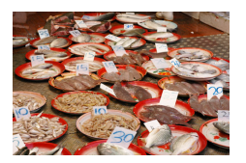
G406: Business Enterprise and Public Policy
1-- MARKETS

Slide 2
Idea of the Day
The function of prices
is to find out who
wants what
most.

Slide 3
Plato’s Republic
“What you say is very fine indeed, Cephalus,” I said. “But as to this very thing, justice, shall we so simply assert that it is the truth and giving back what a man has taken from another, or is to do these very things sometimes just and sometimes unjust?
Take this case as an example of what I mean: everyone would surely say that if a man takes weapons from a friend when the latter is of sound mind, and the friend demands them back when he is mad, one shouldn’t give back such things, and the man who gave them back would not be just, and moreover, one should not be willing to tell someone in this state the whole truth.”
“What you say is right,” he said.
“Then this isn’t the definition of justice, speaking the truth and giving back what one takes.”
Maintaining contracts and property rights— “speaking the truth and giving back what one takes”

Slide 4
Surplus Maximization
How should we decide whether a regulation is good, or bad?
The first step is to choose some valuation rule— some way to compare two policies, and, if possible, to assign numerical values to how good each policy is.
Suppose, for example, that we are trying to decide whether a rule requiring the arsenic level in drinking water to be less than 23 parts per billion is a good rule or not.
The standard valuation rule used by economists is what I shall call surplus maximization.
The idea is simple. Add up how much each person who likes the regulation would pay to have it, and subtract out how much each person who dislikes the regulation would need to be paid to accept it.
If the resulting number is positive, adopt the regulation.

Slide 5
Costs and Benefits
Suppose Anderson and Brown want a stricter arsenic regulation and would pay up to $30 and $70 to get it, whereas Corman and Daniels don’t want it, and would require payments of at least $20 and $10 to feel that the new regulation had not hurt them. Since supporters would pay up to $100, and opponents would accept as little as $30, adopting the regulation does maximize surplus.
If we adopt the regulation and make Anderson pay $25 to Corman, and Brown pay $25 to Daniels, everybody is happy that the deal went through.
We call this a Pareto improvement, after the economist Wilfried Pareto who came up with the criterion that a policy should be adopted if it makes some people better off and no one worse off.

Slide 6
Pareto Optimality
A policy should be adopted if it makes:
(a) some people better off, and
(b) no one worse off.
Whose well-being should count when we define “some people” and “no one”?

Slide 7
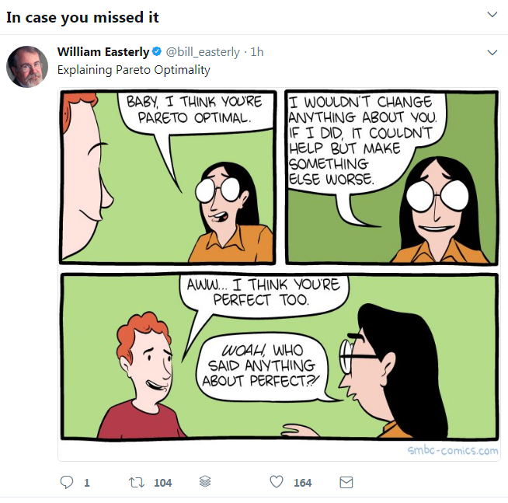

Slide 8
Pareto Optimality
A policy should be adopted if it makes:
(a) some people better off, and
(b) no one worse off.
Whose well-being should count when we define “some people” and “no one”?

Slide 9
Pareto Optimality
A policy should be adopted if it makes:
(a) some people better off, and
(b) no one worse off.
Whose well-being should count when we define “some people” and “no one”?

Slide 10
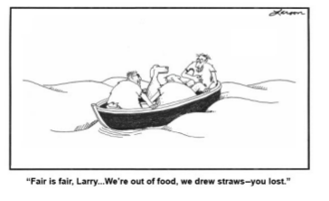
For the Good of the Group . . .

Slide 11
Dollar Amounts of Well-Being
We can not only say that the regulation is a Pareto improvement; we can put a number on the size of the improvement.
In the example, the supporters would pay $100 and the opponents would pay $30, so the surplus rises by $70.
This is the value created by the regulation.

Slide 12
Surplus Maximization
We are calling this valuation rule of trying to make the sum from adding up each person’s dollar value for an object “surplus maximization.”
Not everybody is better off from every surplus-maximizing change. It is not the same as Pareto optimality.
This is a form of utilitarianism.

Slide 13
The Surplus from a Single Transaction
Seller Smith offers to sell a bottle of whisky to buyer Brown for $10. Brown agrees, and the whisky changes hands.
Is the transfer of the bottle from Smith to Brown a good thing?
Surplus maximization says that it is.

Slide 14
What We Put Aside
1. Morality. “It is immoral to drink whisky.”
2. God. “God does not want you to drink whisky, or to profit from the alcoholism of others.”
3. Fairness. “Even though Brown is happy to pay that much, he shouldn’t be, because he’s getting ripped off, and we shouldn’t allow that kind of transaction to take place.”
4. Wrong tastes. “You shouldn’t enjoy Justin Bieber; his singing is pitifully bad.” (“De gustibus non est disputandum.”)

Slide 15
The Merchant of Venice
Now, for your answer:
As there is no firm reason to be render'd,
Why he cannot abide a gaping pig;
Why he, a harmless necessary cat;
Why he, a woollen bagpipe; but of force
Must yield to such inevitable shame
As to offend, himself being offended;
So can I give no reason, nor I will not,
More than a lodged hate and a certain
loathing
I bear Antonio, that I follow thus
A losing suit against him. Are you answer'd?
BASSANIO
This is no answer, thou unfeeling man,
To excuse the current of thy cruelty.
SHYLOCK
I am not bound to please thee with my answers.
SHYLOCK:
You'll ask me, why I rather choose to have
A weight of carrion flesh than to receive
Three thousand ducats: I'll not answer that:
But, say, it is my humour: is it answer'd?
What if my house be troubled with a rat
And I be pleased to give ten thousand ducats
To have it baned? What, are you answer'd yet?
Some men there are love not a gaping pig;
Some, that are mad if they behold a cat;
And others, when the bagpipe sings i' the nose,
Cannot contain their urine: for affection,
Mistress of passion, sways it to the mood
Of what it likes or loathes.

Slide 16
Law and Economics
Suppose Smith lends money to Brown on condition that Brown forfeits his car if he doesn’t repay by June 1. Brown doesn’t repay. On June 2, however, Brown does come to Smith’s house with the money. Should Smith still have the right to take the car, or must he be satisfied with the money?

Slide 17
Efficiency
“Surplus maximization” is also called the Kaldor-Hicks criterion after the economists who first defined it, or wealth maximization or economic efficiency.
(1) Think about “wealth maximization.” If Brown values the bottle of whisky at $15 and Smith at $8, then moving the bottle from Smith to Brown at a price of $10 has a benefit of $5 for Brown and $2 for Smith.
Society’s wealth has increased, measuring wealth in willingness to pay.
(2) In economics, efficiency refers to whether we could increase total surplus without increasing the amount of inputs.
Moving the bottle from Smith to Brown is increases satisfaction even
though there is still just one bottle of whisky.
It is as if someone found a technology that increased output by $7.

Slide 18
Theft
What if Brown steals the bottle of whisky from Smith instead of buying it?
Surplus maximization says that this, too, is a good thing.

Slide 19
The Catch
In the particular case of Brown and Smith, surplus maximization says that the theft is good.
It is good, however, only because we started with a story in which Brown was willing to pay at least $15 and Smith was willing to accept as little as $8.
That information is crucial to whether moving the bottle from Smith to Brown is good or bad.

Slide 20
The Knowledge Problem
What would happen if we didn’t know the particular values Brown and Smith put on the whisky?
Suppose the government announced that it was going to simply give the bottle to whoever valued it most, without actually requiring money to change hands.
Not knowing the numbers, the government would have to ask each person for his value.
What would they say?

Slide 21
Bad Things about Theft
After a theft, unlike after a voluntary transaction, we do not know that surplus has increased.
We do learn something— that Brown was willing to go to the trouble of stealing the bottle, and Smith was not willing to go to the trouble of guarding it effectively— but not enough to guarantee surplus maximization.
Maybe Brown stole the bottle of whisky because he values it at $3 (unlike the earlier example, where it was $15) and the effort of stealing is only $1 for him.
Theft creates productive inefficiency: the $1 cost of stealing, which isn’t producing new goods.
Theft, while it may increase surplus in particular cases, has a bad effect overall.

Slide 22
If a transfer is good, it will happen even if the product isn’t stolen
If the government forbids theft but allows selling, then if Brown really does value the whisky at more than $8 he can offer enough money to Smith to get the bottle anyway.

Slide 23
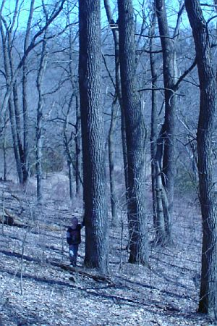
Wealth and Dollars
Surplus maximization depends on how much
people value things, not on the things themselves.
Suppose Smith owns an old walnut tree that he refuses to sell to Brown for $8,000 to cut down as timber.
That outcome maximizes surplus, since clearly Smith values the walnut at more than $8,000 and Brown at less.
If Smith sold the tree, however, GDP would
rise by $8,000, even though “wealth” is not as high.

Slide 24
MORALITY and Natural Law
In this way we’ve derived a reason why theft is bad based on surplus maximization, rather than having to accept the evil of theft as one on a list of many separate moral rules.
The Eighth Commandment says “Thou shalt not steal.”
Even if you don’t believe that God ordained the Ten Commandments, if you accept surplus maximization you come to the same conclusion.
(see David Friedman, Law’s Empire, http://www.daviddfriedman.com/Laws_Order_draft/laws_order_ch_2.htm)

Slide 25
From D. Friedman:
``As we develop the economic analysis of law we will observe a surprising correspondence between justice and efficiency. In many cases, principles we think of as just correspond fairly closely to rules that we discover are efficient. Examples range from "thou shalt not steal" to "the punishment should fit the crime" to the requirement that criminal penalties be imposed only after proof beyond a reasonable doubt. This suggests a radical conjecture---that what we call principles of justice may actually be rules of thumb for producing an efficient outcome, rules we have somehow internalized. Whether that is a sufficient account of justice you will have to decide for yourself.''

Slide 26
Idea of the Day
Free exchange
maximizes surplus

Slide 27
An Entire Market
300,000 consumers each buy at most 1 bottle
5,000 sellers each might sell 100 bottles.
Consumers vary in their willingness to pay from $.01 per bottle to $30. Sellers vary from being willing to accept as little as $4 to requiring $19. If we measure P in price per bottle and Q in thousands of bottles, the demand and supply curves are:
P = 30 - 0.1Q^{d} and P = 4 + 0.03Q^{s}

Slide 28
Graphing the Market (on board)
Notes:
Draw this on the board.

Slide 29
Why a market price of $10?
Think about what would happen if the price were higher— say, $20 per bottle. Sellers would be delighted to sell everything they had, but only 100,000 consumers would be willing to buy (P = 30 - 0.1Q^{d}). As a result, some sellers can’t sell.
Those frustrated sellers would shave the price to $19.99 causing consumers to switch to them. Then other sellers would have no customers and would shave the price to $19.98.
At $10.00, each consumer willing to buy at that price would find a willing seller. No consumer would offer a higher price. No seller would offer a lower price.

Slide 30
Efﬁciency
To show that the equilibrium price is efﬁcient, we need to think about the beneﬁts of the transactions to buyers and sellers.
To maximize surplus we need whisky to be bought by the high-valuing buyers and sold by the low-valuing sellers, as happens in the free market.
Government allocation of the whisky might not reach the same result. It wouldn’t if it gave the bottles to the consumers with the lowest income, or who were the most morally deserving, or who were the best-connected politically rather than to the consumers willing to pay the most.
Organ donations are regulated that way.

Slide 31
Seller (Producer) Surplus
The gross benefit to the sellers who are selling those 200,000 bottles is their sales revenue, which is simply (200,000 bottles) ($10/bottle) = $2,000,000.
Seller values range from $4/bottle to $10/bottle, as shown by the height of the supply curve.
Seller cost is the rectangle $4/bottle high and 200,000 bottles wide (which is $800,000) plus the triangle with a height of ($10/bottle - $4/bottle) and a width of 200,000 bottles, which is (1/2)($6/bottle)(200,000 bottles) = $600,000. That sums to a seller cost of $1,400,000. PS is sellers’ gross benefit (the revenue) of $2,000,000 minus their lost value (the production cost) of $1,400,000, net benefit is $600,000. Producer surplus is the sum across sellers of how much they receive in actual prices minus the minimum prices they would accept.

Slide 32
Buyer (Consumer) Surplus
The sum of the values is the area under the demand curve up to 200,000 bottles. This equals the area of the rectangle $10/bottle high and 200,000 bottles wide, which is $2,000,000; plus the area of the tri- angle above it with height ($30/bottle - $10/bottle) and width 200,000 bottles, which is (1/2) ($20/bottle) (200,000 bottles) = $2,000,000. Adding up the two areas yields the gross benefit to consumers, which is $4,000,000.
The net value for the consumers is less because they have to pay the sellers $10/bottle. The net value is $4,000,000 - $2,000,000 = $2,000,000.
Consumer surplus is the sum across buyers of the maximum prices they would pay minus the actual prices they do pay.

Slide 33
Total Surplus
Adding together the producer surplus and the consumer surplus gives the total surplus created by the existence of this market.
When the quantity is 200,000 bottles and the price is $10/bottle, the total surplus is thus
$600,000 + $2,000,000 = $2,600,000.
Total surplus is the sum across everyone in society of the net beneﬁts received from the market for a good.

Slide 34
The Marginalism Argument
The total surplus does depend on the quantity being 200,000 bottles.
Suppose the quantity of trade increases.
We will need the most reluctant seller to become active, one whose value for a bottle is $10.00 and who has already sold some but not all of his 100 bottles, since sellers with lower values are already selling.
We will need a new buyer to become active too, one whose value is less than $10.00, since buyers with higher values are already buying
Even if the new seller’s value is $10.00 and the new buyer’s value is $9.99, this new exchange reduces total surplus by $.01 rather than increasing it.

Slide 35
Forced Purchases I
Return to the whisky example. It is the quantity of 200,000 bottles that determines the total surplus, not the price of $10/bottle.
To see this, suppose that the quantity traded remains 200,000, being bought by the same consumers and sold by the same sellers as in the free market, but the price rises to $20/bottle.
This must be backed up by government force, as a two-part regulation. The ﬁrst part is that those 200,000 consumers must be forced to buy whisky on pain of prison, since many of them would rather not buy at such a high price. The second part is that sellers must be forbidden to reduce their price, on pain of prison, since there won’t be enough customers to satisfy all the sellers at that high price.

Slide 36
Forced Purchases Surplus
The gross consumer benefit and the seller cost have not changed from their free market levels. Since the same people are buying and selling the same 200,000 bottles, the buyers still value the bottles at $4,000,000 and the sellers still value them at $1,400,000.
But buyers pay a bigger amount — ($20/bottle) x (200,000 bottles) = $4,000,000 — and the sellers get more revenue.
Thus, now the consumer surplus is ($4,000,000 - $4,000,000) = $0, and the producer surplus is ($4,000,000 - $1,400,000) = $2,600,000.
The total surplus is unchanged from its free market level of $2,600,000; all that has happened is that now the sellers get all of it.

Slide 37
Only Quantity Matters
Whatever price is chosen under this two-part regulation, the total surplus will stay the same. When the quantity is ﬁxed, the price is just
a transfer from buyer to seller. The total surplus is
( Gross Buyer Benefit - Price∗Quantity) + ( Price∗Quantity - Seller Cost) .
The Price ∗ Quantity terms cancel each other, so the total surplus is
(Gross Buyer Beneﬁt - Seller Cost),
which does not depend on the price.

Slide 38
How the Price Helps
First, the free market arrives at the equilibrium price, without any government intervention necessary.
Then, that price gets the right quantity. So price does matter.
How would the government know that the optimal quantity is 200,000?

Slide 39
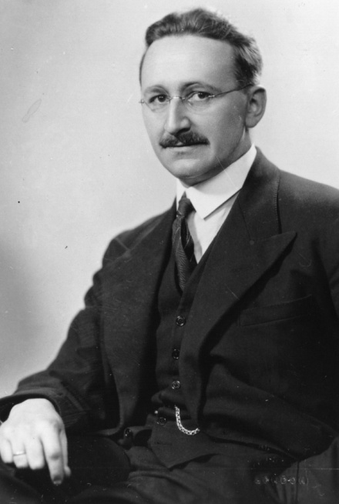
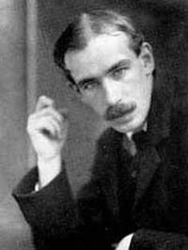
How Price Helps
The free market, unlike the government, needs very little information.
The free market maximizes surplus without the need for government intervention.
This is a modern interpretation of Adam Smith’s idea of The Invisible Hand in his 1776 book, The Wealth of Nations. Hayek too. (Keynes- Hayek rap video)

Slide 40
The Invisible Hand (see Joyce)
“...Every individual necessarily labours to render the annual revenue of the society as great as he can. He generally, indeed, neither intends to promote the public interest, nor knows how much he is promoting it.
...He is in this, as in many other cases, led by an invisible hand to promote an end which was no part of his intention.
Nor is it always the worse for the society that it was no part of it. By pursuing his own interest he frequently promotes that of the society more effectually than when he really intends to promote it.”

Slide 41
A Price Ceiling (rent control)
A
B

Slide 42
Price Ceiling--- Surplus Areas

Slide 43
Rent Control
Landlords are supplying apartment units, and potential tenants are demanding them. As the price falls, the quantity of apartments demanded increases as more people prefer them to houses and want to live in the city, so the demand curve slopes down.
Should the supply curve be vertical, or should it slope up? It would be vertical if the quantity supplied of apartments did not depend on the price— perfectly inelastic, perfectly insensitive to price.
The regulation imposes a price ceiling. That price ceiling is less than the free market price, so now the quantity landlords are willing to supply is less than the quantity tenants demand, the situation called excess demand.

Slide 44
More Rent Control
In the free market, the quantity is Q∗, so the surpluses will only cover areas from the quantity 0 to the quantity Q∗. Consumers’ total beneﬁt (the tenants’) is the area under the demand curve from quantity 0 to quantity Q∗, but they have to pay P∗, so their surplus is the area between the demand curve and the P∗ ﬂat line, area A+B+C. Producers’ total beneﬁt (the landlords’) is their revenue, P∗Q, but their surplus is the difference between that revenue and their costs, which is the area D+E+G between the supply curve and the P∗ ﬂat line.
CS (laissez faire) = A+B+C
PS (laissez faire) = D+E+G
TS (laissez faire) = A+B+C+D+E+G

Slide 45
Still More Rent Control
Figure out which areas are in producer surplus, consumer surplus, effects on third parties (for example, tax revenue), and total surplus in the regulated market.
With rent control, the quantity is Q₁, so the surpluses will only cover areas from 0 to Q₁. Consumers’ total benefit is the area under the demand curve from quantities 0 to Q₁, but they have to pay the rent-control price , so their surplus is the area A+B+D between the demand curve and the flat price line. Producers’ total benefit (the landlords’) is their revenue, but their surplus is the difference between that revenue and their costs, the area G between the supply curve and the flat price line.
CS (rent control) = A+B + D
PS (rent control) = G
TS (rent control) = A+ B +D+G

Slide 46
Surplus Not Maximized
The free market has the biggest total surplus, because it includes all the areas in the regulated surplus plus C+E. This difference is called the deadweight loss or triangle loss or allocative inefﬁciency.
Consumer surplus has risen by amount D-C because of rent control, but producer surplus has fallen by D+E. The losers lose more than the winners gain, so rent control does not maximize surplus.
The diagram doesn’t illustrate all the effects of rent control: besides the basic triangle loss, rationing could be inefficient.

Slide 47
Efﬁcient Rationing
Our analysis above assumed that whichever consumer valued the apartment the most would get it, so the consumers left apartmentless are the consumers with the lowest values.
That form of priority is efﬁcient rationing, because it gives the apartments to the people who value the good the most.
Any kind of excess demand or supply and rationing creates inefﬁciency but at least under efﬁcient rationing the deadweight loss is smaller.

Slide 48
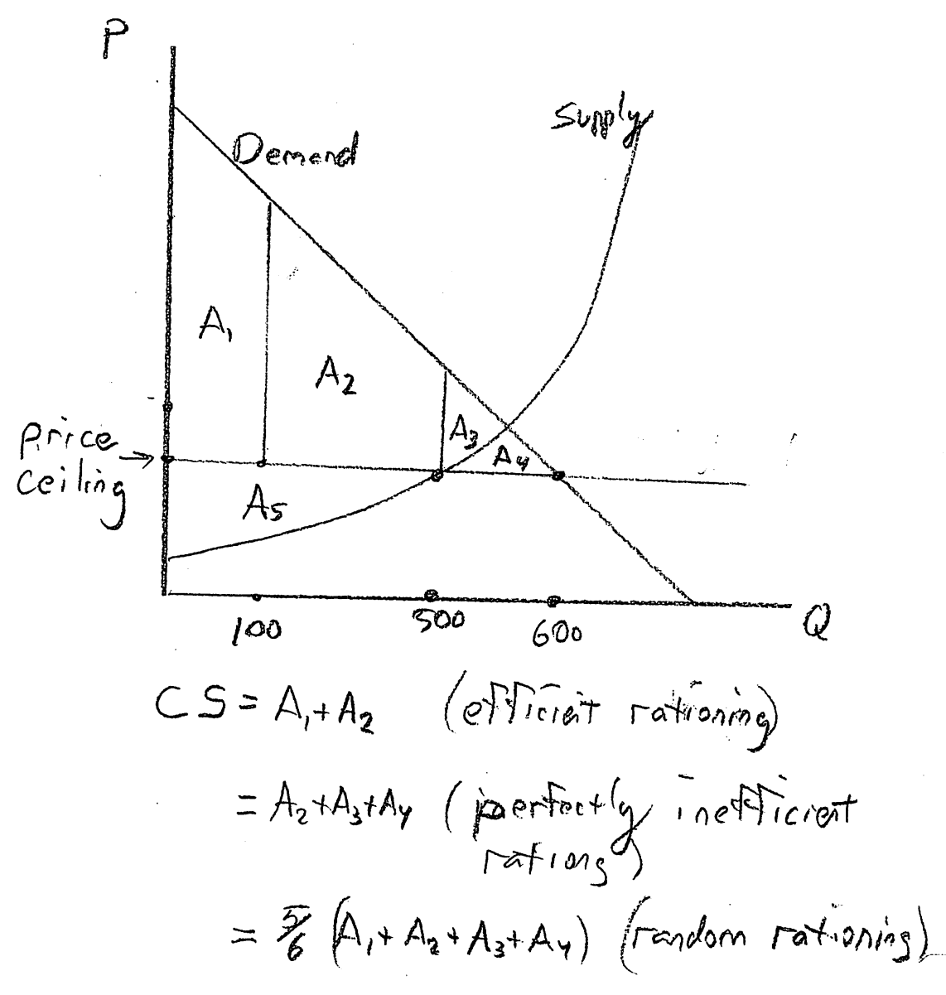
Three Kinds of Rationing
OR
OR

Slide 49
Quality
Before rent control, landlords had to maintain the quality of their apartments to attract tenants willing to pay the equilibrium rent of $500.
Rent control reduces the rent to $400, so even if the landlord stops maintaining the apartment he will still ﬁnd tenants willing to rent it.
If quality falls enough, the rent of $400 actually becomes the equilibrium price and there is no excess demand, but there is still a surplus loss because of the inefﬁciently low level of quality.
Rent control can be used to illustrate the most common criticism of surplus maximization: it ignores distribution.

Slide 50
Rent Control in New York
Many cities in New York State instituted rent control after World War II because of “the post-war rental housing emergency,” but by 2010 most cities had declared an end to the emergency and only 40,000 apartments were covered under that rent control law. It covers only apartments built before 1947 and still occupied by the same family as in 1971.
Though what is called “rent control” in the law has diminished, over one million apartments are “rent stabilized.” This means that rents can only rise at a government-controlled rate each year.
Bonfire of the Vanities, Tom Wolfe.

Slide 51
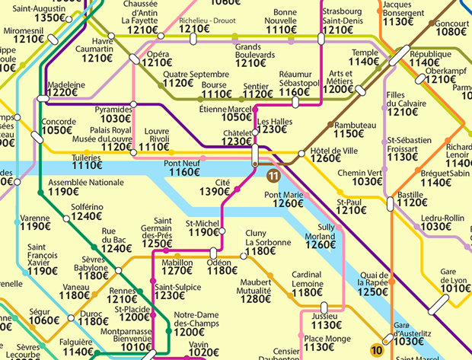
Rent Control in France
In 2015, a law came into effect in Paris prohibiting a landlord from charging more than 20% above the median rent in his neighborhood. After various court challenges, in 2019 it was finally put into effect.
https://www.france24.com/en/20190405-france-paris-rent-control-controversial-comeback-housing-crisis-rising-living-costs

