Slide 1
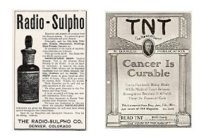
2--MARKET FAILURE

Slide 2
Idea of the Day
Market failure is just not a term for market outcomes we do not like--- it refers a failure to maximize surplus for specific reasons such as externalities.

Slide 3
When Do Markets Fail to Maximize Surplus?
1. Monopoly
2. Externalities
3. Asymmetric information/ Poor Reasoning
4. Poor property rights
5. Poor contract enforcement

Slide 4
Monopoly and Market Power
A monopoly can capture more producer surplus, but at the expense of diminishing total surplus.
Monopoly welfare losses arise from these inefficient attempts to capture surplus. The loss may arise either from the attempt to become a monopoly or from the attempt to exploit the monopoly or from the allocative inefficiency of monopoly--- the triangle loss.
A firm has market power whenever the demand curve facing that firm individually is downward sloping instead of flat.
If a firm with market power raises its price, it loses some but not all of its customers.

Slide 5
Market Power
In a perfectly competitive market of very small ﬁrms selling an identical product, ﬁrms do not have market power.
Any ﬁrm that raises its price will lose 100% of its sales— the demand facing it is perfectly elastic, perfectly price-sensitive.
This is true even though the market demand curve slopes down and is not perfectly elastic.
The reason is that the market demand curve shows what happens to quantity demanded when the market price rises, which happens when all sellers raise their price simultaneously.
The demand curve facing one ﬁrm shows what happens to the quantity demanded from that one ﬁrm if only that ﬁrm raises its price.

Slide 6
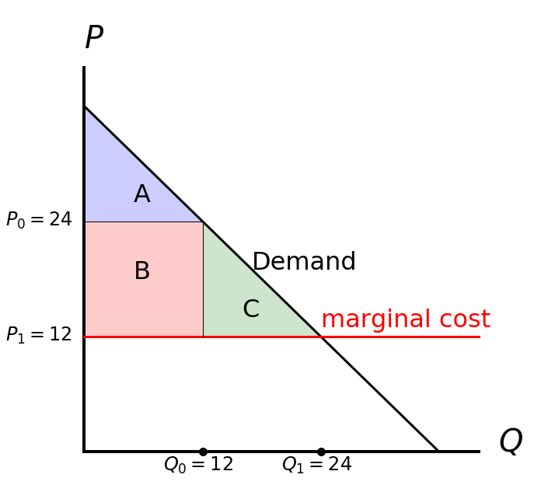
Monopoly Allocative Inefﬁciency
6

Slide 7
Monopoly proﬁts are a little like the proﬁts from theft
The process of creating a monopoly requires effort that transfers surplus from one person to another without creating new surplus.
“The Welfare Costs of Tariffs, Monopolies, and Theft” (Gordon Tullock)
Whether by merging existing ﬁrms in an industry, lobbying for a law that knocks out one’s competitors, or illegal violence to scare off other ﬁrms, the creator has to spend time and effort to get his monopoly.

Slide 8
The transactions cost of extracting consumer surplus
How do you get the most possible out of the consumer?
If Smith has a monopoly on selling whisky to Brown, and Brown has a monopoly on buying whisky, then they have to bargain over the price, creating wasteful transaction costs.
Even when bargaining isn’t one on one, companies spend a lot of time on clever pricing schemes to extract consumer surplus.

Slide 9
Production Costs
A third problem with monopoly: production costs may rise.
Monopolies like profits, but maybe they are not as effective as competitive firms at reducing costs.
Shareholders of a competitive firm can compare its president’s performance to the presidents’ at other firms. A monopoly can’t.

Slide 10
Externalities (Spillovers)
Suppose Buyer Brown, after buying whisky from Seller Smith for $10 and drinking it, will throw the bottle onto the sidewalk in front of Third Party Thurman’s house, where it will shatter and cost Thurman $20 to clean up.
The transaction between Brown and Smith has still created surplus of $7 as far as those two are concerned— Brown’s value is $15 so he gets $5 surplus, and Smith’s is $8 so he gets $2 surplus.
The problem is Thurman, the third party. External to the transaction, he suffers a value loss of $20. The negative externality of $20 more than wipes out the gains from trade of $7.
Just because there is a harmful externality to other people, however, does not mean that a trade is inefficient.

Slide 11
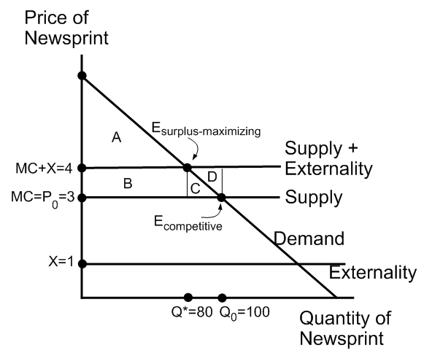
A Pollution Tax

Slide 12
Externalities can be looked at as weak property rights
In the whisky example, Brown shatters the bottle on Thurman’s sidewalk. A solution would be for the government to make it clear that although Brown does have the right to walk on Thurman’s sidewalk, he does not have the right to shatter glass there.
The government would also have to enforce the right by making Brown fear the police too much to break the bottle or forcing him to pay compensation.
If the people downstream of the paper mills owned the river or the right to clean water, they could make the paper mills pay for the privilege of polluting the water.

Slide 13
Positive Externalities
Positive externalities are spillovers that benefit third parties.
Smith and Jones are neighbors. Smith is deciding whether to pay $500 to plant a tree in his yard. If Smith plants the tree,
Jones receives a benefit of $200— that is, he would be willing to pay up to $200 to have the tree next door. That $200 is a positive externality.
Positive externalities create surplus. We would not make the world a better place by somehow eliminating Jones’s enjoyment of Smith’s tree. But the market does not generate enough of them.

Slide 14
Private Benefits
Example: Smith could plant a tree that his neighbor Jones would like too.
If Smith would pay up to $450 to have the tree, we say that his private benefit is $450. Suppose Jones’s private benefit is $200.
The social benefit is the private benefit plus any positive externalities, which sums to $650 here.
The private benefit of $450 is less than the $500 cost, so Smith will not plant the tree, but the social benefit of $650 is greater than $500, so surplus maximization says the tree should be planted.
Smith fails to plant the tree because he makes his decision in isolation, ignoring benefits external to himself. If he and Jones were to talk and make a deal, Jones would be willing to pay him an amount - say, $150 - that would make Smith plant the tree. Why not make the deal, then?

Slide 15
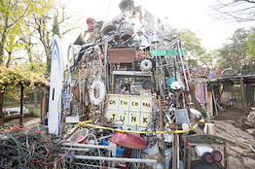
The Cathedral of Junk

Slide 16
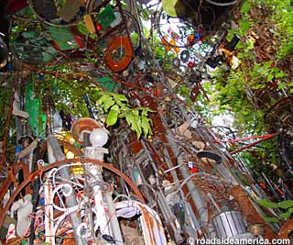
The Cathedral of Junk

Slide 17
Public Goods
Smith’s tree is a non-excludable good because Smith cannot exclude Jones from enjoying it.
It is a non-rivalrous good because when Jones enjoys it that does not impose any extra costs on Smith.
A good that is both non-excludable and non-rivalrous is called a public good.

Slide 18
Real versus pecuniary externalities
The shattered whisky bottle, the water pollution, and the tree in the yard create real externalities: spillovers such that someone’s action affects the utility of someone else directly rather than through prices.
If the spillover results from prices changing, it is called a pecuniary externality.
18

Slide 19
Keeble v. Hickeringill
"This is like the case of 11 Henry IV, p. 47: one schoolmaster sets up a new school to the damage of an ancient school, and thereby the scholars are allured from the old school to come to his new; the action there was held not to lie.
But suppose Mr. Hickeringill should lie in the way with his guns, and frighten the boys from going to school and their parents would not let them go thither, sure that schoolmaster might have an action for the loss of his scholars. 29 Edward III, p. 14.
A man hath a market, to which he hath toll for horses sold; a man is bringing his horse to market to sell; a stranger hinders and obstructs him from going thither to the market; an action lies because it imports damage."

Slide 20
Coordination and network externalities
Pessimistic expectations generate runs on banks. In one equilibrium, nobody expects a bank run, so withdrawals stay at a normal level and the bank is able to fund them.
In a second equilibrium, everybody expects a bank run, so a run does happen and the bank cannot pay everyone.
Expectations also matter when there are network externalities: a consumer gets more benefit from a good if more other people are using the same kind of good. (CELLPHONES)

Slide 21
Back to socialism?
1. Market solutions. Market power is limited by entry of competitors.
Poor information is limited by advertising. Externalities are limited by voluntary agreements to limit harmful behavior.
2. The government might do even worse. Government Failure– chapter 3.

Slide 22
Aren’t externalities pervasive?
“No man is an island, entire of itself; every man is a piece of the continent, a part of the main.
If a clod be washed away by the sea, Europe is the less, as well as if promontory were, as well as if a manor of thy friend’s or of thine own were.
Any man’s death diminishes me, because I am involved in mankind; and therefore never send to know for whom the bell tolls; it tolls for thee.”
--John Donne, Devotions Upon Emergent
Occasions, Meditation XVII (1654)
22

Slide 23
Asymmetric Information
Not all poor information is a source of market failure. We don’t say it’s market failure if we can’t predict the future, or don’t know all the inventions that will be around in 2050. Those are innate limitations on our production.
Asymmetric information is the real problem. What if only seller Smith knows the quality of his whisky, not buyer Brown?
If Brown buys colored water, his value is not $15, but $0.
Eventually consumers will not buy at all.

Slide 24
The Principal-Agent Problem
At its most basic: the boss-worker problem.
Moral Hazard: The agent has low effort
Adverse Selection: The agent has low ability
More generally: Buyers do not know exactly the quality of the services they buy.
It is too hard to monitor, or to write into a contract.
Examples: mechanics, lawyers, doctors, accountants. (Getting synthetic oil in an oil change, 5,000 vs. 7,500 miles)

Slide 25
Poor information about the markets themselves
Suppose a market has one hundred competing sellers but some consumers only know about one of them.
Those consumers effectively face a monopoly.
When consumers need to search for prices and learn about different sellers, they may end up buying from the wrong seller or buying the wrong product.

Slide 26
Bad decision-making
Does a consumer who buys a magical spell as a cure for cancer have poor information, or is he just foolish?
Either way, his beliefs about the product are wrong and he pays
more than his true value,
Either way, government regulation could help.
Whether unethical businesses take advantage of poor information
or poor reasoning, penalties on their bad behavior raises surplus and
protects ethical businesses from what we can, I think, call unfair competition.
If someone is ignorant, informing him ﬁxes his problem; if he is
stupid, one may have to make the decision for him.

Slide 27
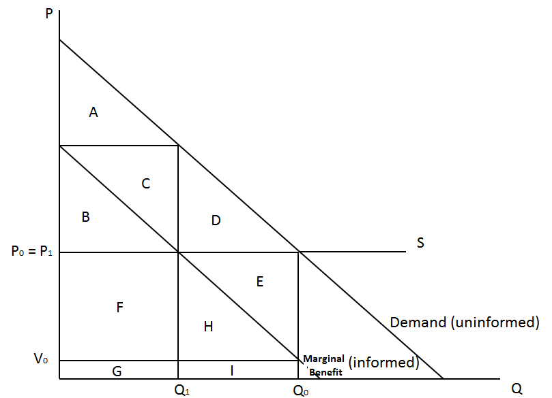
Marginal Benefit Curves
27

Slide 28
Idea of the Day
Property rights and the rule of law are crucial to national wealth.

Slide 29
Property in Land
The holder of a land title that says he owns it “in fee simple” can use the land for his entire life, leave it to heirs, or sell it in fee simple to someone else, without having to worry about what kinds of rights he has over the land.
Rather than checking the ﬁne print on the property deed, he can rest assured that he has bought the conventional package of rights.

Slide 30
Joint Ownership
Often people hold property as joint owners.
Usually husband and wife both are listed as owners of the house they live in.
Partners own property jointly.
A corporation own property individually, as a “corporate person”.
Government units such as towns also own property.
30

Slide 31
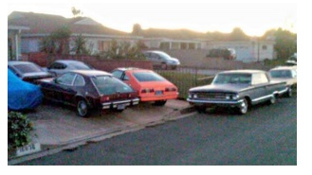
Common Property
When more than one person has a right to use property, problems often arise. Consider parking.
In Covina, California, Mark Shoff kept ﬁve unregistered cars in his driveway plus 43 others on the streets.
How do we decide when to put in parking meters?
31

Slide 32
Creation
Particularly important is that property rules award ownership to someone who creates something new.
The usual rule is that Smith has the right to keep most but not all of what he produces, giving up some of it to the government as taxes. The property rule for another class of goods is that the producer owns them, but only temporarily. This class is intellectual property: patent and copyright.
A patent gives the inventor of an idea ownership for 20 years, but after that anybody can use it for free. Copyright gives the writer of a book exclusive rights for his lifetime plus 70 years.
32

Slide 33
Too Much Private Property?
Are patents, trademark, and copyright a good idea? Yes, but maybe not at their margins. It is very inconvenient to have to pay license fees for small-time use. The incentive effects are tiny, too.
Not all innovations need property rights to incentivize them. Property rights always exclude people who aren’t the owners. That makes more sense for land than for dress designs.
Within a family, most property is common--- or, if you like, it is jointly owned. That’s true within a corporation too. Employees can use many company possessions without asking, even though they don’t own them.
33

Slide 34
Madison on Property
“This term in its particular application means "that dominion which one man claims and exercises over the external things of the world, in exclusion of every other individual." In its larger and juster meaning, it embraces every thing to which a man may attach a value and have a right; and which leaves to every one else the like advantage. In the former sense, a man's land, or merchandize, or money is called his property.
In the latter sense, a man has a property in his opinions and the free communication of them. He has a property of peculiar value in his religious opinions, and in the profession and practice dictated by them. He has a property very dear to him in the safety and liberty of his person. He has an equal property in the free use of his faculties and free choice of the objects on which to employ them. In a word, as a man is said to have a right to his property, he may be equally said to have a property in his rights.”

Slide 35
Contracts
Property rights need to be established before buying and selling take place, but the trading process also needs laws.
Suppose Smith would like for Brown to pay today for a bottle of whisky that Smith will deliver tomorrow. Without a law against breach of contract, Brown will be reluctant to hand over the money, since Smith could just keep it and not deliver. A law must say what happens if Smith violates his promise.
The law could be that Smith must refund the money, or that he must deliver the bottle or be jailed, or that he must pay Brown enough to make Brown as happy as delivery would have.
Which of these rules maximizes surplus is not clear, but any of them is better than no rule at all.

Slide 36
Clarity
What matters most for surplus maximization is that there be clear rules about who owns what, and that there be high enough penalties for broken promises
Getting the exact rules right is less important, because people can adapt to imperfect rules.
But if nobody is quite sure what the rules are, or who has the power to get what he wants, total surplus falls.
Thus, “The Rule of Law”, not “The Rule of Man”, is helpful to surplus maximization.

Slide 37
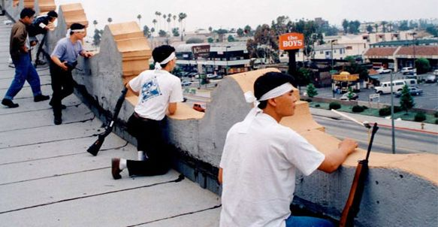
Private Police and Militia
Private organizations could replace government in deﬁning and protecting property and contract rights.
People could sign up with one of various competing “protective or-
ganizations” and pay the organization a yearly fee, a fee similar to taxes but a price rather than a tax. (David Friedman, The Machinery of Freedom)
37

Slide 38
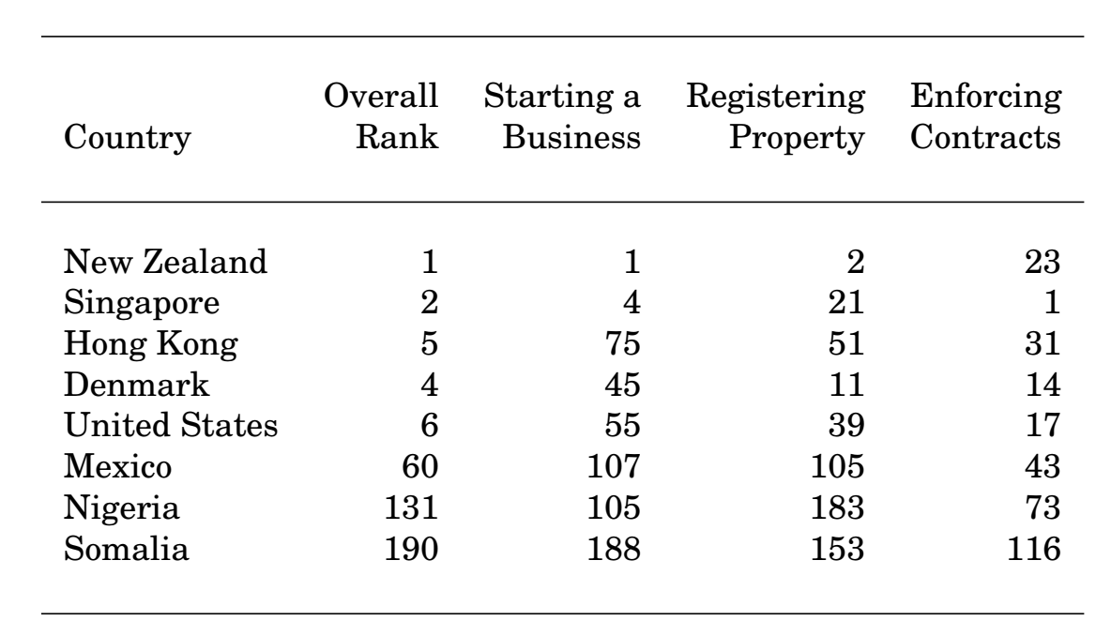
The World Bank’s “Doing Business” https://www.doingbusiness.org/
Rankings: https://www.doingbusiness.org/en/rankings
https://www.doingbusiness.org/content/dam/doingBusiness/country/u/united-states/USA.pdf

Slide 39
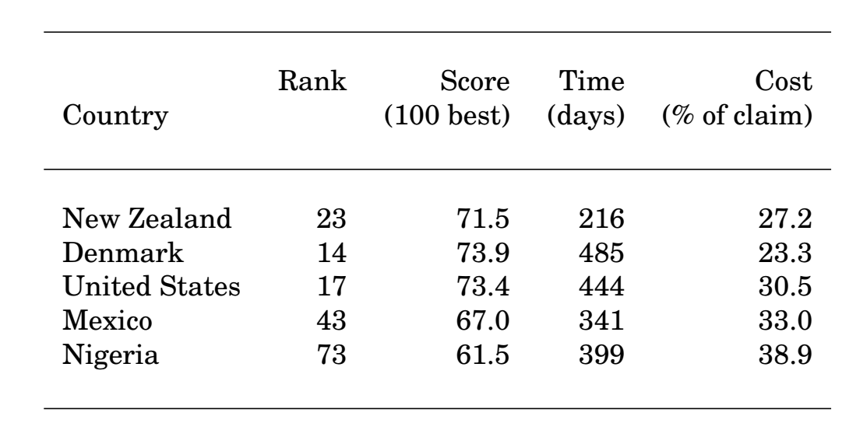
“Doing Business”: Contracts https://www.doingbusiness.org/
https://www.doingbusiness.org/en/data/exploretopics/enforcing-contracts
https://www.doingbusiness.org/content/dam/doingBusiness/country/u/united-states/USA.pdf

Slide 40
The Merchant of Venice
ANTONIO:
The duke cannot deny the course of law:
For the commodity that strangers have
With us in Venice, if it be denied,
Will much impeach the justice of his state;
Since that the trade and profit of the city
Consisteth of all nations. …

