Slide 1
Idea of the Day
We want making, not taking, but government regulation is often a form of taking other people’s surplus.

Slide 2
3 - Government Failure
https://en.wikipedia.org/wiki/List_of_places_named_after_Robert_Byrd

Slide 3
Government as a Solution to Market Failure
It is not enough to analyze a problem and say:
“There’s market failure. If the government passes a law changing the quantity traded to X then surplus will be maximized.”
The government might fail too.
If you say, “Fix it!”, it might do the wrong thing, accidentally or on purpose.

Slide 4
What is a government?
The sociologist Max Weber said that what characterizes government is
“a monopoly on violence”
The whole point of government is coercion--- making people do things they don’t want to do.
-- paying taxes, obeying traffic laws, staying away from heroin, abiding by their contracts…

Slide 5
Government Failure: Bad Objectives
Suppose there is a proposal in Congress to impose fines on any company that sells copper at a price of less than $10/pound.
Who will support the proposal? Who will oppose it?

Slide 6
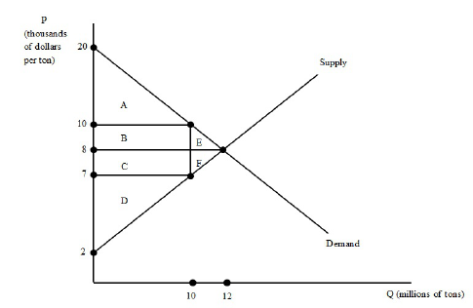
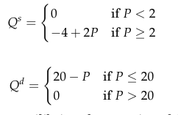
A Price Floor

Slide 7
Scenario 1: Tyranny of the Majority
1 million people each lose $100 from the regulation.
1,000 people each gain $2 million.
Total cost is $100 million.
Total benefit is $2 billion.

Slide 8
Point 1: Political Markets will often succeed
Even if a policy has winners and losers, we would expect there to be a tendency for the side with the most surplus at stake to fight the hardest and to succeed.
If that happens, the political market has generated the efficient, surplus-maximizing policy.

Slide 9
Problem: Tyranny of the Majority
If it comes to a straight vote, and intensity of feeling does not matter, the majority will win even when it feels less strongly.

Slide 10
Problem: Special Interests
1 million people each lose $1 from the regulation.
1,000 people each gain $200.
Total cost is $1 million.
Total beneﬁt is $200,000.

Slide 11
Two Opposite Problems
1. The Tyranny of the Majority. If it comes to a straight vote, and intensity of feeling does not matter, the majority will win even when it feels less strongly.
2. Tyranny of the Minority. If the issue is obscure enough that only a few people care enough to pay attention, that minority will win even if in total it has less at stake. (rent-seeking, special-interest politics, regulatory capture)

Slide 12
Rational Ignorance
If an action has only a small impact on a voter, it is rational for the voter not to bother about it.
He should remain ignorant of exactly what is happening rather than spend his time analyzing it, and even if he understands the situation, he should balance the costs of political action against the benefits.
Being an informed voter is a public good.

Slide 13
Example: Sugar
The US has four policies that favor sugar producers (cane and beet):
1. Loans with collateral of 24 cents per pound. Producers can repay the loan and sell their sugar for more than 24 cents, or give up their sugar to the government.
2. Marketing allotments--permits that are required to sell sugar.
3. Ag Dept. can buy sugar and sell to biofuel companies to make fuel with if prices fall too low.
4. Import quotas, with tariffs for any additional imports beyond the quota level.

Slide 14
So sugar prices are high
US sugar prices are double the price on the world market.
One estimate puts the cost to consumers at $2.4 billion and the benefit to producers at only $1.4 billion.
There is substitution to corn syrup, and some candy producers have moved their factories abroad.
https://www.cato.org/publications/policy-analysis/candy-coated-cartel-time-kill-us-sugar-program

Slide 15
Example: Shipping
The Jones Act is a 1920 law that requires ships going between US ports to be made in America and use American crews.
The justification is that this preserves US shipbuilding and crewing capabilities in case of war.
.

Slide 16
Effects of the Jones Act
Jones Act ships cost four times as much to build and twice as much to operate as foreign ships. This is especially hard on US possessions such as Guam and Puerto Rico.
https://www.vox.com/policy-and-politics/2017/9/27/16373484/jones-act-puerto-rico
https://www.mercatus.org/publications/trade-and-immigration/economic-analysis-jones-act

Slide 17
Waivers of the Jones Act
The Bush Administration did some limited waivers after Hurricane Katrina in New Orleans.
“Those in the affected U.S. industries regarded these waivers as hugely important, and they lobbied the Administration hard.
The pushback was not just from maritime unions, but also from the U.S.-flagged shipping industry, including shippers and shipbuilders, and including Rs and Ds on Capitol Hill who were close to the industry.” https://keithhennessey.com/2010/06/18/how-to-waive-the-jones-act/

Slide 18
Situations Leading to Government Failure
1. Is it hard to see who is hurt and who is helped by the law?
2. Are the benefits concentrated and the costs diffused? (or vice versa)
3. Are the benefits short-term and the costs long-term? (or vice versa)

Slide 19
Law-making is a market
Politicians are trying to sell themselves and packages of laws to voters.
They compete for votes, and consumers of laws provide them with votes, campaign contributions, and effort to persuade other people.
Since politics is a market, it is subject to market failure.
What are the sources of market failure?

Slide 20
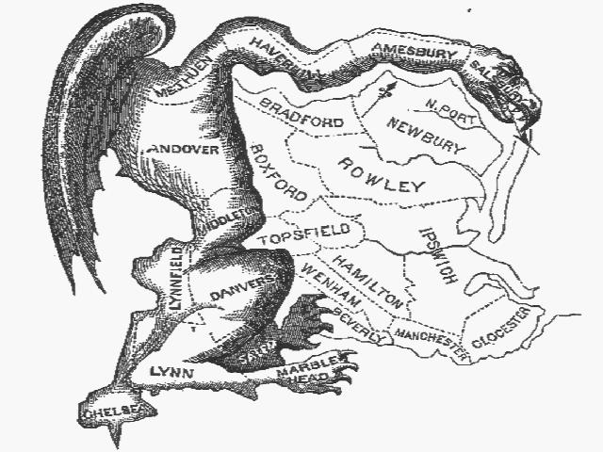
The Original Gerrymander
lk;

Slide 21
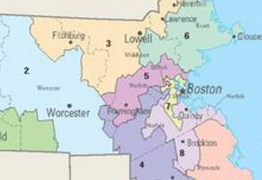
Mr. Gerry’s Descendants

Slide 22
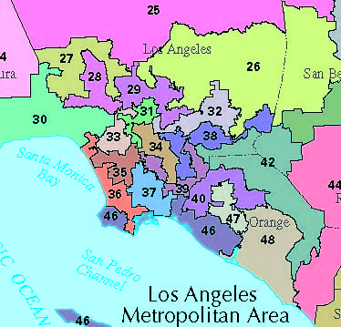
Congressional Districts

Slide 23
Regulatory Capture
It can happen that a government agency intended to regulate an industry to protect consumers becomes, controlled by the very industry it is meant to regulate: regulatory capture.
The standard example is the Interstate Commerce Commission, set up in 1887 and abolished in 1995.
The Interstate Commerce Commission was established to keep railroad shipping prices low, but it became an agency to protect railroads from competition from each other and trucks.

Slide 24
The Louisiana Coffin Cartel
After Hurricane Katrina's damage, the 38-member Saint Joseph Abbey in Louisiana decided to make and sell coffins to support themselves.
The Louisiana State Board of Embalmers and Funeral Directors told them not to.
The monks won.

Slide 25
The Oklahoma Court.
The judge said that if courts struck down special-interest laws, then:
``besides the threat to all licensed professions such as doctors, teachers, accountants, plumbers, electricians, and lawyers,… every piece of legislation in six states aiming to protect or favor one industry or business over another in the hopes of luring jobs to that state would be in danger. While the creation of such a libertarian paradise may be a worthy goal, Plaintiffs must turn to the Oklahoma electorate for its institution, not us.''

Slide 26
Rentseeking Costs
Rational ignorance leads to another source of surplus reduction besides bad legislation: rentseeking costs.
Not only does the legislative process result in surplus-reducing regulations: it does so at a cost.
The cost includes the lobbying costs to obtain regulations (proactive rentseeking costs) and the lobbying costs incurred to prevent regulations (defensive rentseeking costs).

Slide 27
Costs from Disguises
Another cost is the cost of disguising regulations so that the losers will not overcome their rational ignorance.
A small part of this is the care given to the wording and explanation of regulations so as to mislead the public as to their costs and benefits.
The bigger part, however, is the need to actually change the form of the regulation to disguise its effect.

Slide 28
Idea of the Day
Think of the government as a group of people, each one with his own objective.

Slide 29
Schumpeter: Rational Ignorance
“Political questions take their place in the psychic economy of the citizen with leisure-hour interests that have not attained the rank of hobbies and with the subjects of irresponsible conversation.
These things seem so far off; they are not at all like a business proposition;
dangers may not materialize and may not prove so very serious;
one feels oneself in a fictitious world.”

Slide 30
Government Failure: Poor Performance
Since the costs and benefits of government actions flow to third parties there is little incentive for the decisionmakers to expend effort.
Outside pressure lead to rentseeking.
The government falls between the Scylla of interested rentseeking and the Charybdis of disintererested incompetence.

Slide 31
Governments vs. Corporations: Goals
The problem is not just that the government is large and bureaucratic. Many U.S. corporations are larger than entire countries.
A corporation has the advantage that its goal is simple and its owners agree on it: to make profit.
A government has a harder time measuring costs (what is the cost of a lower speed limit?)
... and an infinitely harder time measuring benefits (what is the benefit of a reduced rate of marijuana use?).
.

Slide 32
Governments vs. Corporations: Governance
In a corporation, the shareholders elect a board of directors which has the power to run the company subject to the by-laws.
The board of directors chooses an executive to run the company, and he chooses subordinates to help him.
If the board fails to do its job properly, the shareholders elect a new board, or someone buys out enough shareholders to acquire enough votes to choose a new board or merge the company with another company. Nonprofits?

Slide 33
The Principal-Agent Problem
This is a problem of asymmetric information.
The boss is a principal. The worker is an agent.
How does the boss make the worker work hard and do the right things?
How do corporations motivate their CEO’s?

Slide 34
Four Types of Officials
1. Careerist. Their loyalty is to the agency.
2. Politician. Their loyalty is to whoever can promote them.
3. Professional. Their loyalty is to their profession.
4. Ideologue. Their loyalty is to their cause.
All would like to do a good job, but for different reasons. All three can be either political appointees or civil servants.

Slide 35
The Three-Part Test for Regulation
1. Is there market failure?
2. Is there a regulation that would solve the market failure better?
3. Would there be government failure if we tried to pass the regulation?

Slide 36
How to Think about Government
(1) Remember the Three-Part Test for Regulation.
(2) A government is not one godlike person, who makes decisions for the public good. It is a group of regular people, motivated both by duty and by personal objectives.
Once you understand that in your bones, you will both be more suspicious of politicians and bureaucrats, and more sympathetic to them.

