Slide 1
Big Idea
Government can be designed to encourage making and discourage taking.

Slide 2
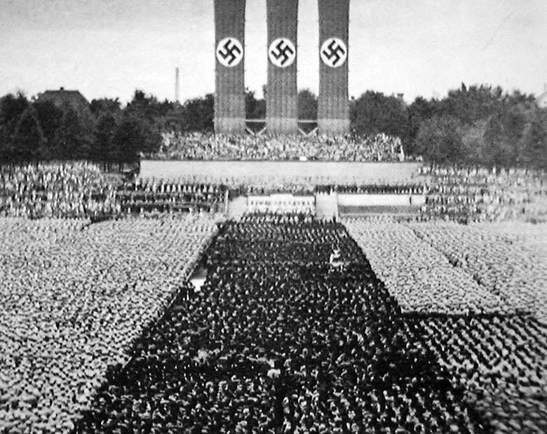

4- Government Design
Eric Rasmusen, erasmuse@indiana.edu
September 12, 2016

Slide 3
Bell, California
Five of the six city councillors were earning over $80,000/year based on attending imaginary council meetings.
The LA Times revealed the story.
There was a recall election, and criminal charges were brought.

Slide 4
Good Government
It is possible to design a government to reduce the amount of government failure.
As with goods markets, the trick is to get the incentives right.
Plato said that we will never have good government till the Philosophers become Kings. Confucius pretty much agreed. But government design takes a different approach, trying to make rules take the place of virtue.

Slide 5
Bad Men, Good Government?
“Now there are not more than ten truly merciful and faithful men in this country, whereas there are hundreds of official posts. So if only merciful and faithful men are selected for public service, the candidates will not be sufficient for filling all the official posts. In that case, those who maintain order would be few while disturbers would abound. Therefore, the way of the enlightened lord is to unify laws instead of seeking for wise men, to solidify policies instead of yearning after faithful persons. In consequence, as long as laws do not fail to function, the body of officials will practise neither villainy nor deception.”
Han Fei, The Five Vermin

Slide 6
Don’t Trust Philosophers?
“For such reasons, it is a common trait of the disorderly state that its learned men adore the ways of the early kings
by pretending to benevolence and righteousness and adorn their manners and clothes and gild their eloquent speeches
so as to cast doubts on the law of the present age and thereby beguile the mind of the lord of men…”
Han Fei, The Five Vermin (scholars, speechmakers, swordsmen, merchants, artisans)

Slide 7
Independence?
If government officials are completely insulated from rentseeking, that means they must also be completely insulated from punishment or reward.
Think of appointed U.S. Federal judges, elected state judges, and Japanese career civil servant judges.

Slide 8
C. S. Lewis on Democracy
“There are two opposite reasons for being a democrat.
You may think all men so good that they deserve a share in the government of the commonwealth and so wise that the commonwealth needs their advice. . . .
On the other hand, you may believe fallen men
to be so wicked that not one of them can be
trusted with any irresponsible power over his fellows."

Slide 9
Separation of Powers
Our government is designed so that no single group of officials holds all the power.
The legislative branch makes laws--- statutes.
The executive branch carries out statutes--- including making regulations, specific rules.
The judicial branch interprets statutes and regulations.

Slide 10
Three Categories of Public Servants
Elected officials such as the United States President.
Bureaucrats who are appointed by the elected officials and who can be fired by them, e.g., the Secretary of the Treasury.
Bureaucrats who spend most of their careers in government service (e.g., FBI agents)

Slide 11
The Civil Service
How do we get the right kind of civil servants?
The civil service system protects employees from being fired for political reasons.
Should there be an examination for the civil service?
The US had one till the late 1970’s.

Slide 12
University Governance
The Bloomington Faculty Council is made up mostly of professors elected by other professors, plus some students, staff, and lecturers elected by those groups, plus the vice-provosts and the provost. It votes on things like general education requirements and tenure policies.
Two views of it are as REPRESENTATION and DELIBERATION. Do we want members to represent their departments, or do we want members who are the most interested and talented? Should there be at-large members, voted on by all professors but representing no department?

Slide 13
A Big Idea
Transparency helps discourage both kinds of government failure--
bad objectives
and
bad performance.

Slide 14
Making Regulations: Administrative Law
A regulation is like a law, but Congress doesn’t have to approve it.
Every regulation is supposed to be a mere implementation of a Congressionally-passed law.
If Congress passes a law that says dangerous substances must be kept to safe levels in the workplace, the executive branch must decide how much to limit benzene, if at all.
This gives a lot of power to the President.

Slide 15
Checks on the Bureaucrats
Congress has passed laws to constrain the executive branch in how it makes regulations.
A major goal is to make sure that regulation-making is transparent: it proceeds slowly and openly with enough time for anyone who might be affected to comment.
Also, citizens can appeal to the courts.

Slide 16
How Regulations Are Made-1
1. Congress passes a vague law. ``Milk products must not contain dangerous levels of chemicals.''
2. The agency proposes regulations, notifying the Office of Management and the Budget (OMB). One might be:
``Yogurt can only contain a limited amount of propozine.''
3. The agency sends a specific rule to OMB, together with a Regulatory Impact Analysis (``Yogurt produced by companies with over 30 employees can only contain 50 parts per million of propozine.'')
4. OMB has at least 60 days to comment and then approve or reject. (OMB says it should be 40 ppm, not 50).

Slide 17
How Regulations Are Made-2
5. The agency publishes a Notice of Proposed Rulemaking in the Federal Register.
6. The agency listens to public comment for 30 to 90 days. (Large yogurt companies propose changing to 70 ppm and removing the small-company exemption; small yogurt companies propose 20 ppm.)
7. After the comment period closes, the agency decides whether to revise the rule. (It decides to go to 45 ppm.)
8. The agency sends the revised rule to OMB for a month of consideration and approval or disapproval.
9. The agency publishes the final rule in the Federal Register.

Slide 18
How Regulations Are Made-3
10. After 30 days, the rule goes into effect.
The agency starts enforcing it.
11. Within 60 days of publication, the Congressional Review Act lets the House and Senate pass a bill killing the regulation by a 50% vote rather than the 60% often required by their rules. If the President signs the bill, the regulation is killed and must be rewritten.
12. Maybe somebody objects to the rule and takes the agency to court. (Statutory: 45 ppm is too lax, because even 10 is ``dangerous''. Constitutional: The Constitution does not give Congress the right to regulate yogurt that is only sold locally, not across state lines.)
13. Later, the agency may re-evaluate the rule, and possibly change it. (20 years later, scientists have found conclusively that propozine is harmless, so the rule is rescinded.)

Slide 19
The Federal Register
The Federal Register is where proposed, interim, and final regulations are first published. https://www.federalregister.gov
https://www.regulations.gov/ is a more convenient site for making comments. When finalized, rules are put in the proper chapter of the Code of Federal Regulations. (https://www.law.cornell.edu/cfr/text)
/

Slide 20
How to Comment
Regulation.gov lists regulations up for comment. https://www.regulations.gov/
The new rule about lead in water has many useful comments. https://www.regulations.gov/document?D=EPA-HQ-OW-2017-0300-0951
The new airline animal rule has many comments that will not make a difference.
https://www.regulations.gov/docket?D=DOT-OST-2018-0068

Slide 21
A finalized rule
“Inadmissibility on Public Charge Grounds”
The Department of Homeland Security (DHS) proposed regulatory provisions guiding the inadmissibility determination on whether an alien is likely at any time to become a public charge.
The proposed rule and comments:
https://www.regulations.gov/document?D=USCIS-2010-0012-0001
The big change: is the alien likely to be costly in terms of non-cash welfare benefits such as Medicaid, not just cash benefits? https://www.uscis.gov/news/fact-sheets/public-charge-fact-sheet
This regulation is now finalized.

Slide 22
Whistleblower Regs
“Awards for Information Relating to Detecting Underpayments of Tax or Violations of the Internal Revenue Laws” 26 CFR Part 301
https://www.federalregister.gov/documents/2014/08/12/2014-18858/awards-for-information-relating-to-detecting-underpayments-of-tax-or-violations-of-the-internal “One commenter [Eric Rasmusen] suggested that the final regulations should use the term “claimant” throughout and eliminate all references to the term “individual.” The final regulations recognize, however, that not all individuals who submit information to the IRS regarding tax non-compliance become award claimants. To achieve consistency with Treas. Reg. §301.6103(n)-2 and reduce any confusion caused by the use of several terms, Treasury and the IRS changed almost all of the references to “individual” or “claimant” to “whistleblower” in the final regulations.”

Slide 23
Net Operating Losses
“Awards for Information Relating to Detecting Underpayments of Tax or Violations of the Internal Revenue Laws” 26 CFR Part 301
https://www.federalregister.gov/documents/2014/08/12/2014-18858/awards-for-information-relating-to-detecting-underpayments-of-tax-or-violations-of-the-internal A more important change was to say that if the taxpayer had taken excess Net Operating Loss deductions to reduce his future taxes, the whistleblower would be rewarded in those future years if the deductions were disallowed.

Slide 24
Memo Assignment- I
Find another student to team up with. Create a team in Canvas under People on the menu at the left and under the Regulation Comment Team tab.
Go to the government site at https://www.regulations.gov/. Click on Comments Due Soon. Then check Proposed Rule, and proposed rules will show up. If you click Public Submission, you will also see comments from other people on regulations. This will show which proposals have aroused the most interest. Note that the "docket" is a file of all the information about a particular regulation-- its history, the text, public comments, when the hearings are, and so forth.
Find two examples of comments on the same regulation, one that you think will not make a difference in the final regulation, and one that you think might matter. Explain your thinking.

Slide 25
Memo Assignment- II
(2) Yourself submit a comment on some regulation, the same as in (1) or a different one. Make sure that you identify yourself as a student in a course on regulation, that you say precisely what regulation you are commenting on, and say which part you would change. Your change can be very minor. If you find some confusing wording and say why it is confusing or improve it for them, that is probably the most useful comment you can make. You can look at other people's comments and use their ideas, but you must cite to any comment whose idea you are using. You can also react to other comments and say why you disagree with them. Your comment should be no longer than one page.
(3) Tell me where I can find your comment in the docket in your assignment submission. Also include a printout or copy of the webpage showing your public comment. Submit this assignment via Canvas.

Slide 26
The Chevron Doctrine
If a regulation has gone through the formal process and someone questions in court whether the regulation is a correct application of the statutes, the courts give the benefit of the doubt to the regulation.
This is known as administrative deference, or the Chevron Doctrine.

Slide 27
The Chevron Two-Part Test
``If the intent of Congress is clear, that is the end of the matter; for the court as well as the agency must give effect to the unambiguously expressed intent of Congress.
If the Court determines Congress has not directly addressed the precise question at issue, the court does not simply impose its own construction of the statute . . . rather,…
If the statute is silent or ambiguous with respect to the specific question, the issue for the court is whether the agency's answer is based on a permissible construction of the statute.''

Slide 28
An Example: Disclosure of College Student Grades
A law which is passed by a legislature, not made by a court or agency, is called a statute.
Names of the statute: FERPA, the Family Educational Rights and Privacy Act, Buckley Amendment,
UNITED STATES CODE, TITLE 20, CHAPTER 31 , SUBCHAPTER III , Part 4, §1232g
(b) Release of education records; parental consent requirement; exceptions; compliance with judicial orders and subpoenas; audit and evaluation of federally supported education programs; recordkeeping (1) No funds shall be made available under any applicable program to any educational agency or institution which has a policy or practice of permitting the release of education records...

Slide 29
Publicly Posting Tripos Grades
Public Policy has changed a lot on grade privacy over the past 30 years. As late as 2014:
“For the first time in 300 years the University of Cambridge has made exam results available online to students before displaying them publicly at Senate House…. Moreover, some anxiety remains regarding the publication of results of the mathematics Tripos which will continue to be read out from the balcony of Senate House.” “Exam results made available online before class lists” (2014)
But the Cambridge policy was changed in 2018--- now students can opt out: https://www.varsity.co.uk/news/15506

Slide 30
The definition of “education records”
UNITED STATES CODE, part (a) of TITLE 20, CHAPTER 31, SUBCHAPTER III, Part 4, §1232g) (4)
(A) For the purposes of this section, the term “education records” means, except as may be provided otherwise in subparagraph (B), those records, files, documents, and other materials which (i) contain information directly related to a student; and (ii) are maintained by an educational agency or institution or by a person acting for such agency or institution.
(B) The term “education records” does not include (i) records of instructional, supervisory, and administrative personnel and educational personnel ancillary thereto which are in the sole possession of the maker thereof and which are not accessible or revealed to any other person except a substitute;

Slide 31
Regulations
Regulations are based on the statutes. They are issued by executive agencies, not passed by Congress.
Code of Federal Regulations, §99.3, “What definitions apply to these regulations?”
Education records. (a) The term means those records that are:
(1) Directly related to a student; and (2) Maintained by an educational agency or institution or by a party acting for the agency or institution.
(b) The term does not include: (1) Records that are kept in the sole possession of the maker, are used only as a personal memory aid, and are not accessible or revealed to any other person except a temporary substitute for the maker of the record.

Slide 32
Are the records of the campus cops “educational records”?
Code of Federal Regulations, §99.8 “What provisions apply to records of a law enforcement unit?”
(c)(1) Nothing in the Act prohibits an educational agency or institution from contacting its law enforcement unit, orally or in writing, for the purpose of asking that unit to investigate a possible violation of, or to enforce, any local, State, or Federal law. (2) Education records, and personally identifiable information contained in education records, do not lose their status as education records and remain subject to the Act, including the disclosure provisions of §99.30, while in the possession of the law enforcement unit.
(d) The Act neither requires nor prohibits the disclosure by an educational agency or institution of its law enforcement unit records.

Slide 33
Taking Regulations to Court
Sometimes issues come up that have not been addressed by either the statute or the regulations. The case Falvo v. Owasso, 534 US 426 (2002), was about the question of peer grading.
“Teachers sometimes ask students, including respondent’s children, to score each other’s tests, papers, and assignments as the teachers explain the correct answers to the entire class. Claiming that such “peer grading” violates the Family Educational Rights and Privacy Act of 1974 (FERPA or Act), respondent filed a 42 U.S.C. §1983 action against the school district and school officials (petitioners).”

Slide 34
District Court (The Trial Court)
The first stage of the case was that unhappy parents went to the Federal District Court and claimed that FERPA had been violated because the grade one student gave to another was an “educational record,” so the very act of grading violated FERPA by disclosing the grade to the student grader.
At the District Court stage, one judge makes the decision, sometimes with a jury and sometimes not, depending on the kind of case.
Here, the judge rejected the case using summary judgment:
even if the facts are just like the plaintiff says (the one who’s suing), he loses. So no evidence needs to be presented.

Slide 35
The Appeals
The parents appealed to the Circuit Court of Appeals, which uses a three-judge panel to look at issues that are purely legal rather than questions of fact. The Circuit Court ruled that the peer grades indeed were “educational records”.
The school district appealed to the Supreme Court, which reversed the Circuit Court and said the District Court was right in the first place.

Slide 36
The Supreme Court Opinion
“Even assuming the teacher’s grade book is an education record— a point the parties contest and one we do not decide here— the score on a student-graded assignment is not “contained therein,” §1232g(b)(1), until the teacher records it.
The teacher does not maintain the grade while students correct their peers’ assignments or call out their own marks.
For these reasons, even assuming a teacher’s grade book is an education record, the Court of Appeals erred, for in all events the grades on students’ papers would not be covered under FERPA at least until the teacher has collected them and recorded them in his or her grade book.
We limit our holding to this narrow point, and do not decide the broader question whether the grades on individual student assignments, once they are turned in to teachers, are protected by the Act.”

Slide 37
The Regulations Amended
As a result, the Dept. of Education amended the FERPA regulations in §99.3 by adding that “educational records” does not include:
(6) Grades on peer-graded papers before they are collected and recorded by a teacher.

Slide 38
Internal Compliance Rules
A point unaddressed by the statute or regulation: If a student asks for a recommendation letter, has he implicitly consented to release of his grades in the letter?
Indiana University: “I’m often asked to write letters of recommendation for students for awards, graduate school, or job applications. How does FERPA apply this case?”
Statements based on your personal assessments and observations of the student are not derived from "education records" covered by FERPA. However, you must obtain the student’s written consent if our letter includes such information as the student’s overall GPA, or grades in specific courses.
The university policy is cautious: the instructor should not mention that the student received an A.
Legal departments often are cautious. This is a principal-agent problem.
Managers need to recognize this principal-agent problem.

Slide 39
“Informal Guidance”
Often agencies will issue “informal guidance”: interpretations that do not go though “notice and comment”. Sometimes these get judicial deference, sometimes not.
Consider the issue of whether a video of a group of students taken by the university is an “educational record”. Is it? The regulations don’t say.
The Dept. of Education was asked about a particular case. A parent asked for a surveillance video of hazing for which several students were disciplined, in order to obtain the “educational record” of his son. The Dept. agreed in the public “Letter to Wachter”.
https://studentprivacy.ed.gov/sites/default/files/resource_document/file/Letter%20to%20Wachter%20%28Surveillance%20Video%20of%20Multiple%20Students%29_0.pdf

Slide 40
The Letter to Wachter
“…we agree that the video and the witness statements appear to be the education records of each of the students who were disciplined as a result of their involvement in the incident (note: While it is not necessary to answer the questions posed by the District, we note that we also think that they would be the education records of the two victims). We reach this conclusion because you indicated that the video and the witness statements are maintained by the school administration in the students' disciplinary files (and not by the District's or school's law enforcement unit) and are directly related to the hazing incident and the group of students involved in that incident. Further, the school used these records to discipline the students who perpetrated the hazing.”…
https://studentprivacy.ed.gov/sites/default/files/resource_document/file/Letter%20to%20Wachter%20%28Surveillance%20Video%20of%20Multiple%20Students%29_0.pdf

Slide 41
2018: “FAQs on Photos and Videos under FERPA”
FERPA regulations do not define what it means for a record to be “directly related” to a student. …
Among the factors that may help determine if a photo or video should be considered “directly related” to a student are the following:
The educational agency or institution uses the photo or video for disciplinary action (or other official purposes) involving the student (including the victim of any such disciplinary incident);
The photo or video contains a depiction of an activity:
that resulted in an educational agency or institution’s use of the photo or video for disciplinary action …
  that shows a student in violation of local, state, or federal law;
  that shows a student getting injured, attacked, victimized, ill, or having a health emergency;

Slide 42
Video FAQs, Continued
The person or entity taking the photo or video intends to make a specific student the focus of the photo or video (e.g., ID photos, or a recording of a student presentation); or
The audio or visual content of the photo or video otherwise contains personally identifiable information contained in a student’s education record.
A photo or video should not be considered directly related to a student in the absence of these factors and if the student’s image is incidental or captured only as part of the background, or if a student is shown participating in school activities that are open to the public and without a specific focus on any individual.
https://studentprivacy.ed.gov/sites/default/files/resource_document/file/Letter%20to%20Wachter%20%28Surveillance%20Video%20of%20Multiple%20Students%29_0.pdf

Slide 43
A Big Idea
Taxes have a big hidden cost: lost surplus from discouraged market activity.

Slide 44
Taxes: The Cost of Taxes
(1) A tax is a transfer.
(2) A tax has incentive effects.

Slide 45
Computing the Cost of Taxes
Suppose the government imposes a tax on sellers of coal of T dollars per ton— that is, each seller must pay the government T dollars per ton that it sells. Who gains and who loses?

Slide 46
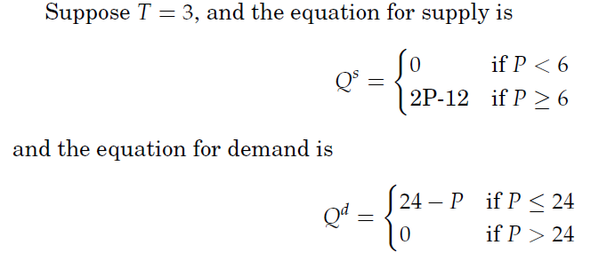
Supply and Demand with Tax
Notes:
Draw the curve here.

Slide 47
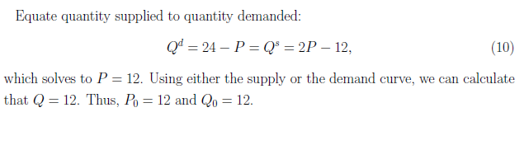
Solve for Equilibrium
Next, add a tax on sellers of $3/unit. The next slide shows what happens.

Slide 48
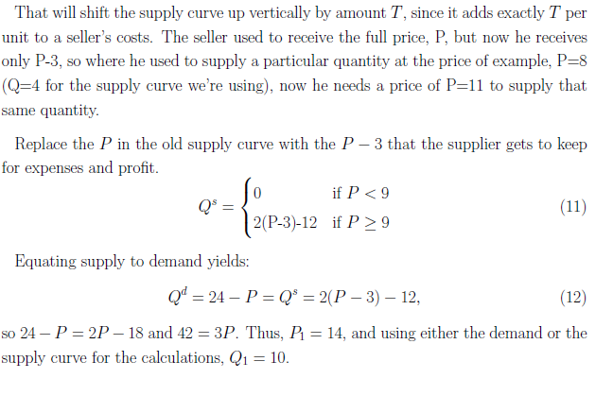
Notes:
Do another example. Now let T=1. We get Qs= 2(P-1)-12, Qd = 24-P. Equating, 2P-2-12=24-P, 3P=38, P = 38/3 = 12 2/3. Q = 11 1/3. ½ dQdP = .5 (.66) (1) = .33. Tax revenue is (1) (11.33) = 11.333. So the tax revenue is more than 1/3 of when T=3, and the deadweight loss is less than 1/3.

Slide 49
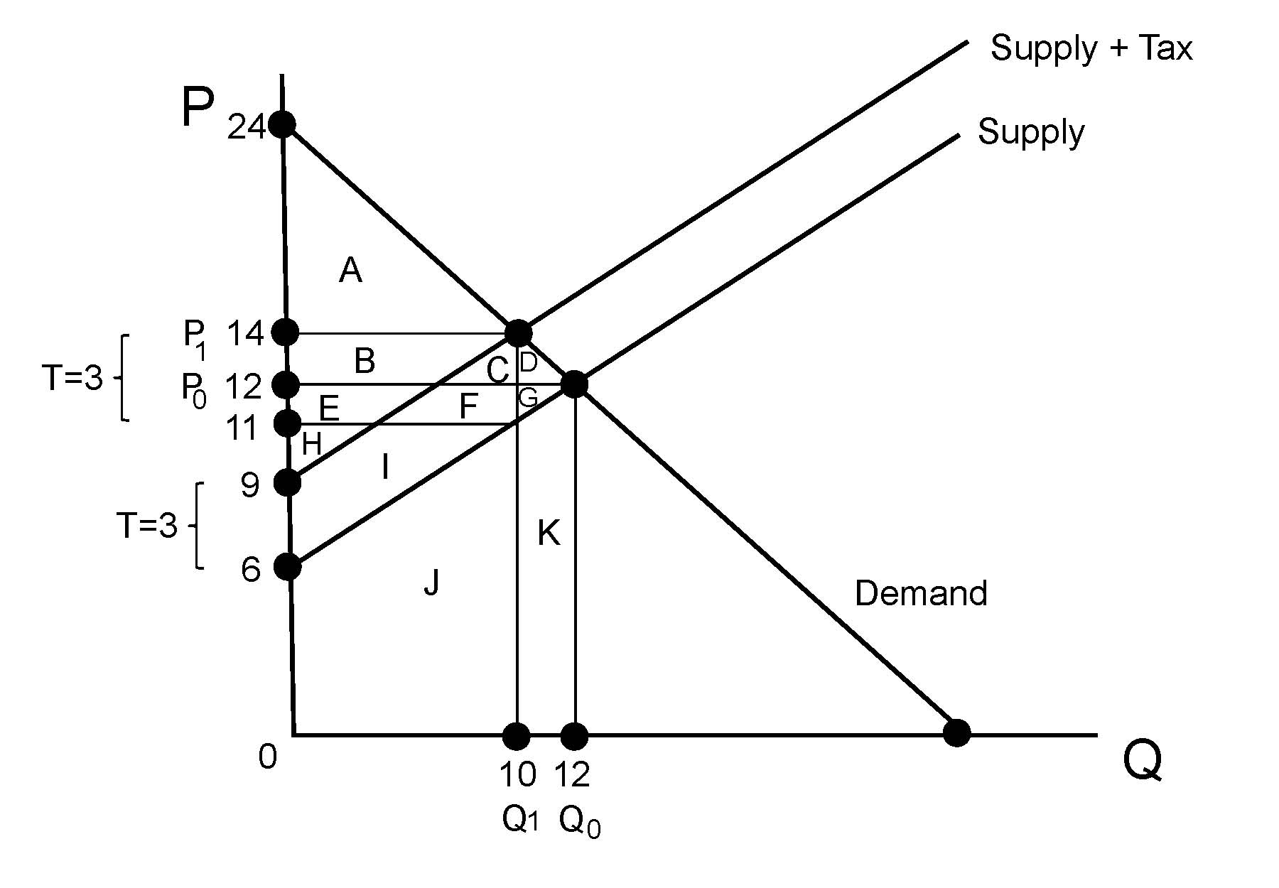
Notes:
D+G = .5 (3) (2) = 3.
Tax revenue is (3) (10) = 30.
Have the students work out the other areas.
Tax on demand of 3: equate Q =24 - (P+3) = 2P-12, so 33 = 3P, P=11. Then Q=9.

Slide 50
Triangle Losses
Office of Management and the Budget: “Because taxes generally distort relative prices, they impose a burden in excess of the revenues they raise.
Recent studies of the U.S. tax system suggest a range of values for the marginal excess burden, of which a reasonable estimate is 25 cents per dollar of revenue.” https://www.whitehouse.gov/sites/whitehouse.gov/files/omb/circulars/A94/a094.pdf
(State,local,federal taxes/GDP were 29.9% in 2018-III, Economic Report of the President 2019.)

Slide 51
Triangle Losses II
OMB: “The presentation of results for public investments that are not justified on cost-saving grounds should include a supplementary analysis with a 25 percent excess burden.
Thus, in such analyses, costs in the form of public expenditures should be multiplied by a factor of 1.25 and net present value recomputed.”

Slide 52
Triangle Losses III: loss = .25
If the government had a project that would yield 1.1 million dollars in benefit but it had to use taxes to fund the project, the project would reduce social surplus overall.
On the other hand, if the government had a project that would yield 1.4 million dollars in benefits and required taxes, the project would be worthwhile despite the inefficiency of taxes.

Slide 53
Professor Mankiw’s Taxes: Does His Rate Affect His Work?
“I can afford to pay more in taxes. My income is not in the same league as superstar actors and hedge fund managers, but I have been very lucky nonetheless. Unlike many other Americans, I don’t have trouble making ends meet.
… Paying an extra few percent in taxes wouldn’t create a lot of hardship.”
His article shows that he may well end up paying a 90% marginal tax rate.
https://www.nytimes.com/2010/10/10/business/economy/10view.html

Slide 54
Mankiw II
I could go so far as to say I am almost completely sated. [yet]...Taxes influence the decisions I make. I am regularly offered opportunities to earn extra money. It could be by talking to a business group, consulting on a legal case, giving a guest lecture, teaching summer school or writing an article. I turn down most but accept a few.
Suppose that some editor offered me $1,000 to write an article. If there were no taxes of any kind, this $1,000 of income would translate into $1,000 in extra saving.

Slide 55
Mankiw III
Suppose that some editor offered me $1,000 to write an article. ...
At 8 percent a year, 30 years from now my children would inherit about $10,000 if there were no taxes.
BUT: 39.6 percent in federal income taxes
Phaseout of deductions adds 1.2 percent
Medicare tax, 3.8 percent,
Massachusetts state income tax, 5.3 percent, part of which I get back as a federal deduction.
$1,000 of pretax income becomes $523 of saving.

Slide 56
Mankiw IV
The corporation I invest in pays 35 percent corporate income tax, leaving a return of 5.2%. (Note: This was cut in 2017 to 21%)
Then I pay federal and state income taxes AGAIN, leaving a 4 percent return. The $523 grows to $1,700 after 30 years.
When my children inherit, the estate tax is, say, 55% (hard to predict). Thus, of the $1,700 I leave when I die, my kids will get about $1,000.
That $1,000 is about the same as if I earned $100 today taxfree and it grew at 8% per year till my kid inherited it. So that’s like a 90% tax rate.

Slide 57
Ramsey Taxation
When supply and demand are less elastic, a tax doesn’t create so much deadweight loss.
In the extreme, when either supply or demand is completely inelastic, the tax creates no loss at all. There’s no quantity change, no triangle.
That was the idea for Henry George’s “Single Tax” in 1879. He ran for mayor of New York City and came in second (TR was third).

Slide 58
Income Tax vs. Sales Tax vs. VAT
Income Tax: A tax on earnings, from land, labor or capital.
Sales Tax: A percentage or per-unit tax on transactions, usually just on sales to the final consumer and not from one business to another.
Value-Added Tax: A percentage tax on the value added between one sale of a good and the next.

Slide 59
VAT Example
Value-Added Tax: a percentage tax on the value added between one sale of a good and the next.
Supplier sells Retailer wood for $100.00. The VAT is 10%, so Supplier must pay $10 to the government.
Then Retailer carves the wood and sells the carving to Consumer for $400. Retailer’s “value-added” is $300.
The VAT is 10%. Retailer would pay $40 to the government, except Retailer also attaches to his tax form a copy of his receipt from Supplier for $100 (which shows that Supplier paid $10 already), so after this deduction, Retailer’s VAT bill is $30.

Slide 60
The Essentials of Taxes
1. Taxes create inefficiency.
2. The burden of a tax is shared between producers and consumers, even if it is the producers who have to give the tax money to the government.

