Slide 1
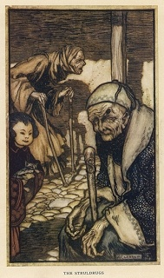
Life and Time
Prof. Rasmusen
erasmuse@Indiana.edu

Slide 2
THE VALUE OF TIME

Slide 3
BIG IDEA OF THE DAY
Far-off costs don’t matter much.

Slide 4
Tax advice
(Capital gains--- the price increase since you bought--- aren’t taxed if you don’t sell before you die.)
Buy, Borrow, Die.

Slide 5
Business Addition
One dollar plus one dollar does
not always equal two dollars.

Slide 6
Three Bonds
• Bond A pays out $10,000 adjusted for inflation to be received 1 year from today.
• Bond B pays out $10,000 adjusted for inflation to be received 50 years from today.
• Bond C pays out $1,000 adjusted for inflation each year forever, with the first payment one year from today.
If I gave each bond to you right now, how much would you sell it to me for?
Notes:
write them down, don’t hand in. Ask afterweards afor a few answers.

Slide 7
Present discounted value
The present discounted value or present value of X dollars received t years from today is, if the discount rate is constant at r:
The value of X dollars
received t years from today is,
if the discount rate varies
each year:
The present value of X dollars at the end
of each year forever, the bond known as
a perpetuity or a consol:
Notes:
Use the explanation of a consol that rV =X, so we want something where r interest per year on V is just as good as X per year.

Slide 8
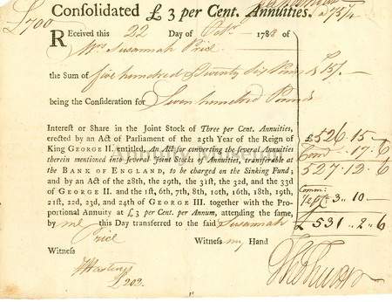
A Consol
The U.K. government redeemed the last consols in 2015. https://www.gov.uk/government/news/repayment-of-26-billion-historical-debt-to-be-completed-by-government

Slide 9
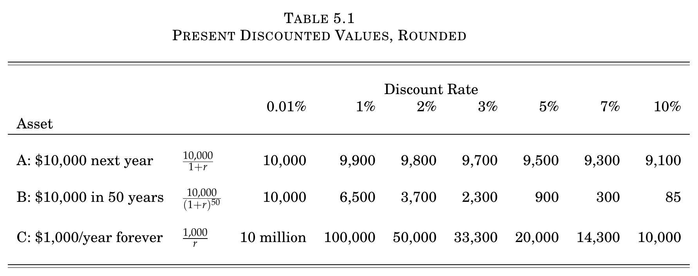

Slide 10
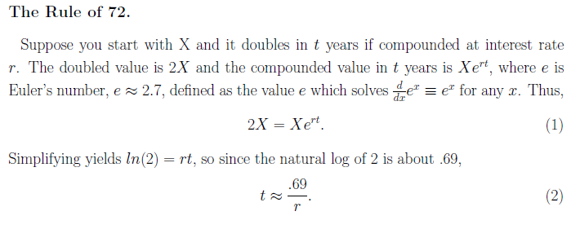
The Time t To Double Your Initial
Investment X
72 is close to 69.
72/8 = 9 years. 72/3 = 24 years. 72/10 = 7.2 years. 72/1 = 72 years.

Slide 11
How To Estimate the Value of 25 Years of Cash Flows
Suppose a business will earn $80,000 per year for 25 years. How much is it worth at a discount rate of 10%?

Slide 12
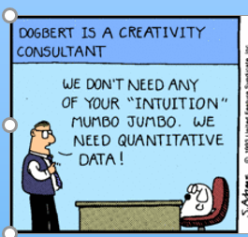
Choosing the Discount Rate
Notes:
write them down, don’t hand in. Ask afterweards afor a few answers.

Slide 13
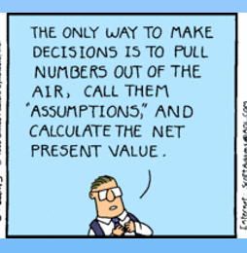
Choosing the Discount Rate
Notes:
write them down, don’t hand in. Ask afterweards afor a few answers.

Slide 14
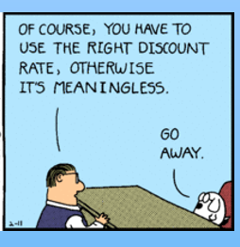
Choosing the Discount Rate
Notes:
write them down, don’t hand in. Ask afterweards afor a few answers.

Slide 15
Choosing the Discount Rate
Notes:
write them down, don’t hand in. Ask afterweards afor a few answers.

Slide 16
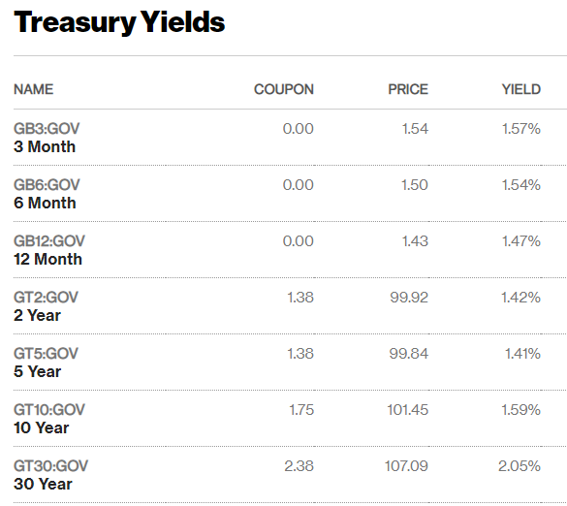
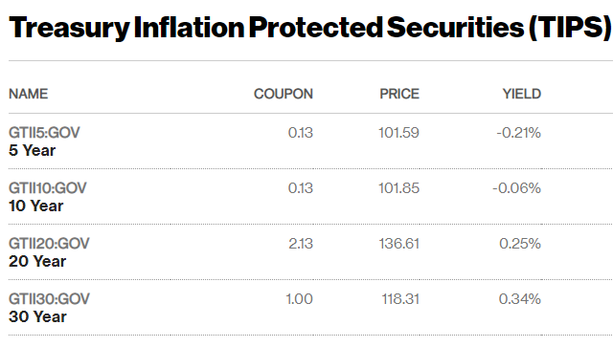
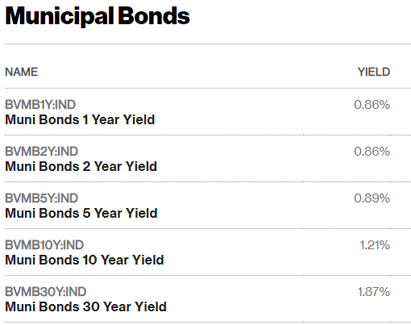
Yields on US Debt
http://www.bloomberg.com/markets/rates-bonds/government-bonds/us
Inflation Jan. 2019-20: 2.5%.

Slide 17
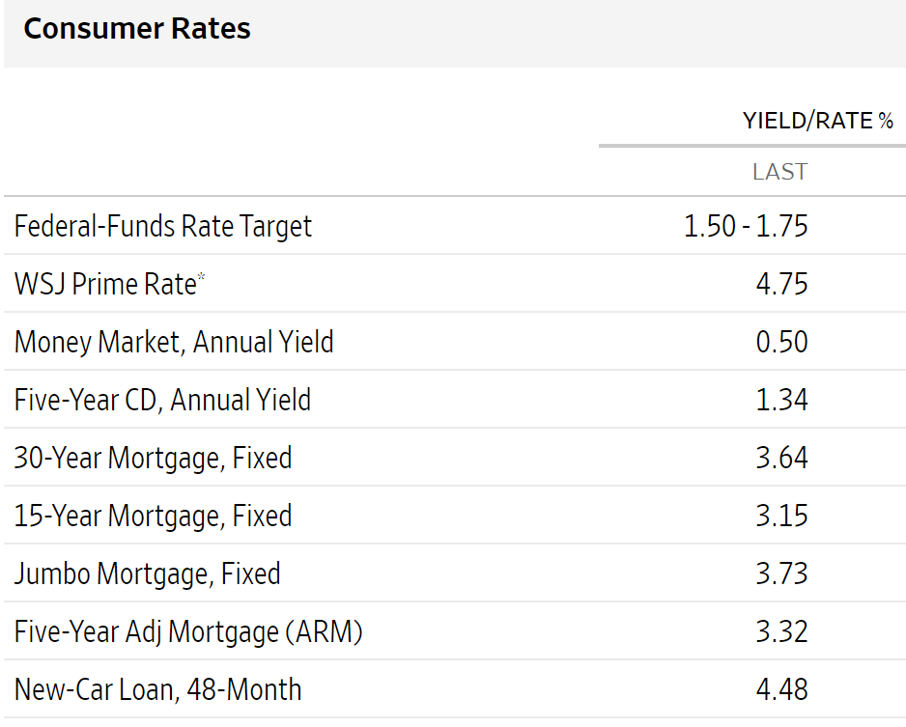
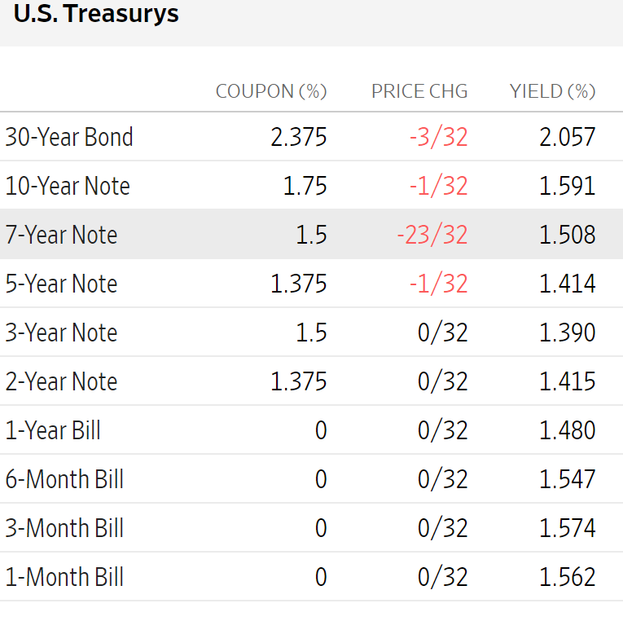
Some Yields on Other Debt
http://www.wsj.com/mdc/public/page/mdc_bonds.html?refresh=on
A good article on the prime rate is at
https://www.thestreet.com/markets/what-is-the-prime-rate-14742514

Slide 18
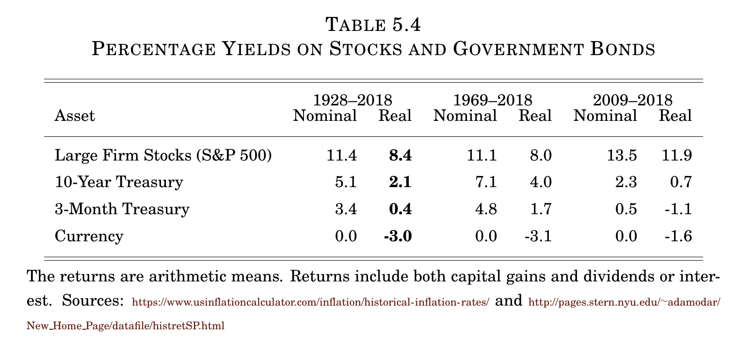
Stock and Safe Bond Yields

Slide 19
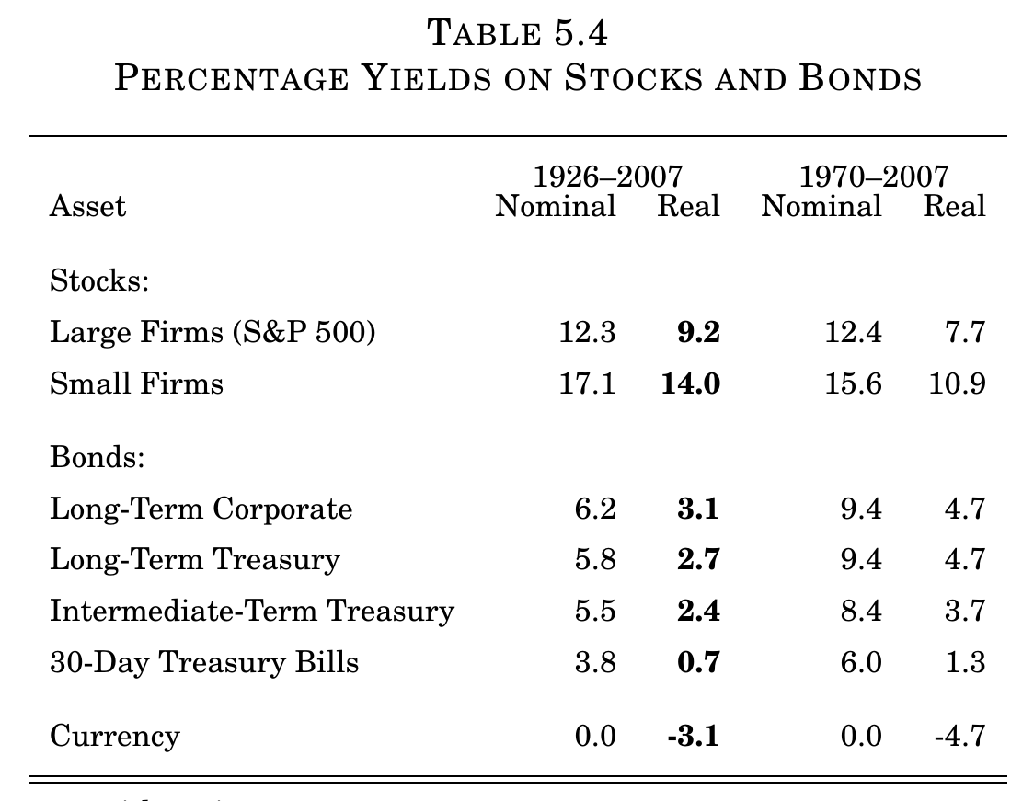
Other Assets

Slide 20
Risk and Return
Expected return rises with risk.
The CAPM model says it rises only with systematic risk--- that stocks more correlated with other stocks have higher return.
The Fama-French model adds two other factors that increase return: being a smaller firm, and having “value”--- a high Book/Market ratio, where Book is the accounting value (original cost of assets) and Market is the value at the current market price of the stocks and debt.

Slide 21
Numbers to Know:
Marginal deadweight loss from taxes is 25%.
Government discount rate is 7%.
Real yield on S&P 500 1928-2018 was 8.4%.
Real yield on 10-year Treasuries 1928-2018 was 2.1%.
Real yield on 3 month Treasuries 1928-2018 was .4%
Real yield on currency (inflation) 1928-2018 was -3.0%.
Value of a statistical life is $10 million (my estimate, since I can't find precise current numbers government uses).

Slide 22
Circular No. A-94– The Government Discount Rate
1. Base-Case Analysis. Constant-dollar benefit-cost analyses of proposed investments and regulations should report net present value and other outcomes determined using a real discount rate of 7 percent.
This rate approximates the marginal pretax rate of return on an average investment in the private sector in recent years.

Slide 23
Circular No. A-94: Leases, etc.
When the government will reduce govt. expenditure later by an investment now, don’t use 7%:
“The Treasury’s borrowing rates should be used as discount rates …
Cost-Effectiveness Analysis. Analyses that involve constant-dollar costs should use the real Treasury borrowing rate on marketable securities of comparable maturity to the period of analysis. . .”

Slide 24
The Social Discount Rate
Some philosophers say that the discount rate should be 0%, because why should we discriminate between generations?
The standard answer economists give is that this ignores opportunity cost. If we spend $1 million now to give a benefit of $1.1 million to someone 100 years from now, that is not the best way to maximize surplus.
Instead if we invested that $1 million, we could get, say, a safe 2% return, and (1.02)^100 is about $7.24 million. So we should do that instead.

Slide 25
The Value of Life

Slide 26
BIG IDEA OF THE DAY
Anybody who makes safety decisions is essentially trading off life against money.

Slide 27
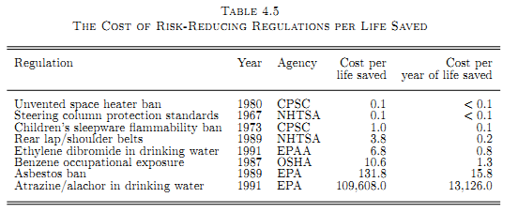
The Cost of Risk-Reducing Regulations per Life Saved
Surplus would rise if we made Steering Column Protections Standards more strict and Atrazine in Drinking Water standards looser. MARGINALISM.
Think of each regulation as a way to “buy human lives”.
Remember MRS=MRT from price theory. MRS is 1 here.
The Space Heater Ban is a cheap way to buy a life, and the Atrazine regulation is an expensive way.

Slide 28
Pick the Number of Lives, Minimize Costs
Make steering columns even safer than they are now--- at a cost of .1M, we save one life.
Relax benzene standards enough to lose one extra life--- and save 10.6M.
Net result: same number of lives saved, but more cheaply. For new data, see the very good report at: http://www.ncpa.org/pdfs/st204.pdf

Slide 29
The Great Queen Seondeok (Netflix)
Should the disciple sell Deokman to the evil lord in exchange for rare herbs that will save 200 dying villagers? He does.
His master hits
him with a stick and
says:
“You should not play number games with people’s lives!”
Note also John 11:50, where Caiphas says, “It is better for you
that one man die for the people than that the whole nation perish."

Slide 30
When Do We Have to Value Life?
Smith killed Jones by his negligent driving. How much should the court make Smith pay to the heirs of Jones? (exclude the idea of punishing Smith)
The EPA is considering a regulation which will cost the public X dollars and which will save 10 lives per year.
Acme Inc. is considering selling a safety product which would cost X dollars and reduce a customer’s chance of death by .001 this year before the product wears out.
You are stuck in a cave. It will cost X dollars to save your life. Should taxpayers authorize the operation?

Slide 31
Two Methods
1. The Forensic Approach
Look at the value of earnings and services that could be bought for dollar amounts,
A man has 10 years of working life left, he earns $50,000/year, and interest rates are zero, so his life is worth $500,000.
2. The Statistical Life Approach
Look at how much people accept to bear small risks of death and scale that up,
We would each pay $20 to avoid a 1/1,000 chance of death this year, so as a group, 1,000 of us would pay $20,000 to avoid the certainty of one of us dying this year.

Slide 32
The Forensic Approach to Valuing a Human Life
Suppose we take a single man aged 40 who will earn $80,000 per year for 25 years.
The present value would be, if we use a discount rate of 10%:

Slide 33
What about Children and the Elderly?

Slide 34
The Human Life Value Calculator
http://www.lifehappens.org/human-life-value-calculator/
They don’t say anything about their calculation method, so don’t take this too seriously. It seems way too high to me. This is a way to see how much money your family would lose if you died--- appropriate for insurance decisions.

Slide 35
The Value of a Statistical Life
You will be crossing the street and you have one chance in 10,000 of being hit by a bus and killed instantly. You may buy out of this risk for a cash payment now. This risk is about the same as the average yearly fatality rate for construction workers. How much would you pay?
If you would pay X, your value of a statistical life is 10,000X.

Slide 36
Statistical Life’s Rationale in Group Risks
A group of 10,000 people know that one of them, picked randomly, will die next year unless we each pay amount X now. What is the maximum X you would pay? If each person would pay $1,000, the total payment is 10,000 times $1,000, which is 10 million dollars. We can say that is the statistical value of a life.
How much would you be willing to *accept* to take on an extra risk of this size? Would it be the same as your willingness to pay?
Suppose Mr. Smith is only willing to pay $200 to eliminate the risk, not $1,000. Should we require him to pay more anyway?
On the other hand, is it fair for other citizens to pay $1,000 on his behalf?

Slide 37
The EPA’s Terminology Suggestion
The EPA suggests replacing the term
“value of a statistical life”
with
“value of mortality risk reduction”.
What do you think?

Slide 38
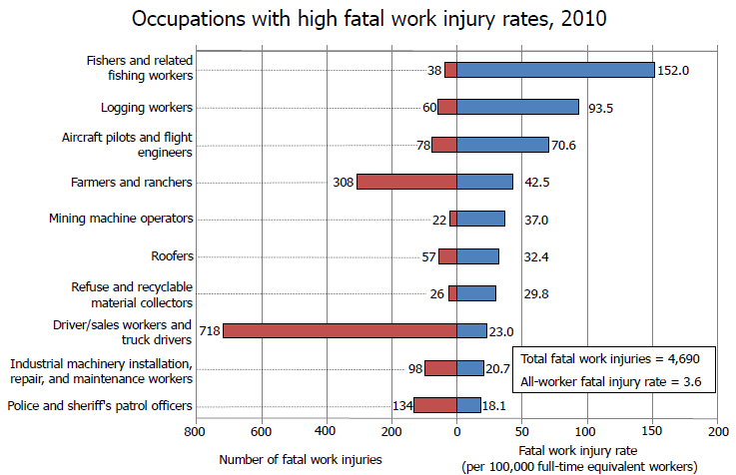
Occupational Hazards
http://www.bls.gov/iif/oshcfoi1.htm

Slide 39
Hedonic Regression

Slide 40
OMB’s Value of Life
The Office of Management and Budget told agencies in 2004 to pick a number between $1 and $10 million.

Slide 41
The Statistical Value of Life
The Dept. of Transportation used $9.6 million ijn 2016 as the value of a statistical life. It assumes an income elasticity of 1, so the value will grow proportionally with income as the country grows richer. If we increase that by 3%/year for 4 years, we get 9.6(1.03)^4 = $10.8 million for 2020.
See: https://www.transportation.gov/regulations/economic-values-used-in-analysis (2016-- not changed as of 2020). This has a table of research studies.
The EPA used $6.9 million in 2019.

Slide 42
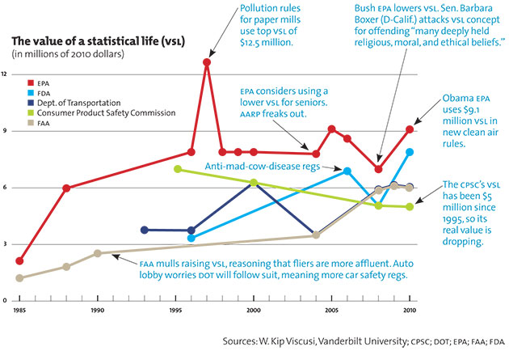
Viscusi Graph of Life Estimates

Slide 43
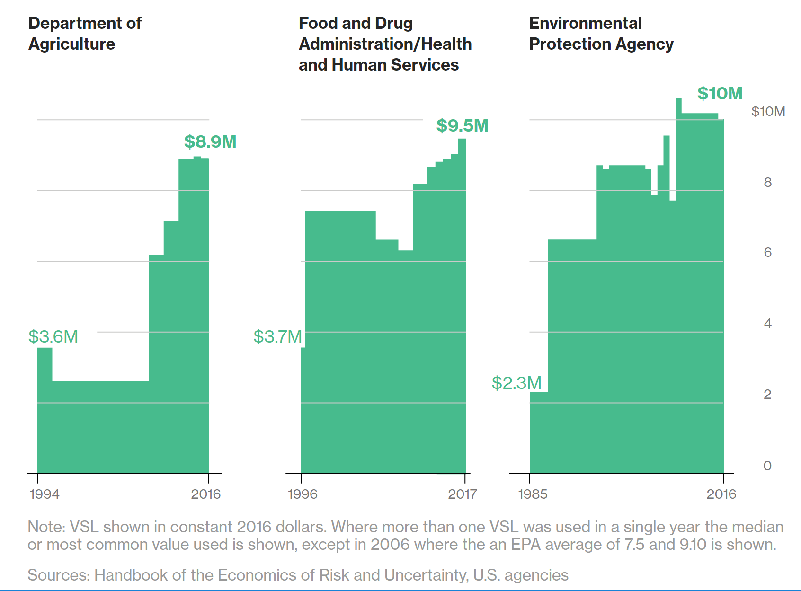
Another Presentation
https://www.bloomberg.com/graphics/2017-value-of-life/

Slide 44
Lost Workday Injuries
Viscusi and Aldy found that the average worker valued a typical lost-workday injury at $47,900.
Smokers valued a lost day at $26,100.
Workers who used seat belts valued a lost day at $78,200.

Slide 45
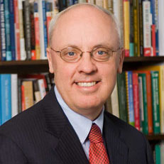
John Graham
In March 2001, President George W. Bush nominated Graham to serve as Administrator, Office of Information and Regulatory Affairs, Office of Management and Budget. He was confirmed by the Senate in July 2001. Located in the Executive Office of the President, this small office of 50 career policy analysts oversees the regulatory, information, and statistical activities of the federal government.
On July 28, 2008, Graham became the dean of the unique two-campus, $50 million professional school, the Indiana University School of Public and Environmental Affairs (SPEA). (Stepped down, Fall 2019)

Slide 46
Fishermen
"Fishermen are brought to the safety table kicking and screaming," says Jim Herbert, an Alaskan fisherman and chairman of an industry- dominated safety committee that advises the Coast Guard..
"Prevention of casualties will occur when we decide to require design, construction and maintenance standards for all fishing vessels and licensing standards for operators and crewmembers," says Richard Hiscock, a marine safety expert …
Today, most fishing boat operators aren't required to have a license or safety training. Yet, recreational boating operators in at least 33 states are required to have such training…
Fishing boat crewmembers also aren't certified, and most have little or no training, safety experts say. As for the boat itself, nearly all operate without safety standards for design, construction and maintenance.
Yet many fishermen have strongly opposed standards that might save their own lives," …

Slide 47
Iraq
Some workers are more risk-averse than others, or more danger-averse, and they prefer safer but less remunerative jobs. A few years ago a young college graduate who wanted a high income would have done better as truck driver in Iraq than as an investment banker, though with less chance for advancement.
“When National Guardsman Gerald Harris was offered $120,000 in July to work as a truck driver in Iraq for Kellogg Brown & Root, it didn’t take him long to make up his mind….

Slide 48
Some Iraq Calculations
Harris was ending a six-month tour hauling battle tanks to the front line, and had spent his share of sleepless nights listening to the echo of weapons fire from the sweltering sand floor of his Army tent.
`I don’t care how much money you offer me, I won’t do it,’
I did some calculations based on the newspaper article:
30 killed plus 7 missing divided by 24,000 employees equals 0.00154, = 154 per 100,000.
The fatal injury rate for fishermen was 152 in 2010.

Slide 49
Risks Taken Voluntarily
“To value reductions in more voluntarily incurred risks (e.g., those related to motorcycling without a helmet) that are “high", agencies should consider using lower values than those applied to reductions in involuntary risk.
When a higher-risk option is chosen voluntarily, those who assume the risk may be more risk-tolerant, i.e., they may place a relatively lower value on avoiding risks.
Empirical studies of risk premiums in higher-risk occupations suggest that reductions in risks for voluntarily assumed high risk jobs . . . are valued less than equal risk reductions for lower-risk jobs.”

Slide 50
The Value Affects Policy
The Bush Administration rejected regulation in 2005 to require car roofs to double in strength.
It estimated that this would prevent 135 deaths in rollover accidents each year, but at a value of a life of $3.5 million the extra cost would exceed the extra value (which also included averted injuries) by $800 million.
The agency therefore proposed a smaller increase in roof strength that was estimated to save 44 lives per year.
In 2010 the Obama Administration imposed the stricter and more expensive standard, using a value of life of $6.1 million.

Slide 51
Consumption Data
So far we’ve talked about using employment risks. One could also use consumption risks.
Example: If someone is paying $200 extra to buy a car with a strong roof, eliminating a 1/1,000 risk, that person has a value of a statistical life of $200,000.

Slide 52
Paragliding – The Up Side

Slide 53
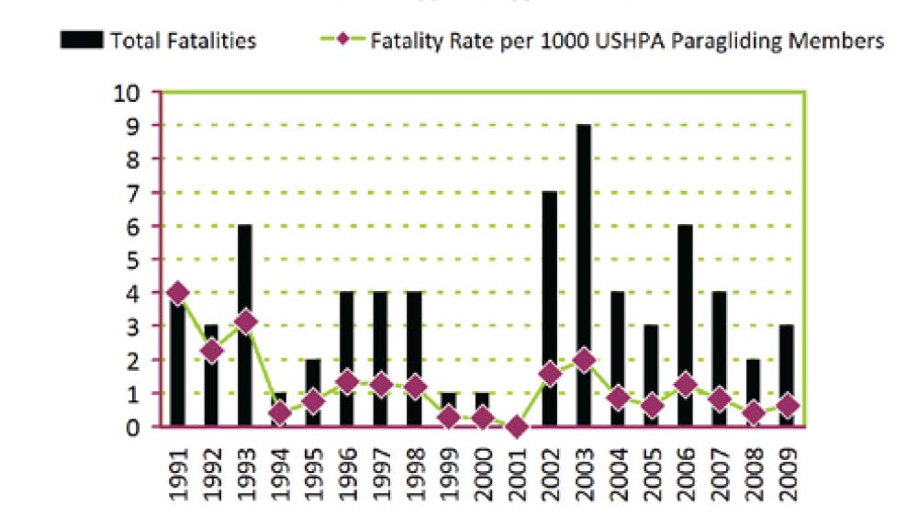
Paragliding – The Down Side
The moral: People differ in their values of life and their value of paragliding. (Most people would pay NOT to paraglide.)

Slide 54
Voluntary Choice
“To value reductions in more voluntarily incurred risks (e.g., those related to motor- cycling without a helmet) that are ”high,” agencies should consider using lower values than those applied to reductions in involuntary risk. When a higher-risk option is chosen voluntarily, those who assume the risk may be more risk-tolerant, i.e., they may place a relatively lower value on avoiding risks. Empirical studies of risk premiums in higher-risk occupations suggest that reductions in risks for voluntarily assumed high risk jobs (e.g., above 104 annually) are valued less than equal risk reductions for lower-risk jobs.” Office of Management and the Budget, “Economic Analysis of Federal Regulations Under Executive Order 12866,” January 11, 1996, .

Slide 55
Nub City (https://allthatsinteresting.com/nub-city-vernon-florida)
“There was another man who took out insurance with 28 or 38 companies,” said Murray Armstrong, an insurance official for Liberty National. “He was a farmer and ordinarily drove around the farm in his stick shift pickup. This day -- the day of the accident -- he drove his wife’s automatic transmission car and he lost his left foot. If he’d been driving his pickup, he’d have had to use that foot for the clutch. He also had a tourniquet in his pocket. We asked why he had it and he said, ’Snakes. In case of snake bite.’
He’d taken out so much insurance he was paying premiums that cost more than his income. He wasn’t poor, either. Middle class. He collected more than $1-million from all the companies. It was hard to make a jury believe a man would shoot off his foot.”

