Slide 1
Coronavirus(Covid-19, COVID-19,Wuhan flu)

Slide 2
IDEA OF THE DAY
The coronavirus epidemic illustrates market failure because of externalities,
but government failure too, because governments are slower than the private sector to adapt, and more constrained by laws and rules.

Slide 3
Externality: Contagion
When someone spreads the virus by going to a concert, that is an externality, a cost he imposes on other people.
Traditional “police power”: Restrict liberty to protect the “health, safety, morals, and general welfare of the public.” https://en.wikipedia.org/wiki/Police_power_(United_States_constitutional_law)
The lockdown reduces this externality. It is like quarantining a shipful of sick people.
Notes:
You’ve heard of this before. What does it mean? It is for choosing output.
Remember how with welfare, output was key. Find optimal output, then find a price which gets the market to choose it. Same here.

Slide 4
Government Agencies
The two most important federal agencies are:
The FDA. The Food and Drug Administration (drug quality)
The CDC. The Centers for Disease Control and Prevention (epidemic control)
Notes:
You’ve heard of this before. What does it mean? It is for choosing output.
Remember how with welfare, output was key. Find optimal output, then find a price which gets the market to choose it. Same here.

Slide 5
Mission Creep
The CDC has expanded to many other things. See its mission statement at https://www.cdc.gov/about/organization/mission.htm. It started as the Communicable Disease Center in 1946. It became the Center for Disease Control in 1970. In 1992, it added “and Prevention”.
“Of the $11 billion allocated to CDC for fiscal year 2015, the agency spent just more than 20 percent on diseases transmitted by humans and animals.”
Its attention has been on obesity, smoking, alcohol, nutrition, etc.
Mission creep. The agency wants to expand, and the politicians like to claim credit for that. Like software with more and more features and less attention on the main thing people use it for. Mission creep is a big problem for corporations too.
What will be the effect of coronavirus on the CDC, politically?
https://www.cdc.gov/mmwr/preview/mmwrhtml/00042732.htm
https://cei.org/blog/tom-price-should-focus-reversing-mission-creep-hhs
Notes:
You’ve heard of this before. What does it mean? It is for choosing output.
Remember how with welfare, output was key. Find optimal output, then find a price which gets the market to choose it. Same here.

Slide 6
Government Failure:
The Federal Mask Stockpile
In 2009, the federal government used up ¾ of its N95 masks for a flu epidemic. They weren’t replaced by either Obama or Trump.
There were many government reports 2003-2015 warning that there would be too few ventilator machines if an epidemic hit. It was obvious even without formal study.
https://www.dailysignal.com/2020/03/25/after-last-pandemic-task-force-advised-obama-to-avert-shortage-of-masks/
https://pjmedia.com/trending/report-obama-biden-administration-ignored-three-government-reports-that-hospitals-lacked-ventilators-supplies/
Notes:
You’ve heard of this before. What does it mean? It is for choosing output.
Remember how with welfare, output was key. Find optimal output, then find a price which gets the market to choose it. Same here.

Slide 7
Government Failure: California’s Mobile Hospitals
In 2006, after an avian flu scare, Gov. Schwarzenegger had the state spend $200 million on 3 200-bed mobile hospitals and 50 million N95 masks, 2400 ventilators, kits for 21,000 more beds in amphitheaters, etc.
In 2011 Gov. Brown cancelled it to save $5.8 million/year in maintenance.
In 2020, the Public Health Dept. said it had 21 million masks, but it wouldn’t release them for Covid-19 because they’re past expiration date.
https://www.latimes.com/california/story/2020-03-27/coronavirus-california-mobile-hospitals-ventilators
Notes:
You’ve heard of this before. What does it mean? It is for choosing output.
Remember how with welfare, output was key. Find optimal output, then find a price which gets the market to choose it. Same here.

Slide 8
Asymmetric Information:
Danger of Contagion
A separate market failure is not knowing that somebody you voluntarily interact with is contagious.
Governments require doctors to report a list of “reportable diseases” such as AIDS and syphilis. This helps with stats and with “contract tracing” to stop the spread.
The CDC doesn’t list Covid-19--- See https://wwwn.cdc.gov/nndss/conditions/notifiable/2020/https://www.cdc.gov/coronavirus/2019-ncov/php/reporting-pui.html
England only listed it March 4. https://www.reuters.com/article/us-health-coronovirus-britain/britain-to-register-covid-19-as-notifiable-disease-bbc-idUSKBN20R01U
But they do “request” reporting. Would adding to the required list require notice-and-comment? https://www.cdc.gov/coronavirus/2019-ncov/php/reporting-pui.html
Should everyone with a fever be required to tell that to everyone they meet? Everyone with Covid-19?
Notes:
You’ve heard of this before. What does it mean? It is for choosing output.
Remember how with welfare, output was key. Find optimal output, then find a price which gets the market to choose it. Same here.

Slide 9
What the Doctors Said
The UK, and perhaps US, was going to use a “herd immunity” strategy of giving up on “containment” and focus on “mitigation” protecting the people who might die.
But they were widely criticized, and on March 16, doctors at Imperial College, London release a report recommending suppression. Both countries quickly changed their policies. A good change? Maybe. But
the doctors said,
“We do not consider the ethical or economic implications of either strategy…. Instead we focus on feasibility, with a specific focus on what the likely healthcare system impact of the two approaches would be.”
That is: Benefits, but No Costs. By that methodology, we should have a permanent lockdown, because we have flu every year and we could reduce the number of cases.
Manski in Scientific American: https://blogs.scientificamerican.com/observations/covid-19-policy-must-take-all-impacts-into-account/
Notes:
You’ve heard of this before. What does it mean? It is for choosing output.
Remember how with welfare, output was key. Find optimal output, then find a price which gets the market to choose it. Same here.

Slide 10
Quick Calculations Using
Value of a Statistical Life
The lockdown costs about $1 trillion per month. That’s $1,000 billion, or $1,000,000 million.
If the value of a human life is $10 million, we need to save 1,000,000/10 = 100,000 lives per month for this to be a good idea using surplus analysis.
Notes:
You’ve heard of this before. What does it mean? It is for choosing output.
Remember how with welfare, output was key. Find optimal output, then find a price which gets the market to choose it. Same here.

Slide 11
The Number at Risk: My First Estimate
About 75 million people in the US are more than 60 years old.
At a 5% death rate, that is .05(75) = about 4 million.
So it’s worth locking down for 40 months, it seems, if a lockdown is worth it if it saves 100,000 lives/month.
But will they all get it? If they self-quarantine and only 1% die, it’s only 750,000 deaths and only worth locking down 8 months.
But a lockdown just delays the disease, rather than stopping it, unless something else happens. It just “flattens the curve”, delaying the fatalities. Or does flattening reduce them?
https://www.statista.com/statistics/241488/population-of-the-us-by-sex-and-age/
https://www.nationalreview.com/corner/a-covid-cost-benefit-analysis/ Here is a back-of envelope opinion piece.
https://theincidentaleconomist.com/wordpress/economic-cost-of-flattening-the-curve/ Another good one. Years of life saved.
Notes:
You’ve heard of this before. What does it mean? It is for choosing output.
Remember how with welfare, output was key. Find optimal output, then find a price which gets the market to choose it. Same here.

Slide 12
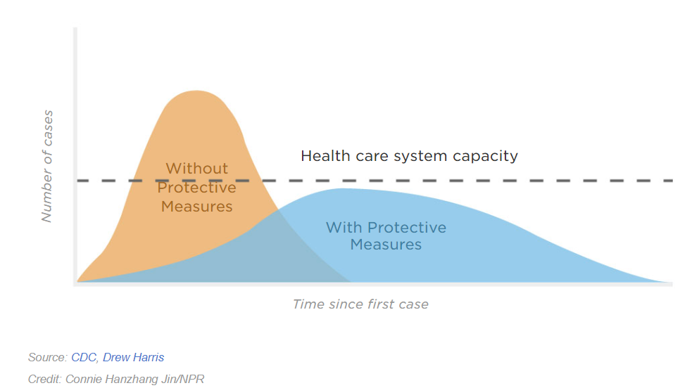
Flattening the Curve: Cases
If we can spread out when people get sick, the hospital beds and ventilators won’t all get used up at once, and the number of them can be increased. To the extent that these help, the total number of deaths would be reduced.
So even if just as many people get sick, the cost is lower.
Notes:
You’ve heard of this before. What does it mean? It is for choosing output.
Remember how with welfare, output was key. Find optimal output, then find a price which gets the market to choose it. Same here.

Slide 13
Flattening the Curve: Deaths
Greenstote estimate: 2.2 million deaths with no distancing. Moderate distancing reduces this by 1.13 million flu deaths and 630,000 overflow deaths from hospitals having more space for other patients.
Ferguson moderate distancing:
7-day isolation for anyone showing coronavirus symptoms, a 14-day voluntary quarantine for their entire household, and dramatically reduced social contact for those over 70 years of age. (Closing schools has little impact)
https://bfi.uchicago.edu/working-paper/2020-26/
Notes:
You’ve heard of this before. What does it mean? It is for choosing output.
Remember how with welfare, output was key. Find optimal output, then find a price which gets the market to choose it. Same here.

Slide 14
Intensive Care Overflow
From Greenstone and Nigam, based on Ferguson.
https://bfi.uchicago.edu/working-paper/2020-26/
Notes:
You’ve heard of this before. What does it mean? It is for choosing output.
Remember how with welfare, output was key. Find optimal output, then find a price which gets the market to choose it. Same here.

Slide 15
Cutting Off the Curve with a Vaccine?
A vaccine would not flatten the curve---it would cut off the right-hand-side of it, reducing the total number of cases.
A vaccine causes the person to develop antibodies which will stop the flu virus ever multiplying in his body.
A vaccine will take at least 18 months to be deployed, experts say. That is after herd immunity ends the epidemic anyway.
https://www.bbc.com/news/health-51665497
https://www.newyorker.com/news/news-desk/how-long-will-it-take-to-develop-a-coronavirus-vaccine
Notes:
You’ve heard of this before. What does it mean? It is for choosing output.
Remember how with welfare, output was key. Find optimal output, then find a price which gets the market to choose it. Same here.

Slide 16
Cost-Benefit Analysis: The AEI Scherbina Study
Start with an epidemiological study like the Imperial College one. Assume that in 20 months a vaccine stops the spread.
Make assumptions about death rates for different age groups, and the cost of treating flu.
Use the government (CEA) 2019 assumption that one missed workday has a productivity loss of $152.
Assume that 90% of infected people miss work or otherwise incur costs. For value of statistical life (VSL):
https://www.aei.org/research-products/working-paper/determining-the-optimal-duration-of-the-covid-19-suppression-policy-a-cost-benefit-analysis/ Scherbina
Notes:
You’ve heard of this before. What does it mean? It is for choosing output.
Remember how with welfare, output was key. Find optimal output, then find a price which gets the market to choose it. Same here.

Slide 17
The Number at Risk:
Expert Estimate
Scherbina on what happens with kids going to school, concerts, normal travel:
Peak in July 2020. Attack rate is 80%.1.9 million deaths.
Cost: $13.2 trillion when the value of statistical lives for the fatalities is taken into account and $1.2 trillion when it is not.
https://www.aei.org/research-products/working-paper/determining-the-optimal-duration-of-the-covid-19-suppression-policy-a-cost-benefit-analysis/ Scherbina
From, CDC similar deaths and attack rate in worst-case scenario, https://www.nytimes.com/2020/03/13/us/coronavirus-deaths-estimate.html
Notes:
You’ve heard of this before. What does it mean? It is for choosing output.
Remember how with welfare, output was key. Find optimal output, then find a price which gets the market to choose it. Same here.

Slide 18
Prof. Scherbina’s Conclusions
Use “suppression” for 13 weeks: closing schools and public gatherings (a “lockdown” is not analyzed). Cost estimate: just $17 billion/week.
I think the assumption of a spread rate of just .7/case during suppression is way off.
https://www.aei.org/research-products/working-paper/determining-the-optimal-duration-of-the-covid-19-suppression-policy-a-cost-benefit-analysis/
https://www.bloomberg.com/opinion/articles/2020-03-26/coronavirus-lockdowns-look-smart-under-cost-benefit-scrutiny Other c/b studies.
Notes:
You’ve heard of this before. What does it mean? It is for choosing output.
Remember how with welfare, output was key. Find optimal output, then find a price which gets the market to choose it. Same here.

Slide 19
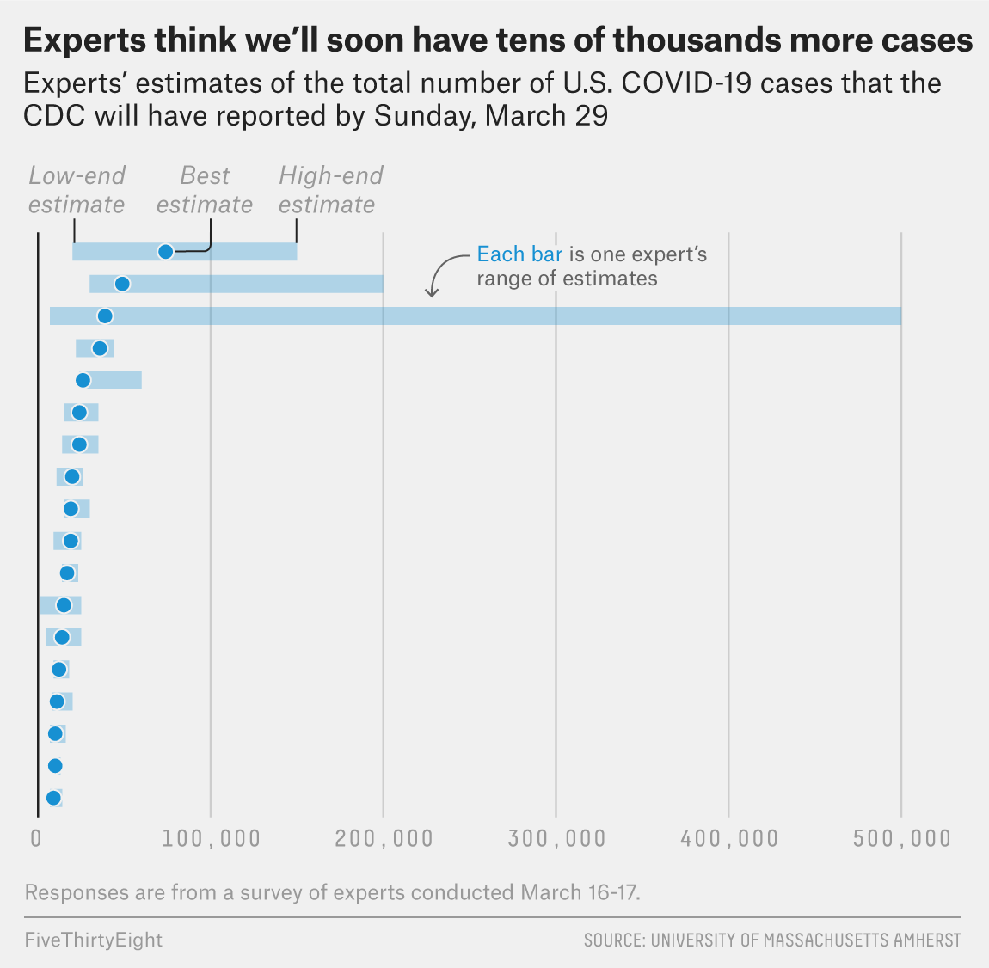
Experts Don’t Know Either
FiveThirtyEight reported on a March 16 survey of epidemiologists of what the number of reported cases would be March 29.
The CDC reports140,000 cases for March 29.
https://fivethirtyeight.com/features/infectious-disease-experts-dont-know-how-bad-the-coronavirus-is-going-to-get-either/
https://www.cdc.gov/coronavirus/2019-ncov/cases-updates/cases-in-us.html
Notes:
You’ve heard of this before. What does it mean? It is for choosing output.
Remember how with welfare, output was key. Find optimal output, then find a price which gets the market to choose it. Same here.

Slide 20
Shortages:
Masks, Toilet Paper, Tests
Why are there shortages?
--because prices are too low.
What is bad about them?
-- Output is too low (triangle losses)
-- The people who want things the most might not be the ones to get them (inefficient rationing)
Remember which diagram applies?
Notes:
You’ve heard of this before. What does it mean? It is for choosing output.
Remember how with welfare, output was key. Find optimal output, then find a price which gets the market to choose it. Same here.

Slide 21
The Solution:
Let Prices Rise
What is undoubtedly true is that if prices rise:
1. Quantity supplied will rise.
2. Nobody who is willing to pay the price will have to go without the good.
Notes:
You’ve heard of this before. What does it mean? It is for choosing output.
Remember how with welfare, output was key. Find optimal output, then find a price which gets the market to choose it. Same here.

Slide 22
Price Gouging Is Good
People hate letting prices rise. They don’t like it that profits rise. They don’t like it that poor people are at a disadvantage in buying things.
One response is that the whole idea of a market is to allocate goods to people who are willing to pay more for them. This is no different.
But don’t some buyers *need* masks more than others?
Hospitals and doctors are rich. If the price were allowed to rise, they would be the ones to get the masks-- with a trivial quantity going to millionaires and hypochondriacs.
Instead, with low prices, it is speculators who buy and resell, or are forbidden to resell so they just keep them in their garages.
Notes:
You’ve heard of this before. What does it mean? It is for choosing output.
Remember how with welfare, output was key. Find optimal output, then find a price which gets the market to choose it. Same here.

Slide 23
Speculation in Toilet Paper
The government can always buy toilet paper and give it to poor people if it comes to that.
Toilet paper actually is not going to run out.
Demand for use has not gone up.
It’s just that fear of shortages that creates shortages--- combined with low prices. There will be a surplus pretty soon.
Notes:
You’ve heard of this before. What does it mean? It is for choosing output.
Remember how with welfare, output was key. Find optimal output, then find a price which gets the market to choose it. Same here.

Slide 24
We Need More Masks and Tests
What matters most is getting more quantity supplied.
With masks and tests, in particular, we should be happy to give amazingly high profits to anyone who will produce more. The equilibrium price is high.
A lockdown costs $1 trillion each month. What if we offered $500 billion dollars in abnormal profits to firms that supply masks and tests? They would spend lavishly on trying to increase supply.
But are masks useful for everyday interaction? Hard to know. They’re discouraged in Taiwan, which has had great success in containment.
https://asiatimes.com/2020/03/taiwan-serves-as-model-in-global-virus-battle/
Notes:
You’ve heard of this before. What does it mean? It is for choosing output.
Remember how with welfare, output was key. Find optimal output, then find a price which gets the market to choose it. Same here.

Slide 25
Government Threats of Regulation
“At $1.2-$1.5 billion that’s $15,000-$18,750 per ventilator which is well below the standard price of $25,000-$50,000 (maybe these ventilators would be simpler or less fancy.)”
The deal was cancelled. The Federal Emergency Management Agency said it needed more time to assess whether the estimated cost was prohibitive.
“The President, however, then went on Hannity to say that he didn’t think we needed 30-40 thousand ventilators and also insulted GM CEO Mary Barra in a series of tweets. This was clearly some kind of clever bargaining strategy. Surprise! It failed.
So President Trump invoked the National Defense Act and used command-and-control to force GM to produce the ventilators.
This goes to the market failure of Insecure Contracts and Insecure Property Rights. Companies can’t tell if they will be allowed to keep profits or even enough to pay their costs.
https://marginalrevolution.com/marginalrevolution/2020/03/the-defense-production-act.html
Notes:
You’ve heard of this before. What does it mean? It is for choosing output.
Remember how with welfare, output was key. Find optimal output, then find a price which gets the market to choose it. Same here.

Slide 26
Tests: Why is Supply Low and late?
The tests everybody is talking about are for whether you have the virus and might get sick. That test looks for virus DNA in your body. If it is there, your antibodies have not killed all the virus yet (unless there are just some dead fragments left).
https://www.scientificamerican.com/article/heres-how-coronavirus-tests-work-and-who-offers-them/
A second kind of test is for whether someone was exposed and is now immune look for whether the person has antibodies. If we can figure out who is immune, we can let them go back to work.
The USA has totally botched testing. But the reason is overregulation. We have actually blocked private companies from producing tests. After
a detour to South Korean policy, we will get back to that.
Notes:
You’ve heard of this before. What does it mean? It is for choosing output.
Remember how with welfare, output was key. Find optimal output, then find a price which gets the market to choose it. Same here.

Slide 27
A Surprising Fact
South Korea is hailed for using widespread testing, but the US has actually done more tests.
CNN, which hates President Trump, said on March 25 the US has done 418,000. The President said it was just 370,000 with 220,000 in the past eight days. Korea has done 360,000.
To be sure, the US has 6 times as many people as Korea, but the
problem isn’t just in coming up with the same quantity supplied. It is that
we started very late, and it is probably too late to use Korea’s strategy.
https://www.cnn.com/2020/03/25/politics/coronavirus-testing-trump-south-korea-fact-check/index.html
Notes:
You’ve heard of this before. What does it mean? It is for choosing output.
Remember how with welfare, output was key. Find optimal output, then find a price which gets the market to choose it. Same here.

Slide 28
South Korea’s Strategy
Within a week, the government met with companies and promised quick approval of tests. 5 companies produce them now. As of March 27 one producer can produce 400,000 kits/week, almost all for export.
“At 50 drive-through stations, patients are tested without leaving their cars. They are given a questionnaire, a remote temperature scan and a throat swab. The process takes about 10 minutes. Test results are usually back within hours.”
Schools were closed, but businesses were not shut.
https://www.bbc.com/news/world-asia-51836898
https://www.reuters.com/article/us-health-coronavirus-southkorea-testkit/south-korean-test-kit-makers-swamped-as-coronavirus-cases-explode-in-us-europe-idUSKBN21E12V
https://www.nytimes.com/2020/03/23/world/asia/coronavirus-south-korea-flatten-curve.html
Notes:
You’ve heard of this before. What does it mean? It is for choosing output.
Remember how with welfare, output was key. Find optimal output, then find a price which gets the market to choose it. Same here.

Slide 29
More about South Korea
“ Offices, hotels and other large buildings often use thermal image cameras to identify people with fevers. Many restaurants check customers’ temperatures before accepting them….
Websites and smartphone apps detail hour-by-hour, sometimes minute-by-minute, timelines of infected people’s travel — which buses they took, when and where they got on and off, even whether they were wearing masks….
People ordered into self-quarantine must download another app, which alerts officials if a patient ventures out of isolation. Fines for violations can reach $2,500.”
Korea was prepared with a law to allow these things, after the SARS scare. The US is not. The HIPAA law keeps medical info private. https://www.hhs.gov/about/news/2020/03/24/ocr-issues-guidance-to-help-ensure-first-responders-and-others-receive-protected-health-information-about-individuals-exposed-to-covid-19.html
https://www.bbc.com/news/technology-52017993 Taiwan strict quarantine, civil liberties fears.
https://www.nytimes.com/2020/03/23/world/asia/coronavirus-south-korea-flatten-curve.html
Notes:
You’ve heard of this before. What does it mean? It is for choosing output.
Remember how with welfare, output was key. Find optimal output, then find a price which gets the market to choose it. Same here.

Slide 30
Health Care in the US Is Higher Quality
The U.S. is much more careful about safe and effective medical treatment. That is our big problem. We require too much safety and effectiveness. Overly high quality is inefficient.
Is it just that we require too much PROOF of safety and effectiveness? No. Without proof, you can’t get as much safety and effectiveness.
The FDA’s role is to block unsafe drugs, not to foster innovation.
Notes:
You’ve heard of this before. What does it mean? It is for choosing output.
Remember how with welfare, output was key. Find optimal output, then find a price which gets the market to choose it. Same here.

Slide 31
A Perverse Rule
“When federal health authorities declared Covid-19 a public health emergency back in January, it triggered a set of rules requiring any tests to pass the FDA’s ‘emergency use approval’ process. These rules raise the bar for tests developed and run inside a single laboratory.”
This rule was relaxed Feb. 29.
By March 27, approval had become much quicker and easier.
https://www.wired.com/story/everything-you-need-to-know-about-coronavirus-testing/
https://www.scientificamerican.com/article/heres-how-coronavirus-tests-work-and-who-offers-them/
Notes:
You’ve heard of this before. What does it mean? It is for choosing output.
Remember how with welfare, output was key. Find optimal output, then find a price which gets the market to choose it. Same here.

Slide 32
FDA and CDC Chronology
Feb. 4: FDA issued emergency authorization of CDC test. 200 700-sample kits were sent to 115 qualified public health labs.
Feb. 12: Test was flawed--wouldn’t pick up non- Covid-19 coronaviruses. CDC told labs to wait.
The FDA did not allow the World Health Organization test to be produced and used.
Feb. 29: FDA relaxed the rules.
https://www.wired.com/story/everything-you-need-to-know-about-coronavirus-testing/
Notes:
You’ve heard of this before. What does it mean? It is for choosing output.
Remember how with welfare, output was key. Find optimal output, then find a price which gets the market to choose it. Same here.

Slide 33
Industrial N95 Masks
Since January, 3M has been producing N95 masks at capacity, 35 million/month. But it could only see 5 million to hospitals, because the rest were only approved for industrial use. The FDA approves medical, the NIOSH industrial.
The March coronavirus bailout bill exempts 3M from being sued if it sells to hospitals, or sells expired masks. This exemption was controversial.
https://www.washingtonpost.com/business/2020/03/22/masks-ppe-3m-coronavirus/
https://search-proquest-com.proxyiub.uits.iu.edu/saveasdownloadprogress/F2A1598875604A9BPQ/false?accountid=11620
https://www.washingtonpost.com/business/2020/03/19/change-us-law-will-make-millions-more-masks-available-doctors-nurses-white-house-says/
Notes:
You’ve heard of this before. What does it mean? It is for choosing output.
Remember how with welfare, output was key. Find optimal output, then find a price which gets the market to choose it. Same here.

Slide 34
Mask Cleaning Technology Blocked by FDA
A company called Battelle couldn’t get permission to use its new hydrogen peroxide mask sterilization on a large scale.
"The Food and Drug Administration -- after dithering all week -- finally gave Battelle approval to sterilize a measly 10,000 masks a day," Yost said. "They could be doing 160,000 per day.“
(March 29, after news reports and an appeal by Trump, the FDA did give permission.)
https://pjmedia.com/trending/unreal-fda-sits-on-critical-mask-sanitizing-technology-leaving-the-job-up-to-grandmas-with-sewing-machines/
https://pjmedia.com/news-and-politics/the-morning-briefing-bloated-bureaucracy-is-going-to-have-a-coronavirus-body-count/
Notes:
You’ve heard of this before. What does it mean? It is for choosing output.
Remember how with welfare, output was key. Find optimal output, then find a price which gets the market to choose it. Same here.

Slide 35
Labor Regulation
Should we require that medical personnel be of high quality?
Nurses, doctors, orderlies, nursing home employees.
We will be short of all of these. Could untrained volunteers be used?
The heirs of somebody who dies can sue if an unskilled person makes a mistake--- or even if he doesn’t make a mistake but something goes wrong, a jury could be persuaded to grant damages.
Notes:
You’ve heard of this before. What does it mean? It is for choosing output.
Remember how with welfare, output was key. Find optimal output, then find a price which gets the market to choose it. Same here.

Slide 36
Triage Prohibited:
Office of Civil RIghts
Triage is the idea of treating only the moderately hurt, not those who will probably die anyway. But we prohibit:
“discrimination on the basis of race, color, national origin, disability, age, sex, and exercise of conscience and religion in HHS-funded programs, including in the provision of health care services during COVID-19.
OCR is particularly focused on ensuring that covered entities do not unlawfully discriminate against people with disabilities …
OCR enforces the Americans with Disabilities Act, Section 504 of the Rehabilitation Act, the Age Discrimination Act, and Section 1557 of the Affordable Care.”
https://www.hhs.gov/about/news/2020/03/28/ocr-issues-bulletin-on-civil-rights-laws-and-hipaa-flexibilities-that-apply-during-the-covid-19-emergency.html
Notes:
You’ve heard of this before. What does it mean? It is for choosing output.
Remember how with welfare, output was key. Find optimal output, then find a price which gets the market to choose it. Same here.

