Slide 1
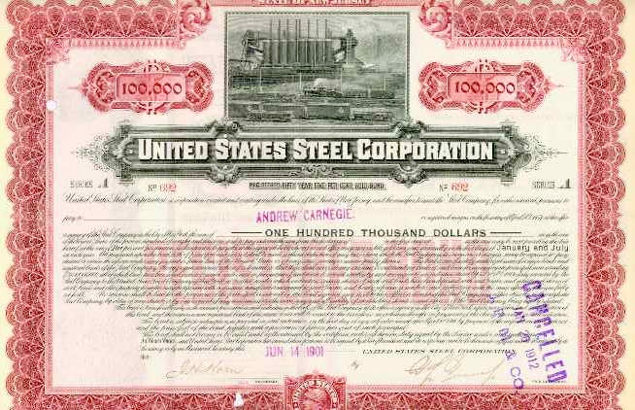
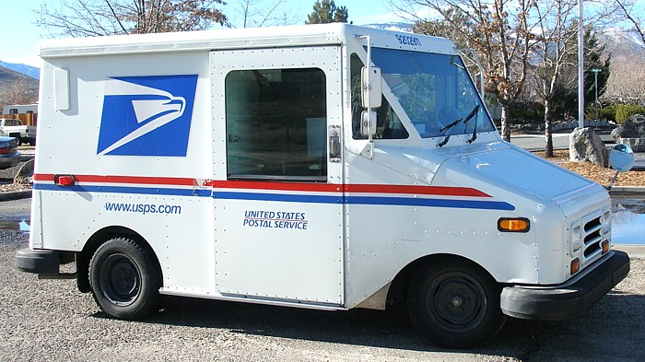
8--MONOPOLY
https://scripophily.net/unstatsteelc4.html

Slide 2
IDEA OF THE DAY
A firm with market power will deliberately sell less than it can, in order to keep the price high.

Slide 3
MR = MC
What does this mean?
Notes:
You’ve heard of this before. What does it mean? It is for choosing output.
Remember how with welfare, output was key. Find optimal output, then find a price which gets the market to choose it. Same here.

Slide 4
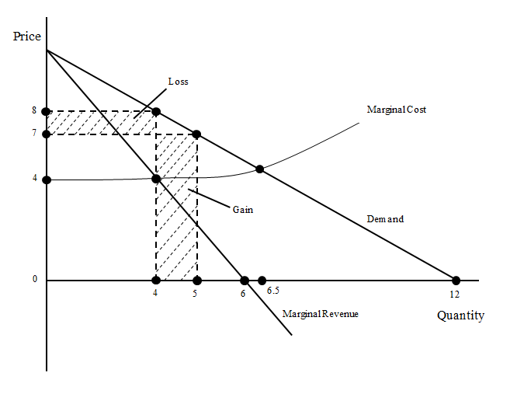
Pricing with Market Power

Slide 5
Linear Demand and
Marginal Revenue
We often use linear (straight slanting line) demand curves in diagrams.
When demand is linear, marginal revenue is linear too, with twice as steep a slope.
Calculus demonstrates this.
If demand is P = a - bQ, then revenue is
R = PQ = (a - bQ)Q = aQ – bQ²
and marginal revenue is
MR = dR/dQ = a - 2bQ
just like demand but with a “2” so it slopes down twice as fast.

Slide 6
Drawing Marginal Revenue
In drawing, remember that if the demand curve hits the quantity axis at Q = 10, then the marginal revenue curve hits it at Q = 5.
Also, though quantity demanded is 0 for bigger quantities than 10, the marginal revenue curve keeps going negative, because revenue can decline as output increases--- if the price falls even faster.

Slide 7
Pricing with Market Power
The simplest case is when the seller has zero marginal cost.
Then its task is to set MR = 0, which means to maximize revenue.
Why not lower all the prices if you aren’t filling up the football stadium?
Note the market failure: some seats were wasted.

Slide 8
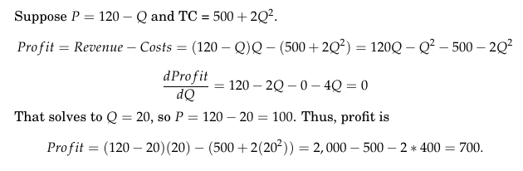
Maximizing Profit

Slide 9
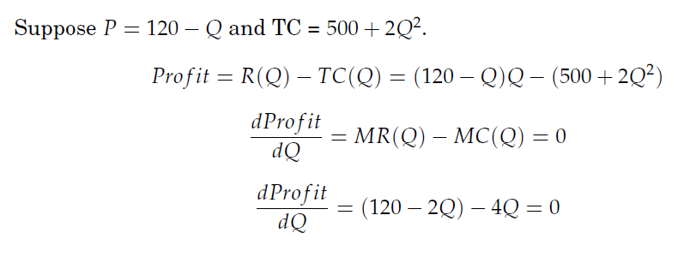
MR = MC again

Slide 10
The Elasticity of Demand
How high the monopolist prices depends on how sensitive demand is to price.
The sensitivity of demand to price is called the Price Elasticity of Demand--- how much does the QUANTITY demanded stretch (change) when the price falls.
It is defined as the percentage change in Q resulting from a percentage change in P.
So if a 1% increase in P causes a 2% fall in Q, the elasticity is -2. This is more than 1 for 1, so we say it is ELASTIC.
If a 1% increase in P causes a 0.4% fall in Q, the elasticity is -0.4. This less than 1 for 1, so we say it is INELASTIC.

Slide 11

The Lerner Rule
MC =100, Elasticity = -2,
The Lerner Rule only applies if demand is elastic. What should the firm do if demand is inelastic?

Slide 12
IDEA OF THE DAY
Concentration is used as a rough guide to whether a merger is allowed.

Slide 13
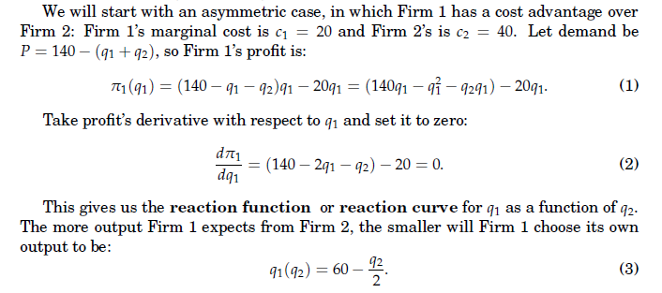
Cournot Duopoly
13

Slide 14
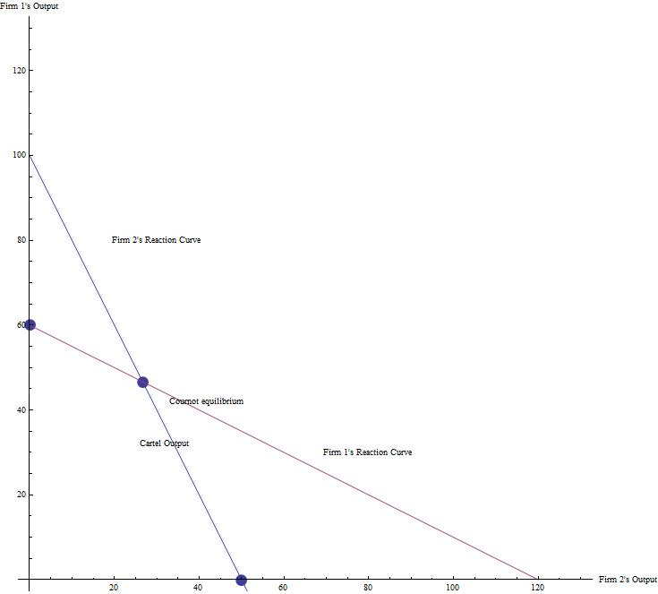

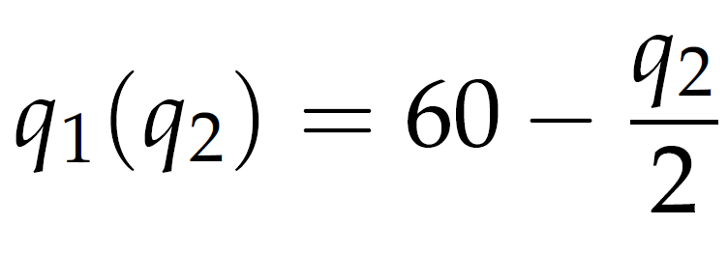

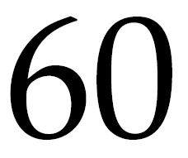



The Reaction Curve
14

Slide 15
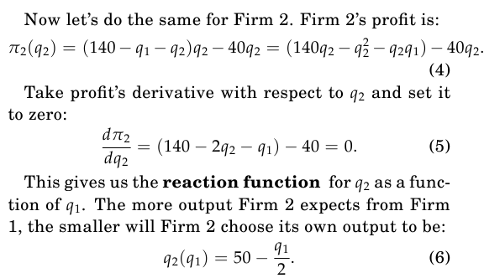
Firm 2
15

Slide 16
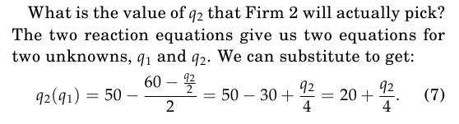
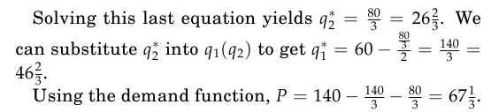
Equilibrium Output in Duopoly
16

Slide 17
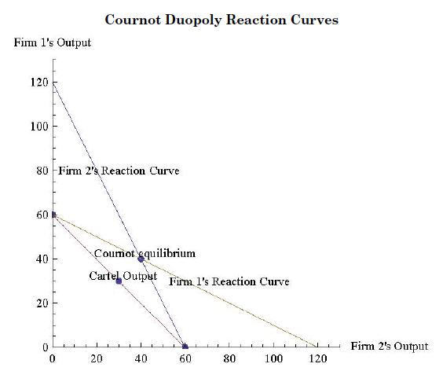
Symmetric Reaction Curves
17

Slide 18
N-Firm Outputs (identical
MC =20)

Slide 19
Measuring Market Power:
The Cellophane Fallacy
Why not just look at a company’s elasticity of demand to see how much market power it has?
DuPont said that it didn’t have market power for its product, cellophane (“plastic wrap”), because it competed against tin foil and wax paper. U.S. v. DuPont (the cellophane case) 351 U.S. 377 (1956). http://mysite.verizon.net/bowenjohnf/dup-celo.htm
DuPont had been charged with monopolization and won, but the court was wrong to conclude that it didn’t have market power. So: the current elasticity isn’t relevant--- it will ALWAYS be elastic.

Slide 20
Easy Case: Documents as Evidence
“St. Luke’s Hospital’s CEO told his board ProMedica would provide it with “incredible access to outstanding pricing on managed care agreements,” but “taking advantage of these strengths may not be the best thing for the community in the long run.”
A St. Luke’s board presentation said joining ProMedica “has the greatest potential for higher hospital rates. A ProMedica-SLH partnership would have a lot of negotiating clout.”
Notes of a St. Luke’s official said,
“ProMedica or Mercy [another area hospital system] affiliation could still stick it to employers, that is, to continue forcing high rates on employers and insurance companies.”
2016: appeals over, 2010 merger starts unwinding)

Slide 21
The Herfindahl Index
The 4-firm concentration ratio is the market share of the top four firms in the market.
The Herfindahl index is the sum of the squares of all the firms in the market.
Thus, if there are two firms, the Herfindahl is…. what? (see the next slide)
How about if there is just one firm?
How about if there are five identical firms?

Slide 22
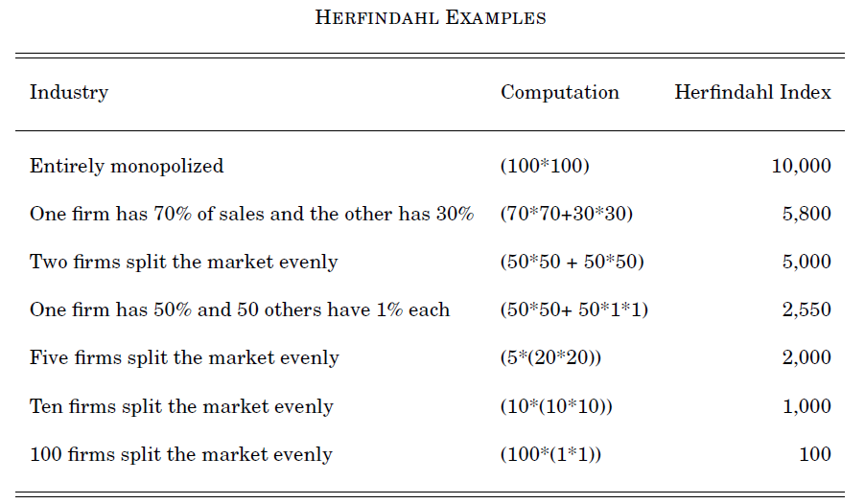
The Herfindahl Index—Examples
22

Slide 23
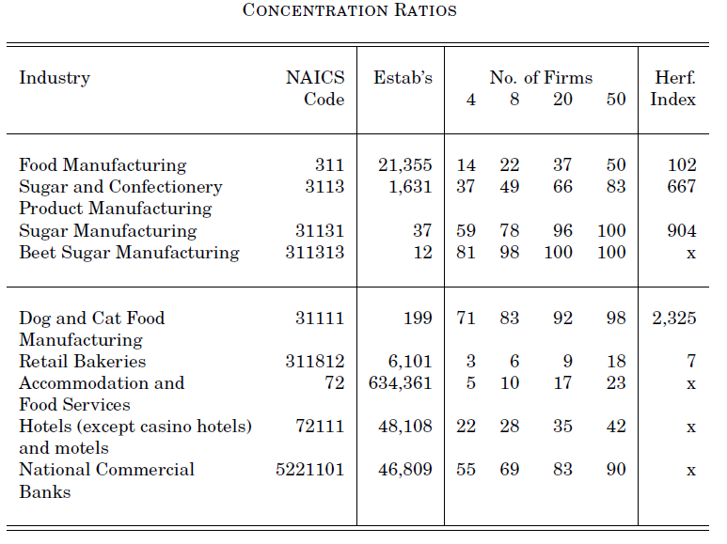
Actual Concentration (“nakes” codes)

Slide 24
Antitrust Law: Thales, the First Philosopher
“Thales, so the story goes, because of his poverty was taunted with the uselessness of philosophy; but from his knowledge of astronomy he had observed while it was still winter that there was going to be a large crop of olives, so he raised a small sum of money and paid round deposits for the whole of the olive-presses in Miletus and Chios, which he hired at a low rent as nobody was running him up; and when the season arrived, there was a sudden demand for a number of presses at the same time, and by letting them out on what terms he liked he realized a large sum of money, so proving that it is easy for philosophers to be rich if they choose, but this is not what they care about. Thales then is reported to have thus displayed his wisdom, but as a matter of fact this device of taking an opportunity to secure a monopoly is a universal principle of business; hence even some states have recourse to this plan as a method of raising revenue when short of funds: they introduce a monopoly of marketable goods.” (Aristotle, Politics)

Slide 25
More Greek Policy:
The Man of Sicily
“There was a man in Sicily who used a sum of money deposited with him to buy up all the iron from the iron mines, and afterwards when the dealers came from the trading-centers he was the only seller, though he did not greatly raise the price, but all the same he made a profit of a hundred talents on his capital of fifty.
When Dionysius came to know of it he ordered the man to take his money with him but clear out of Syracuse on the spot, since he was inventing means of profit detrimental to the tyrant's own affairs.”
http://www.perseus.tufts.edu/hopper/text?doc=Perseus:text:1999.01.0058:book=1:section=1259a&highlight=thales Aristotle Politics, 1.1259a

Slide 26
Losses from Monopoly
1. Restricting output creates triangle losses. The seller gains surplus, but only by reducing the buyer’s surplus more.
2. Since there is profit from monopolizing, people will exert effort to get it. This rent-seeking loss can be bigger than the triangle loss.
3. A monopolist also may be unable to take full advantage of its market because it lacks talents or techniques other people have. Thus there can be technological inefficiency. Poor information prevents an entrepreneur from being able to sell his ideas to the monopolist, but if he could enter himself, he’d do so.
Notes:
Drop this slide

Slide 27
Courts have long refused to enforce “contracts against public policy”, which include cartel contracts
“It recites an oral partnership between the defendant and the plaintiff, who was 'skilled in dealing in several sorts of commodities;' and that the parties had 'proceeded jointly in the said dealings with good success on Hounslow Heath, where they dealt with a gentleman for a gold watch' ... Further recitals show how the parties accordingly 'dealt with several gentlemen for divers watches, rings, swords, canes, hats, cloaks, horses, bridles, saddles, and other things to the value of 200 pounds... and that the defendant would not come to a fair account with the plaintiff touching and concerning the said partnership.” Everet v. Williams (1725)
http://www.hosteny.com/funcases/highwayman.html

Slide 28
“The Highwaymen’s Case”
“Whereas, by an order of this Court, made the 29th day of November last, the tipstaff was ordered to take into his custody and bring into this Court William White and William Wreathock the plaintiff's solicitors in this cause --- reflecting upon the honour and dignity of this Court; ... this Court upon consideration had of the premises, doth fine the said William White 50 pounds, and the said William Wreathock 50 pounds, and commit them to the custody of the Warden of the Fleet until they pay the said fynes.”
The defendant was executed 2 years later, and the plaintiff 5 years later.

Slide 29
The Sherman Act
Section 1: Price Fixing
“Every contract, combination in the form of trust or otherwise, or conspiracy, in restraint of trade or commerce among the several States, or with foreign nations, is declared to be illegal. Every person who shall make any contract or engage in any combination or conspiracy hereby declared to be illegal shall be deemed guilty of a felony, and, on conviction thereof, shall be punished by a fine not exceeding $100,000,000 if a corporation, or, if any other person, $1,000,000, or by imprisonment not exceeding 10 years, or by both said punishments, in the discretion of the court.” (U.S.C. Title 15, Chapter 1, §1) (1890, but amended since then)

Slide 30
Sherman Act
Section 2: Monopolizing
“Every person who shall monopolize, or attempt to monopolize, or combine or conspire with any other person or persons, to monopolize any part of the trade or commerce among the several States, or with foreign nations, shall be deemed guilty of a felony, and, on conviction thereof, shall be punished by a fine not exceeding $100,000,000 if a corporation, or, if any other person, $1,000,000, or by imprisonment not exceeding 10 years, or by both said punishments, in the discretion of the court.” (U.S.C. Title 15, Chapter 1, §2)
What “monopolize” means is left unclear. It must be interpreted by executive branch policy and the courts.

Slide 31
Antitrust law does not make monopoly illegal
Rather, it makes monopolizing illegal.
If a company grows to dominate its industry because it has low costs or good products, that is perfectly legal.
Also, a firm can restrict its output by following the
MR(Q) = MC(Q) rule and that is legal too.
There is still market failure, but the potential for government failure is too great to make a law against mere size or pricing a good idea.

Slide 32
Price Fixing
The two most common kinds of illegal monopolizing cases involve:
industries for homogeneous products that have few sellers,
https://www.youtube.com/watch?v=E21YYoxRs5g(Lysine cartel video)
(b) bidders in auctions, whether auctions to sell objects where the high bid wins or auctions for procurement contracts where the low bid wins.

Slide 33
IDEA OF THE DAY
Being a monopoly is legal, but not monopoly-creating mergers, and not price fixing.

Slide 34
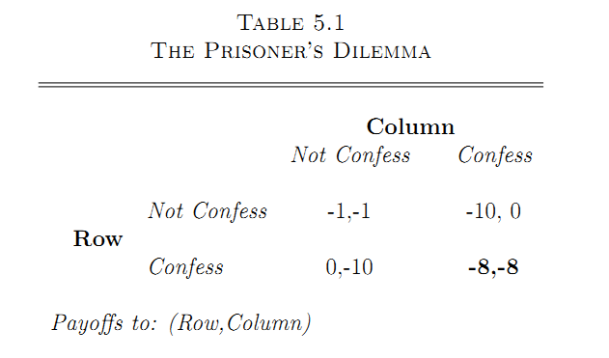
Prisoner’s Dilemma

Slide 35
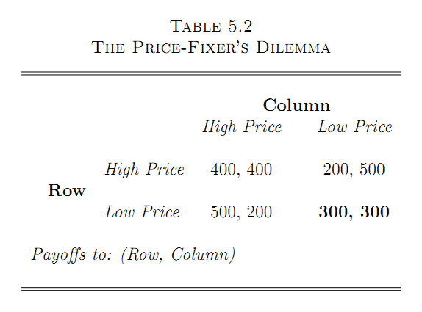
Price-Fixer’s Dilemma

Slide 36
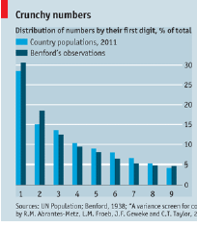
Example of conduct to be stopped: “The Scam Busters,” The Economist (2012).
Benford’s law, 1938. Leading digits (e.g., “3” in 3,259) are not distributed evenly. They follow a pattern: “1” is the most common and “9” is the rarest.
In a 2011 paper Rosa Abrantes-Metz of New York University’s Stern School of Business and Sofia Villas-Boas and George Judge of the University of California, Berkeley, examined LIBOR data over rolling six-month windows, and found that LIBOR was far likelier than another benchmark interest rate to depart from Benford patterns.

Slide 37
Another Example: “Global Cartels Fixed Display Prices for a Decade, EU Finds,” WSJ
Senior executives met in "green meetings,“ called that because they were regularly followed by rounds of golf. They mostly met in Japan and Indonesia.
Details were worked out by subordinates during regular "glass meetings," the "engine room of the cartel," in cities such as Paris and Hong Kong.
“Because of the success of the glass meeting, everybody has been enjoying business this year," according to a document uncovered in the investigation. Another document urged other members to "keep it a secret, as it would be serious damage if it is open to customers and European Commission.”
There was “a sophisticated system of monitoring each cartel participants' behavior.”
Taiwan’s Chunghwa Picture Tubes received immunity from the €17 million fine. Philips and Samsung received reductions in their fines for cooperating

Slide 38
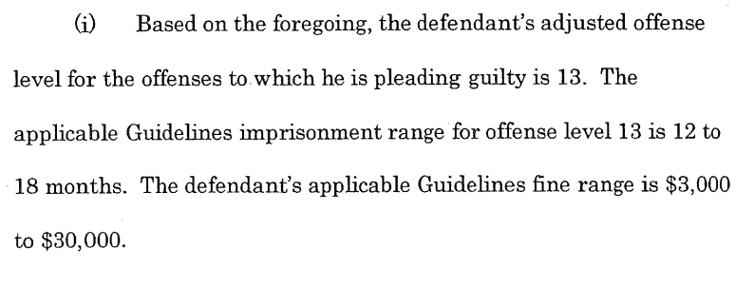
“Georgia Real Estate Investors Plead Guilty to Bid Rigging and Fraud at Public Foreclosure Auctions,”
Department of Justice (2015).
Mohammad Adeel Yoonas and Kevin Shin: “conspired with others not to bid against one another, but instead designated a winning bidder to obtain selected properties at public real estate foreclosure auctions in Gwinnett County, Georgia. ... to divert money to coconspirators that would have gone to mortgage holders, homeowners and others by holding second, private auctions open only to members of the conspiracy.”
http://www.justice.gov/file/336266/download

Slide 39
Criminal Enforcement
The first way the antitrust laws are enforced is the same way as most federal laws are enforced: by the Department of Justice.
One division of the Justice Department is the Antitrust Division, which has economists and lawyers ready to help FBI agents to find and prosecute violations of the Sherman and Clayton Acts.
The accused must be found guilty "beyond a reasonable doubt,” and may be punished with prison time. The reasonable doubt standard is a high hurdle.

Slide 40
Civil Suits: Justice Dept. or
The Federal Trade Commission
A civil action can result in fines, and also in orders from the court called injunctions that can call for the firm to have special government oversight, to cease some business practice, or even to split up into smaller firms.
The burden of proof is “more likely than not”.
Or, the government and the firm may settle a suit by a consent decree, an agreement enforced by the court under which the firm agrees to behave in a certain way.

Slide 41
Private Civil Suits
Someone who is injured by illegal behavior can sue for damages. In the case of anti-trust violations, they can sue
for TREBLE DAMAGES. Government cases are often
followed by private cases by the victims.

Slide 42
Government Design
Each of the three enforcers— the Justice Department, the FTC, and private parties— has different incentives. The Justice Department is headed by the Attorney-General, who is appointed by the President and who can be fired by him.
The Federal Trade Commission was set up by Congress as an “independent agency.” Although its five members are appointed by the President, they cannot be fired by him, and their seven-year terms are staggered so that when the Presidency changes parties, the President inherits the old Commission members.

Slide 43


Slide 44
An Indiana Cement Conspiracy
Gus B. (Butch) Nuckols of Builders Concrete and Supply Co. from Fishers, Indiana, conspired with another company, IMI, to fix cement prices from 2000 till 2004.
The FBI found that meetings were held at the Nuckols horse barn in Fishers to discuss price, discounts, and conditions of sale, as well as during phone calls and other meetings.

Slide 45
An Indiana Cement Conspiracy,Continued
IMI made $225 million from the conspiracy. In a plea bargain, Nuckols assisted the government, turning on his co-conspirators, but received a $50,000 fine and 14 months prison anyway, and his company was fined $4 million.
Four executives of IMI pled guilty, received fines of one to two hundred thousand dollars, and went to jail for 5 months. The company itself was fined $29 million. Since cement is so heavy, competition tends to be local, and it takes some time for high profits to attract new entrants.

Slide 46
The Clayton Act of 1914
Since “monopolizing” is a vague term, the Clayton Act was passed to try to pin down monopolizing practices more clearly. It addressed activities that might or might not be monopolizing:
- Exclusive dealing contracts,
- Tying contracts, bundling products
- Very low prices (predatory pricing)

Slide 47
Per Se vs. Rule of Reason
Sherman Act Section 1 violations are per se illegal, meaning that they are illegal even if they do not cause any harm. If two gas stations agree on a minimum price, they violate Section 1 even if they can show that there are many other competing gas stations and they did not hurt any consumers.
Section 2 violations are subject to the rule of reason: if the defendant can show that his actions were not really intended to monopolize or did not have a bad effect, he can escape punishment.

Slide 48
Labor Markets
A major purpose of the Clayton Act was actually to reduce competition in one area of the economy: labor markets.
“Nothing contained in the antitrust laws shall be construed to forbid the existence and operation of labor, agricultural, or horticultural or­ganizations, instituted for the purposes of mutual help, and not having capital stock or conducted for profit.” (15 U.S.C. §17)

Slide 49
The Clayton Act on Mergers
No person . . . shall acquire, directly or indirectly, the whole or any part of the stock or other share capital and no person. . . shall acquire the whole or any part of the assets of another person . . . where. . . in any activity affecting commerce in any section of the country, the effect of such acquisition may be substantially to lessen competition, or to tend to create a monopoly.

Slide 50
EU Antitrust Law
Article 101 of the Treaty on the Functioning of the European Union prohibits cartels and other “concerted practices,” (it is like Sherman Act’s Section 1.)
Article 102 is like the Sherman Act’s Section 2: “Any abuse by one or more undertakings of a dominant position within the common market... shall be prohibited as incompatible with the common market insofar as it may affect trade between Member States.”
2004 regulations say that the Competition Commissioner can block any mergers which “significantly impede effective competition.”

Slide 51
EU Administration I
EU antitrust policy is administered by the Competition Commissioner, one of 27 commissioners of the European Commission.
He is appointed by the Council of the European Union (informally, the Council of Ministers) which is composed of one representative of each EU country.
In addition, member countries continue to have their own antitrust agencies.

Slide 52
EU Administration II
The European Union’s main legislative branch is the European Parliament, which is elected directly by voters according to a country’s population.
EU directives are rules which member countries are supposed to implement by passing their own national laws and regulations in accord with the rule. EU regulations are rules which take effect immediately and bind every member country (note that "regulation" has a particular legal meaning here, contrasting with directives). The European Parliament does not make antitrust law: the Competition Commissioner does.

Slide 53
A major American law firm advised its client:
“ It is important, therefore, for companies making sales in Germany to follow the development of this law, since,... the law could make illegal any loss leader or other below cost sales... The focus of the German statute is more on the protection of smaller German businesses than on consumer welfare, and thus the actual competitive impact of the below cost pricing, and its impact on consumers, can be outweighed in the FCOs analysis by the potential for harm to small German businesses.
This is very different from US and EC law which are principally concerned with the protection of competition, not competitors and thus generally view low prices, even below cost prices, as pro-competitive and pro-consumer...”

Slide 54
“Horizontal Merger Guidelines”
The “Horizontal Merger Guidelines,” were issued in 2010 for horizontal mergers, mergers between firms selling competing products (replacing earlier guidelines from 1992). Another memo, “Non-Horizontal Merger Guidelines,” not revised since 1984, covers vertical mergers and conglomerate mergers.
These went through notice-and-comment.

Slide 55
Three Types of Markets
• Unconcentrated HHI below 1,500
100 firms with 1% each: H=100.
• Moderately Concentrated HHI between 1,500 and 2,500
10,10,20,20,20,20 so H=1,800.
• Highly Concentrated HHI above 2,500
30,30,30,10 so H=2,800.

Slide 56
CHANGES IN CONCENTRATION:
Government Definitions
1. Small Change in Concentration:
An increase of less than 100 is OK almost always.
2. Unconcentrated Markets: (< 1,500)
OK almost always if the post-merger HHI is less than 1,500.

Slide 57
CHANGES IN CONCENTRATION:
Government Definitions
3. Moderately Concentrated Markets: Ending with a moderately concentrated market from an increase of more than 100, “potentially raises significant competitive concerns and often warrants scrutiny.” (1,500-2,500)
4a. Highly Concentrated Markets: If the result is a highly concentrated market with an increase of 100-200, that “potentially raises significant competitive concerns and often warrants scrutiny.” > 2,500.
4b. Increasing HHI by more than 200 and resulting in a highly concentrated market “will be presumed to be likely to enhance market power.”

Slide 58
Ten firms split the market evenly.
Can two firms merge?
What is the original concentration?
What would be the new concentration?
How big would the change be?
Will the merger be investigated?

Slide 59
Ten firms split evenly: Can 3 Merge?
Can three firms merge?
What is the original concentration?
What would be the new concentration?
How big would the change be?
Will the merger be investigated?

Slide 60
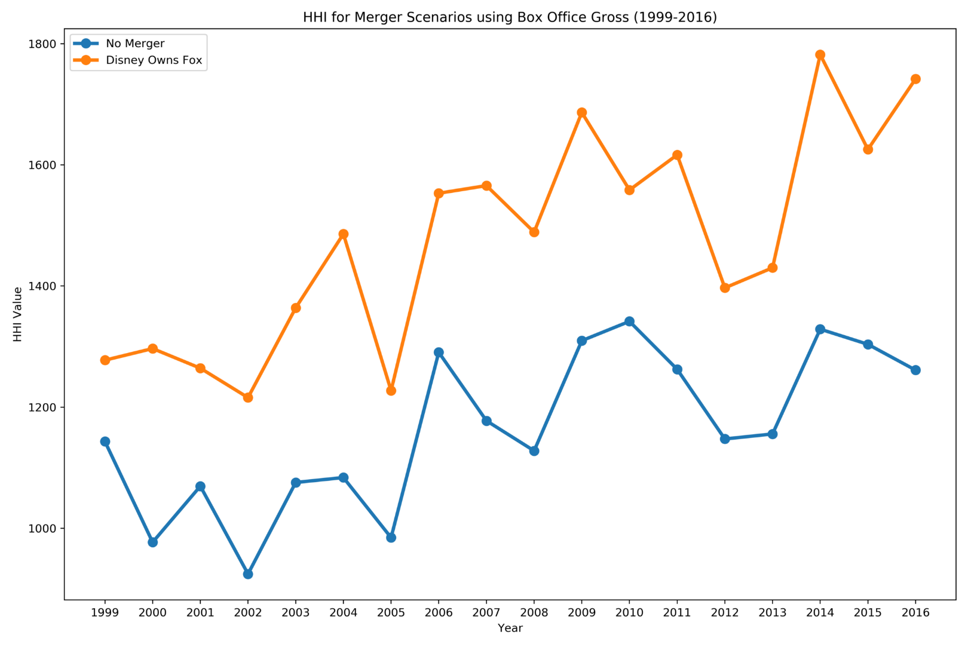
The Disney-Fox Merger (2019)
https://medium.com/@waldoch/herfindahl-hirschman-at-the-movies-b0430acf7cee

Slide 61
ATT Merger with T-Mobile
This was proposed in 2011. ATT agreed to buy
T-Mobile for $39 billion, and if the deal fell through to give T-Mobile $3 billion plus another $3 billion in spectrum and a roaming agreement.
ATT said it could upgrade its network and improve its notoriously spotty service in places such as Manhattan. It said T-Mobile could not survive on its own.
Deutsche Telecom, its owner, wants to sell it.
Wireless prices dropped 50% 1999-2009, despite other mergers.

Slide 62
Some Previous Mergers
ATT - Centennial (2009) 7 of 24 suspect markets divested
Verizon - ALLTELL (2008) 105 of 218
ATT - Cingular (2005) $46 billion 30 of 270
Sprint - Nextel (2004) $41 billion. 0 of 190

Slide 63
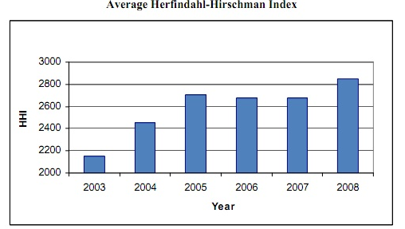
The Telecom Herfindahl
The HHI (Herfindahl) would rise by at least 600 points after the ATT merger with T-Mobile.

Slide 64
Local Markets
New York City: 44% of market, H = 3,335, up 951.
Chicago: 48%, H = 3,189, up 1,114
Seattle: 53%, H = 4,044, up 1,366.
In all top 40 markets, the Herfindahl would rise by more than 200.
“It’s only a slight overstatement to say that if they weren’t going to block this one, the Justice Department might as well just throw the antitrust guidelines out the window,” said Herbert Hovenkamp, “This merger clearly seems to violate them.”

Slide 65
Other Concerns
T-Mobile was known to be a maverick, a competitor on the price dimension. Internal T-Mobile and ATT documents showed ATT saw this as a threat, and T-Mobile as its strength.
Could T-Mobile survive without a merger?

Slide 66
Sprint Merger with T-Mobile (2020)
In 2020, Sprint and T-Mobile merged to have 38% market share, increasing the HHI from 2,507 to 3,186, an increase of 679. In Los Angeles and New York it would rise to 4,158 and 4,284.
But could Sprint survive on its own? That’s the big question.
Verizon’s stock price went up at news of the merger, but ATT’s didn’t change.
The Justice Dept. allowed the merger, after some divestiture to Dish. A group of state attorney-generals sued to block the merger, but lost in 2020.
https://www.rcrwireless.com/20200218/wireless/insights-from-the-sprint-t-mobile-us-merger-ruling-part-2

Slide 67
Other Antitrust Examples
(won’t cover in G406)

Slide 68
The Anthem-Cigna Blocked Merger (2017)
There are four big health insurance companies, including Anthem and Cigna.
Many of the Blue-Cross Blue Shield Association companies are owned by Anthem (but not all).
The Blue rules allow Blue companies to compete against each other only with non-Blue brands, and limits them to 1/3 of their customers or revenue. Blues have exclusive service areas too. Since 1945, insurance of all kinds has been exempt from federal antitrust law, except for mergers. They do have state regulation.
Justice Department slides for their opening statement (I’ll go over this in class):
https://www.justice.gov/atr/case-document/file/912506/download
Good David Dranove article on the issues:
http://healthaffairs.org/blog/2017/09/05/the-anthem-cigna-merger-a-post-mortem/

Slide 69
Anthem’s defense
1. The market is not “national accounts” (companies with over 5,000 employees), because companies can use different insurers in different states.
2. Anthem’s market share should not be combined with the other “Blue” companies in the HHI.
3. Cigna is very innovative, and Anthem will become more innovative, helping consumers.
4. There is lots of potential and actual entry with the Obamacare “exchanges”.
5. Cigna will be able to use Anthem’s size to get bigger discounts from hospitals, saving $2 billion, and there will be administrative savings.
From the opinion at: https://www.justice.gov/atr/case-document/file/940946/download

Slide 70
The Judge Ruled against the Merger
The opinion is at:
https://www.justice.gov/atr/case-document/file/940946/download
“Anthem characterizes this scenario as a supply-side efficiency resulting from the merger, but it has not shown that there is anything about the mere combination of the carriers’ two pools of patients that will enable doctors or hospitals to treat patients more expeditiously or at a lower cost. Since the medical cost savings will not be accomplished by streamlining the two firms’ operations, creating a better product that neither carrier can offer alone, or even by enabling the providers to operate more efficiently, they do not represent any “efficiency” that will be introduced into the marketplace.”
See http://www.cnbc.com/2017/02/08/us-judge-blocks-merger-of-anthem-and-cigna.html $34 billion price for Cigna. $1.85 billion non-approval fee.

Slide 71
Anthem CEO Replaced
https://www.wsj.com/articles/anthem-confirms-joseph-swedish-to-step-down-as-ceo-1509968851
“Anthem Inc. CEO Joe Swedish will receive $4.5 million in annual salary as a senior adviser with the company after stepping down from his current position
Mr. Swedish, 66, would be leaving after his signature strategic effort, Anthem’s $48 billion bid to buyCigna Corp. , ran aground earlier this year. However, since the beginning of the year, Anthem shares have risen by 47%, along with strong results across the health-insurance sector and Anthem’s announced pullback from the Affordable Care Act ”

Slide 72
The Modified ABI-Modelo Merger
“A merger of the 39 percent market share of Anheuser-Busch InBev, also known as ABI, with Modelo’s brands, which account for 7 percent of the United States market, would put 46 percent of the market in one company’s hands.
That would essentially make the United States beer market a duopoly, because MillerCoors, the second-largest brewer of beer sold in the United States, controls 26 percent of the market. The next largest company would be Heineken USA at 6 percent...” (The New York Times)

Slide 73
The HHI of SBI-Modelo
“The U.S. beer industry is largely controlled by two big players: AB InBev, owner of Bud Light and Budweiser, and MillerCoors, maker of the Coors Light brand. Modelo, whose Corona is the best-selling imported beer in the U.S., runs a distant third, with 7% of U.S. beer sales, according to the Justice Department. Together, AB InBev and Modelo would control about 46% of U.S. sales.
The department said that when AB InBev raises beer prices, MillerCoors usually follows followed suit, while Modelo has been resistant. AB InBev internal documents "show that it is increasingly worried about the threat of high-end brands, such as Modelo's, constraining its ability to increase…pricing," the lawsuit said.” (WSJ)
HHI 1,570 from two → 2,116 from one, 546 increase.,
HHI: about 2,300, going to 2846.
The case settled, after ABI agreed to sell Modelo’s US operations to Constellation (Mondavi).

Slide 74
American, US Airways (2013)
“The combined company would surpass United Continental Holdings Inc. UAL -2.05% as the No. 1 carrier by traffic and control about one-quarter of U.S. domestic capacity.
But the deal involves only about a dozen overlapping routes, similar to the number in the most recent three big airline mergers, according to research by J.P. Morgan JPM -0.88% . Those transactions were cleared by the Justice Department, with the carriers in only one deal required to relinquish takeoff and landing slots to maintain competition.” WSJ 2013.
Justice sued, then settled.

Slide 75
A blocked merger:
U.S. v. H&R Block
WSJ, MAY 24, 2011 U.S. Sues to Stop H&R Block Deal for Rival
Business Week: H&R Block Antitrust Loss Is Win for U.S. Ahead of AT&T Trial November 16, 2011
U.S. v. H&R Block, 1:11-cv-00948. The docket and complaint. PACER: http://www.pacer.gov/findcase.html

Slide 76
“A Strike against Rent-Seeking,” George Will, The Washington Post (2014).
Kentucky law says a new moving company must obtain a “certificate of necessity,” issued if the applicant is “fit, willing and able properly to perform” moving services and can show that existing moving companies are “inadequate,” and that his moving service “is or will be required by the present or future public convenience and necessity.” He must put a notice in a newspaper to notify the public or email existing certificate holders.
“From 2007 to 2012, 39 Kentucky applications for CONs drew 114 protests — none from the general public, all from moving companies. Only three of the 39 persevered through the hearing gantlet; all three were denied CONs.”

Slide 77
Refrigerator Compressors
“The GE case follows a 2010 guilty plea by Embraco [= Whirlpool] and Panasonic Corp.6752.TO -1.76% to federal charges of fixing prices for refrigerator compressors from October 2004 to December 2007. The two companies agreed to pay $140.9 million in criminal fines.
GE's 79-page lawsuit claims the defendants met repeatedly over years to push prices for compressors higher than they would have been set by the market. One tactic, GE alleged, was to coordinate on a bargaining strategy that involved coming in with a high price increase and then agreeing to reduce it slightly.
GE claims the companies agreed at a 2004 meeting in Joinville, Brazil, to announce a global price increase of 8% to 10%, with the aim of negotiating a 6% increase.”
“GE Sues Whirlpool on Cartel” WSJ 2013. 2016: https://www.law360.com/articles/854422/ge-s-danfoss-claims-tossed-in-compressor-cartel-mdl (GE suit dismissed, no privity)
77

