Slide 1
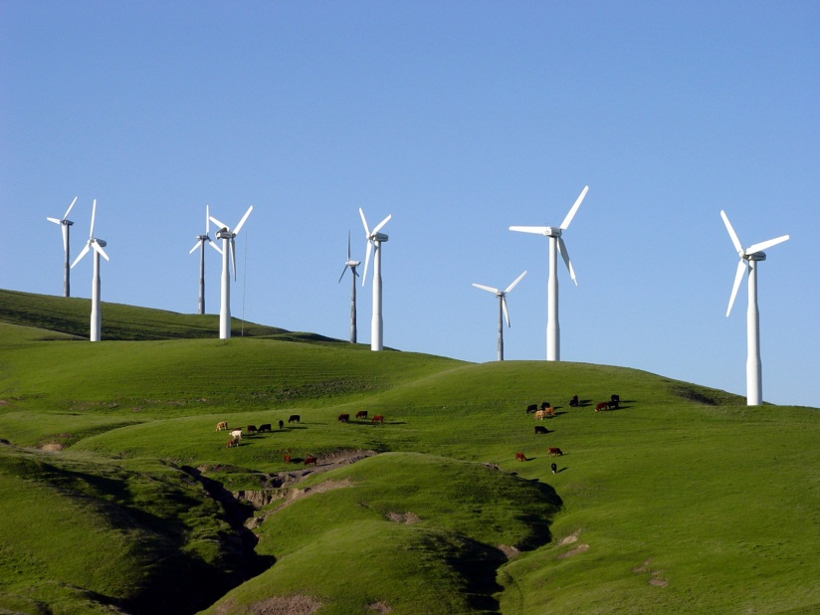
9- Natural Monopoly

Slide 2
IDEA OF THE DAY
With strong economies of scale or network externalities, perfect competition is infeasible and the industry is a “natural monopoly”.

Slide 3
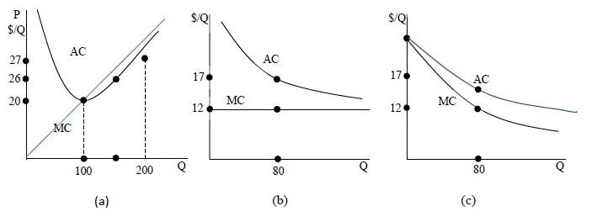
Natural Monopoly

Slide 4
The Companies
There are 3,273 power producers in the United States,
210 investor-owned
2,009 state and local,
9 Federal electric utilities,
883 rural electric cooperatives.
1,738 nonutility power producers,
38% of the gigawatt capacity is from investor-owned utilities, 9% state-and-local, 7% federal, 4% cooperatives, and 42% nonutilities.

Slide 5
Solutions to Natural Monopoly
1. Just let it be an unregulated monopoly.
2. The government sells a license to be the unregulated monopoly in that industry.
3. Government ownership
4. Marginal-cost pricing plus a subsidy
5. Price caps
6. Average-cost pricing

Slide 6
Laissez Faire

Slide 7
Franchise bidding
Franchise bidding: sell the right to be the monopoly by auction. If all potential companies had the same costs, they would all bid amount 80($20-$10)-$300 = $500.
A variant on this is to have each company's bid take the form of the price it would charge for electricity.
7

Slide 8
Government Ownership
Perhaps costs will be higher than for a private company, but the government enterprise at least could set the price equal to marginal cost, and cover the resulting losses (since P < AC in that case) using revenue from income taxes. The price would be $10 and the subsidy would equal area ($11-$10)(160) = $160.
8

Slide 9
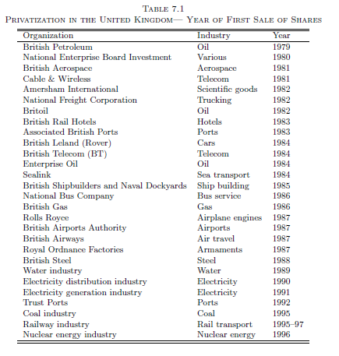
Privatization
9

Slide 10
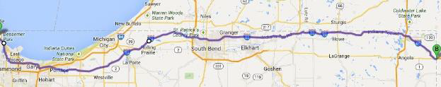
Indiana Toll Road Privatization
“ITRCC has operated the 157-mile toll road since 2006, when it paid $3.8 billion in cash to obtain a 75-year lease concession from the Indiana Finance Authority, a state agency. Opened in 1956, the toll road, part of Interstate 80/90 (Figure 1), had previously been operated by the state.
Bankruptcy was precipitated by much lower traffic than expected and unfavorable interest rate swaps that added to the company's debt. Primarily because of the severe economic recession which began in 2007, but also possibly because the company raised toll rates on trucks, traffic was almost 11% lower in 2013 than it was in 2007. In 2013, ITRCC paid $193 million to service its debt while revenue was only $158 million.”
After bankruptcy, the company was bought by an Australian company in 2015. Creditors recovered 95 cents on the dollar.
http://www.wsj.com/articles/indiana-toll-road-exits-bankruptcy-protection-1432907793
10

Slide 11
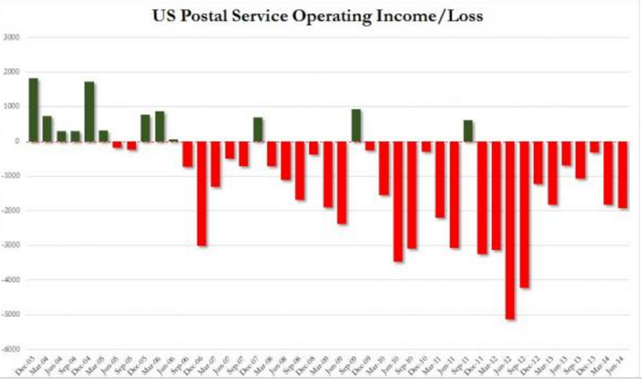
The Post Office
Is postal service a natural monopoly? Has this always been true?
The U.S. Postal Service is a government agency
The Postmaster-general 2000-2016. at least always been someone who spent his entire career with the post office, starting from a bottom-level job. The position is the second-highest paid in the U.S. government, after the President (but it is very low for the CEO of a big organization---around $250,000). It runs a deficit, but it just goes deeper into debt. Congress does impose a borrowing limit each year. The union is very strong.
11

Slide 12
Marginal Cost + Subsidy
Require P = 10.
Pay the firm an annual subsidy.
12

Slide 13
Average-Cost Pricing
Require the firm to sell at a price of 12, so
P = AC.
This is also called rate-of-return regulation.
Price-cap regulation is also a form of this.
13

Slide 14
IDEA OF THE DAY
In rate-of-return regulation, the regulator must decide the company’s cost of capital and whether all of its spending was necessary.

Slide 15
Price-Cap Regulation
Price-cap regulation is now common for electricity and phone service. The regulators set an initial price, which then rises at the inflation rate minus an “X-factor”. The X-factor is intended to reflect the fact that costs of providing utilities rises less than the general inflation rate. Thus, if the
X-factor is 3% and inflation is 4%, the utility could increase its price by 1% that year (= 4 - 3). If inflation is 2% the next year, then that year the utility must reduce its price by 1% (= 2 - 3).
It’s really just rate of return regulation with pre-set review timing.
15

Slide 16

Rate-of-Return Regulation
Go to: http://rasmusen.org/g406/slides/09ramsey.xls
16

Slide 17
A NIPSCO Rate Case
Northern Indiana Public Service Company (NIPSCO) sells electricity and natural gas in northern Indiana. It has 460,000 customers. Though only 1% of its customers are industrial, they buy 53% of the electricity. You cannot buy stock in just NIPSCO, because it is owned by a holding company, NiSource, which also owns utilities in other states.
NIPSCO is regulated by the Indiana Utility Regulatory Commission (IURC).
Its electricity rates had last been set in 1987.
In June 2008 it proposed an increase.
17

Slide 18
The Indiana Utility
Regulatory Commission
Stefanie Krevda. 2018. Commission external affairs staffer. Education nonprofit staffer. Chief of staff, state personnel dept.
Sarah Freeman. 2016. Indiana Legislative Services Agency,
Indiana Attorney-General’s office.
David Ober. 2018. Elkhart state representative. Chairman of Energy, Utilities, Telecom committee.
Chairman Jim Huston, 2014. Chief of Staff at the Indiana State Department of Health. During Governor Mitch Daniels' administration he served as Executive Director of the Office of Faith Based and Community Initiatives. BMV. Congressional aide.
David E. Ziegner, 1990. Senior staff attorney for the Legislative Services Agency, General Counsel for the Commission.
18

Slide 19
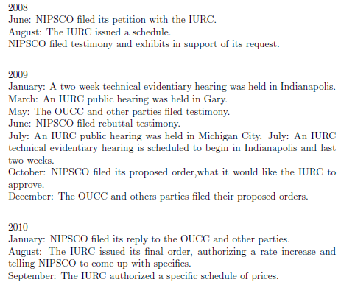
A Rate Case’s Timeline
19

Slide 20
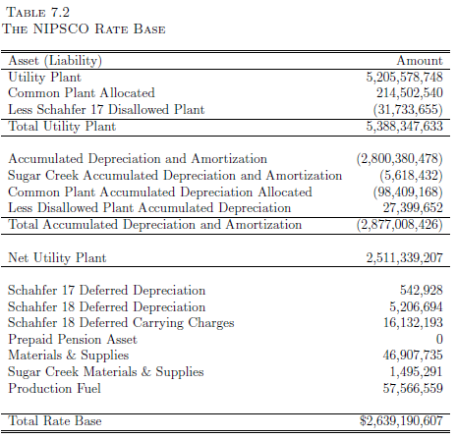
NIPSCO’s Rate Base
20

Slide 21
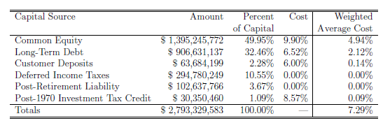
NIPSCO’s Cost of Capital
21

Slide 22
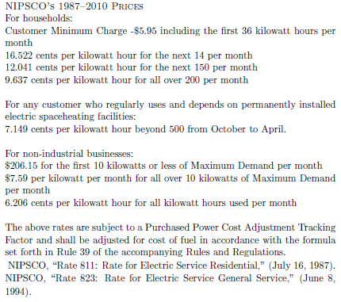
NIPSCO’s Prices
22
http://www.nipsco.com/en/our-services/green-power-rate.aspx

Slide 23
Generation (but not the retail transmission lines) Has Been Deregulated in Some States
23
The US Electricity Industry After 20 Years of Restructuring ...
Severin Borenstein^{1,3} and James Bushnell²

Slide 24
Even Retailing Has Been Deregulated in Some States
24
The US Electricity Industry After 20 Years of Restructuring ...
Severin Borenstein^{1,3} and James Bushnell²

Slide 25
IDEA OF THE DAY
When prices must be raised to cover fixed costs, wealth maximization says we should raise prices on inelastically demanded goods more.

Slide 26
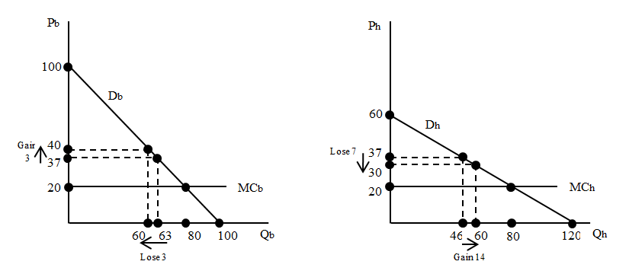
Ramsey Pricing Diagram I
Price is 37 in
both markets
to start with.
FC = 1800
Net Revenue = (37-20)*63 = 1,071
DWL = .5(80-63)*(37-20) = 144.50
Net Revenue = (37-20)*46 = 736
DWL = .5(80-46)*(37-20) = 289
26

Slide 27
Ramsey Pricing Diagram
If prices are equal (both 37):
Net Revenue = 1,071
DWL = 144.50
If prices are equal:
Net Revenue = 736
DWL = 289
FC=1800
P_{b} = 40
Net Revenue = (40-20)*60 = 1,200
DWL = .5(80-60)*(40-20) = 200
P_{h} = 30
Net Revenue = (30-20)*60 = 600
DWL = .5(80-60)*(30-20) = 100
27

Slide 28
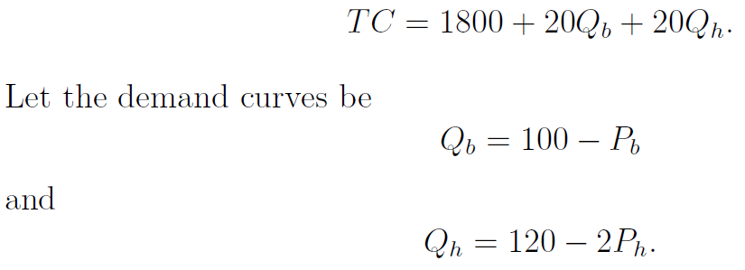

Ramsey Pricing-- Elasticities
What are the elasticities
for business and home
demand at various prices?
28

Slide 29


Q_{b} = 100 - P_{b}, Q_{h} = 120 - 2P_{h}
P_{b} = 37, Q_{b} = 63
P_{h} = 37, Q_{h} = 46
P_{b} = 40, Q_{b} = 60
P_{h} = 30, Q_{h} = 60
29

Slide 30

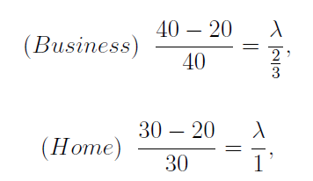
The Ramsey Pricing Rule
30

Slide 31
The Ramsey Pricing Rule
31

Slide 32
Setting Tuition at a School
A private school I know has 9 grade school grades and 4 high school grades. It is a nonprofit that ordinarily is funded 90% by tuition and 10% by donations. The tuition is $4,500 for the grade school $5,500 for the high school. Grade school class sizes are 18, close to the maximum of 22 that school policy permits. High school class sizes are 9. Quite a few students leave for the public schools after 8th grade.
Admission is nonselective; very few applicants are turned away. Many students get financial aid, which the school budgets at $75,000/year, or Indiana government voucher aid, depending on family income. All these figures are rough, for illustration use only. Grade and high school teachers receive the same salaries. The budget is balanced, under the assumption that $80,000 will be raised from donations and that average tuition will rise by 5%, which is $225 for grade school and $275 for high school.
You can deduce from this that the grade school is profitable and the high school is unprofitable. As a matter of policy, the Board wishes to keep the high school going even though it has to be subsidized. It also would like to enroll more students if possible and it MUST balance the budget.
Should both grade and high school tuition rise by 5%?
32

Slide 33
Pricing I –Elasticities of Demand
This is a Ramsey pricing problem: price two goods so as to achieve a certain budget target. That means the data needed to answer it is marginal cost, the budget target, and the demand elasticities.
We don’t know the demand elasticities for grade school and high school classes. It may well be that high school demand is more elastic, since so many students leave after the 8th grade. Then the high school tuition should LOWER, not HIGHER. But the main reason for leaving is not money– it is sports teams, or the child wanting more freedom, or science labs. Maybe demand is not more elastic.
So let’s assume elasticities are the same for both products.
33

Slide 34
Pricing II
How about marginal cost? It is high for grade school, because class size is near capacity. Adding an extra student will make the class a lot harder to manage. A kindergarten teacher tells us that a kindergarten class of over 18 is impossible to teach well. MC is very low for high school.
If elasticities are the same for products X and Y, and marginal cost is lower for product X, then product X should be priced lower.
Thus, high school tuition should not be higher than grade school tuition, as it is now: it should be lower.
34

Slide 35
A Mispricing Mistake
Why, then, is high school tuition higher than grade school tuition?
Answer: so the price comes closer to average cost.
The average cost of a grade school class is much lower, because the fixed cost of the teacher is spread across 18 students instead of 9.
Thus, the instinct of people untrained in economics, especially if they are not in business jobs, is to charge more for high school.
35

