Slide 1
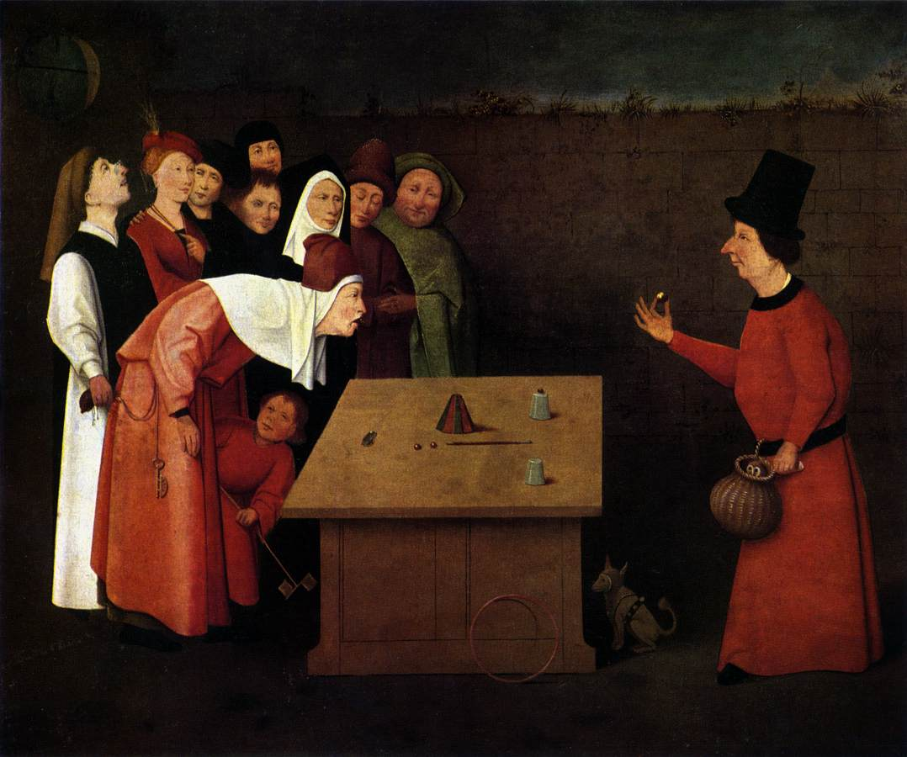
10: Information

Slide 2
Idea of the Day
If every consumer wants at least a minimum level X of quality or safety, then a government regulation requiring X raises surplus by saving on transaction costs.

Slide 3
IDEA OF THE DAY
Minimizing danger does not maximize surplus.

Slide 4
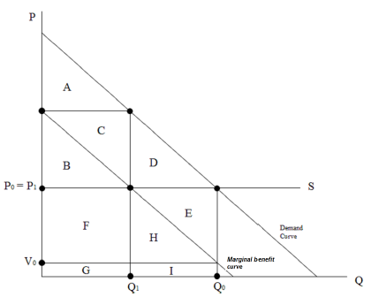
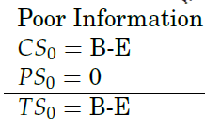
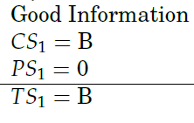
An Overvalued Product

Slide 5
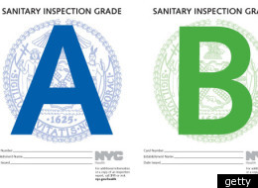
New York Restaurant Grades
But is an A
posted in the
window really a sign of a good
restaurant?

Slide 6
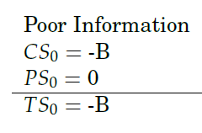
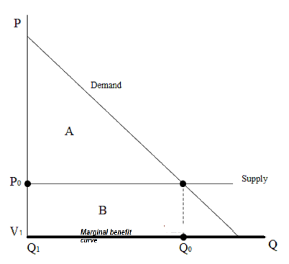
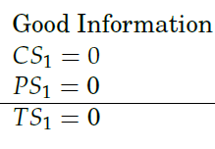
A Worthless Product

Slide 7
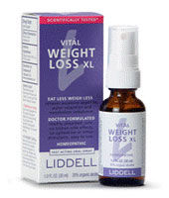
Homeopathic Weight Loss XL
“As Weight Loss XL amounts to just one fluid ounce to
last you 30 days, you are essentially putting a drop under
your tongue three times a day which contains little bits of:
Antimony, Honey bee (ground-up honey bee), Pepper extract,
Bladderwrack, Bedstraw extract, Garcinia hanburyi,
Witch hazel, Dried sheep/cow liver, Histamine dihydrochloride,
Strychnine nut extract, Dried sheep/cow pancreas, Parsley,
Northern whitecedar extract, Sheep thyroid gland,
Ginger root”

Slide 8
The Homeopathic Method
See Huffington Post Defense.
“Like cures like” (why?– no theory) Hahneman shivered
after he tried quinine while well.
Small quantities work as well or better than large (and
they’re much safer!), though they must be shaken vigorously.
The Water Memory theory.
It is “evidence-based medicine”– no theory, but they try
things out and use what works in experiments they call
“provings”. Regression to the mean. Beware of Big Data.

Slide 9
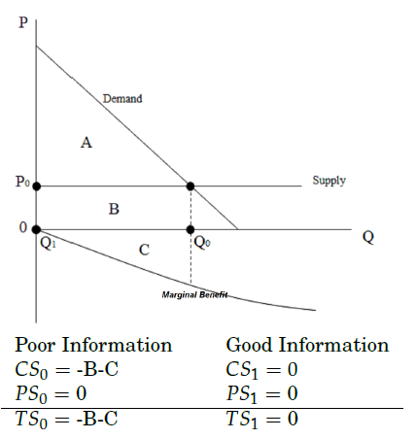
A Harmful Product

Slide 10
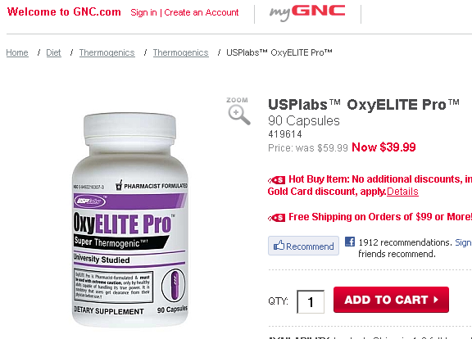
OxyElite Pro
This drug is banned
for athletes. It killed two soldiers.

Slide 11
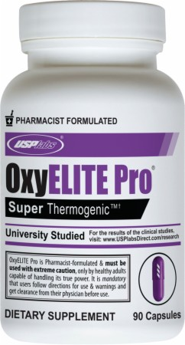
The Food Safety Modernization Act of 2011 allowed the FDA to crack down on this. Companies must provide evidence of reasonable expectation of of safety before they introduce a post-1994 ingredient.
OxyElite Pro Close-up

Slide 12
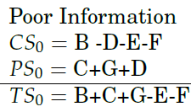
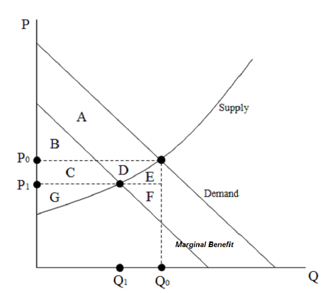
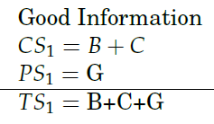
An Overvalued Product with Upward Sloping Supply

Slide 13
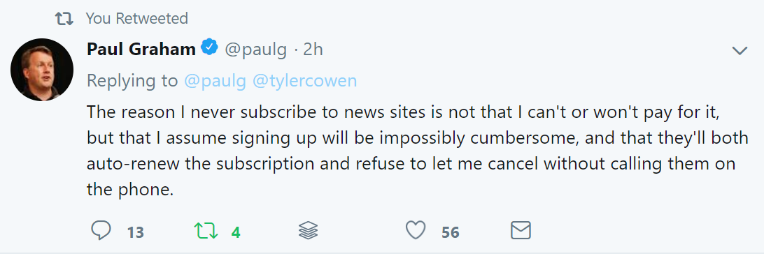
Markets Shrink

Slide 14
Solutions to Asymmetric Information
0. Tort or contract lawsuits.
1. Impose a minimum quality. Good if everyone would want to pay for at least that minimum quality.
2. Require truthfulness. This is always good, though defining “truth” is hard sometimes. “Best hamburger in the world” is mere puffery.
3. Require disclosure. Vitamin lists on cereal boxes.
4. Offer government information.
5. Require all sellers to be tested, and disclose that information.
6. Impose a default minimum quality, but let consumers opt out.
7. Rely on seller reputation.
8. Teach people that they should be honest as a moral duty.

Slide 15
Solution 0: Civil Suits (courts, not regulation)
The plaintiff brings suit against the defendant, asking the court to make the defendant pay him damages.
It’s a tort case if the allegation is that the defendant injured the plaintiff, a contract case if it’s the he broke a contract.
Either side can demand a jury trial. The jury uses “preponderance of the evidence” as a standard rather than “beyond a reasonable doubt,” and it only needs a majority vote, not unanimity.
In rare cases, the jury can add punitive damages. These are only for intentional or reckless harm, in tort cases.

Slide 16
Liability Rules
The negligence rule: Was the defendant ``negligent'' in causing or failing to prevent the injury, or was he taking enough care and should not be blamed for the harm? (The “Hand Rule”: take care if the cost of the care is less than the probability of the accident times its cost.
The comparative negligence rule: How negligent was the defendant compared to the plaintiff? If both are equally negligent, then the plaintiff would pay only 50% compensation.
The strict liability rule: The defendant must pay if he or his product caused the harm, even if he took all reasonable precautions.

Slide 17
Solution 1: Quality Standards
1. Impose a minimum quality. Good if everyone would want to pay for at least that minimum quality. Bad otherwise.
http://en.wikipedia.org/wiki/Bumper_(automobile)

Slide 18
FDA Article in American Spectator
Coming out of Phase I testing in 1998, the experimental drug Gleevec was “known beyond any reasonable doubt to be safe and effective.” The Alliance started requesting access to the drug for chronic myelogenous leukemia in June 2001. FDA did not approve Gleevec until March 2003, during which period approximately 3,600 patients had been denied access to the drug, with many dying. Of the few granted exceptions in small clinical trials by the FDA, more than 80% who received Gleevec were still alive at the time of the court case.”
“In 2014, nearly 25,000 people in France were using investigative treatments through that government’s equivalent program,” “If a country with one-fifth the population of the U.S. can help 2,000 percent more people, we clearly have a problem.”
“The FDA rejected the drug Eloxatin, for advanced colorectal cancer, in March 2000 despite its being approved in at least 29 other countries. In January 2002, the Alliance asked for reconsideration but the agency delayed approval until August, during which period about 40,000 such cancer sufferers died.”
But---Thalidomide (1957-61, Germany, 10000 birth defects. Not approved in US. No tests submitted to FDA. OK after 42 days of gestation. “

Slide 19
Two Types of Error
The null hypothesis: The new drug is unsafe.
Positive for deviation from null: it seems safe.
Negative for deviation from null: it seems unsafe.
Think of Hypothesis testing in Statistics and Econometrics
False Positive for safety
The FDA official says that a drug is has been shown to be safe, but it is unsafe.
False Negative for safety
The FDA official says a drug has been shown to be unsafe, but it is safe.
(Thalidomide, European sunscreen)
If you reduce one kind of error, you increase the other.
Which way would the FDA official tend to make his mistake?

Slide 20
Solution 2: Ban Lying
This is is always good, though defining “truth” is hard sometimes. “Best coffee in the world” is mere puffery. The Federal Trade Commission regulates truthfulness, as do laws against fraud.
See “The World’s Best Cup of Coffee” from the movie Elf.
https://www.youtube.com/watch?v=CUPDRnUWeBA

Slide 21
“FTC Bars Pom Juice’s Health Claims,”
ADS: a POM bottle with a noose around its neck, and the simple phrase: "Cheat death." It said the juice "can help prevent premature aging, heart disease, stroke, Alzheimer's, even cancer.
In 2010, the FTC sued POM to stop running the ads. In 2012, an administrative law judge agreed with the FTC.
POM promptly ran ads selectively quoting the judge's ruling: POM Wonderful is a "natural fruit product with health-promoting characteristics.“ FTC lawyers filed a motion to reopen and expand the complaint against POM to include those ads, but the commissioners denied the request.
2013: 5-0 ruling, FTC's commissioners barred POM Wonderful from asserting the juice is "effective in the diagnosis, cure, mitigation, treatment, or prevention of any disease, including heart disease, prostate cancer, and erectile dysfunction, unless the claim is supported by two randomized, well-controlled, human clinical trials."
2015. Appeals court says FTC is right, except one clinical trial is enough.

Slide 22
Solutions 3 and 4
3. Require disclosure.
Vitamin lists on cereal boxes. Silence is not good enough.
4. Offer government information.
How does the government provide information about cocaine?
One problem with this obvious solution is that there’s a transaction cost for people to read and understand the information. Another is that the government might be wrong, and might even lie.

Slide 23
Ultrasounds for Abortion
14 states require verbal counseling or written materials to include information on accessing ultrasound services.
25 states regulate the provision of ultrasound by abortion providers.
3 states mandate that an abortion provider perform an ultrasound on each woman seeking an abortion and requires the provider to show and describe the image.
10 states mandate that an abortion provider perform an ultrasound on each woman seeking an abortion, and require the provider to offer the woman the opportunity to view the image.
9 states require that a woman be provided with the opportunity to view an ultrasound image if her provider performs the procedure as part of the preparation for an abortion.
6 states require that a woman be provided with the opportunity to view an ultrasound image.

Slide 24
“When Trans Fats Were Healthy”
Unsaturated fats like Crisco and margarine used to be thought much healthier than animal saturated fats like lard and suet.
The Center for Science in the Public Interest “specifically criticized Taco Bell, Arby’s, Hardee’s, and Wendy’s for frying in beef fat and tropical oils (that is, coconut and palm oils). But it praised Burger King for switching to vegetable shortening in 1986, which it described as “a great boon to Americans’ arteries.” The guide also praised KFC, writing that the chain was “fortunately” frying in “partially saturated soybean oil . . . that is much less saturated than beef fat.” So all the fast food chains changed to using tranfats. “
But studies around 1990 showed that there was much stronger evidence that transfats (the most common unsatured fat) caused heart disease than the weak evidence against saturated fat The food industry commissioned a study in response, but it confirmed the other studies. Now even Crisco is made without transfat--- a different kind of vegetable fat is used.

Slide 25
“The Debate About GMO Safety Is Over, Thanks To A New Trillion-Meal Study,”
“Last year, in a survey by the Pew Research Center, 57 percent of Americans said it’s generally “unsafe to eat genetically modified foods.””
“Estimates of the numbers of meals consumed by feed animals since the
introduction of GM crops 18 years ago would number well into the trillions.
By common sense alone, if GE feed were causing unusual problems among
livestock, farmers would have noticed. Dead and sick animals would literally
litter farms around the world. Yet there are no anecdotal reports of such
mass health problems. “
Study: “There was no indication of any unusual trends in the health
of animals”
http://www.slate.com/articles/health_and_science/science/2015/07/are_gmos_safe_yes_the_case_against_them_is_full_of_fraud_lies_and_errors.html

Slide 26
Solutions 5 and 6
5. Require all sellers to be tested, and disclose that information.
http://www.safercar.gov/Vehicle+Shoppers/5-Star+Safety+Ratings/2011-Newer+Vehicles
6. Impose a default minimum quality, but let consumers opt out.
Medical and student records privacy. The default is secrecy, but the person can sign to let other people see the records.

Slide 27
Solution 7: Seller Reputation
Reputation helps cure the temptation to offer low quality. A seller with good reputation can charge more than marginal cost and make an economic profit. If he does, he earns positive economic profits which are a “hostage” that dies if he ever deviates to low quality.
The need for reputation makes it hard to enter such a market. Thus, if reputation is needed, that hurts innovation.

Slide 28
Solution 8: Morality
8. Teach people that they should be honest as a moral duty.
“The taste for well-being is the prominent and indelible feature of democratic times....The chief concern of religion is to purify, to regulate, and to restrain the excessive and exclusive taste for well-being that men feel in periods of equality; but it would be an error to attempt to overcome it completely or to eradicate it. Men cannot be cured of the love of riches, but they may be persuaded to enrich themselves by none but honest means.”
de Tocqueville, Democracy in America http://xroads.virginia.edu/~Hyper/DETOC/ch1_05.htm

Slide 29
Mill: Education and Higher Pleasures
[Of the higher pleasures]
Now it is an unquestionable fact that those who are equally acquainted with, and equally capable of appreciating and enjoying, both, do give a most marked preference to the manner of existence which employs their higher faculties.”
(John Stuart Mill, 1800’s utilitarian and writer of the leading economics text of the time)

Slide 30
Socrates and Swine
But what if you’re ignorant and happy? For example, if you’ve never listened to Beethoven and you’re happy with the pop music of the day?
Mill says,
“It is better to be a human being dissatisfied than a pig satisfied; better to be Socrates dissatisfied than a fool satisfied. And if the fool, or the pig, are of a different opinion, it is because they only know their own side of the question.
The other party to the comparison knows both sides.”

Slide 31
IDEA OF THE DAY
Paternalism can be justified by psychological mistakes and overdiscounting.

Slide 32
A Second Market Failure: Processing Information Badly
You can fool some of the people all of the time;
you can fool all of the people some of the time,
but you can never fool all of the people all of the time.
(variously attributed to Phineas Barnum, others)

Slide 33
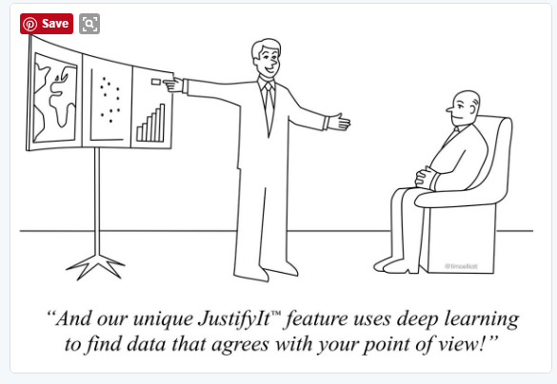
Psychology and Info Combined
“He had a lot of opinions, but they didn’t add up to having a point of view.” (source?)

Slide 34
Astrology Is Widely Believed
Over half of people aged 18 to 24 thinks that astrology is “sort of scientific” or “very scientific.” Mother Jones (NSF data)
2014 Lindgren study, ope ed: https://www.washingtonpost.com/news/volokh-conspiracy/wp/2014/02/16/the-7-political-groups-most-likely-to-believe-in-astrology/?utm_term=.30aedbf7d079

Slide 35
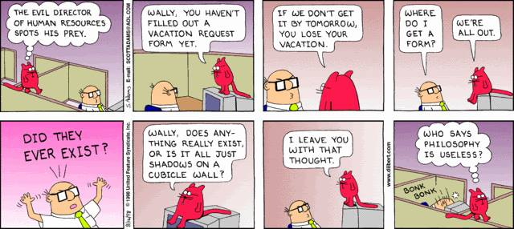
The Cave Allegory
From Plato’s Republic, book VII

Slide 36
The Value of Economics Training
How high is the ceiling of this room?
1. Remember an answer.
2. Say “I don’t know”.
3. Figure out an answer using several steps.

Slide 37
Francis Bacon’s Four Idols
Idols of the Tribe. Misleading ideas inherent in the mind of man. Not understanding statistics. Not thinking logically.
Idols of the Cave. Misleading ideas in the mind of an individual due to his temperament, education, etc. Thinking like an economist (“maximize surplus”), or an epidemiologist (“save lives”), or an engineer (“make it strong”) or a modern American. Plato’s Republic’s Cave Allegory.
Idols of the Marketplace. Misleading ideas arising from thinking in terms of words instead of reality. Freedom of Speech, but if you disagree with it, you don’t think of it as Speech. “Essential services” during an epidemic.
Idols of the Theatre. Misleading ideas propounded by learned men and accepted by everyone else without question. The idea that bleeding cures illnesses.

Slide 38
The Muller-Lyer Illusion

Slide 39
The Muller-Lyer Illusion

Slide 40
Discounting and Self Control
People like things now instead of later. This often seems irrational. There are several ways of thinking about it:
1. A high discount rate.
2. Multiple selves, where the present self inflicts “internalities” on the future selves.
3. Hyperbolic discounting--- there is a bigger discount rate for the first day than for every other day.
4. Lack of self-control, so the person’s actions do not carry out
their true desires.

Slide 41
Social Security
Why should the government require everybody to put part of their wages into social security?

Slide 42
“The Faces of Meth”
People who become meth addicts generally know what they’re getting into. And there is a lot of public information available. So why do people start on meth? Is it imperfect information about their own willpower?
http://www.thegooddrugsguide.com/gallery/before-and-after-drug-abuse/crystl-meth-abuse/index.htm

Slide 43
106 Visual Phenomena & Optical Illusions by Michael Bach
http://www.michaelbach.de/ot/

Slide 44
Optical Illusions

Slide 45
Optical Illusions

Slide 46
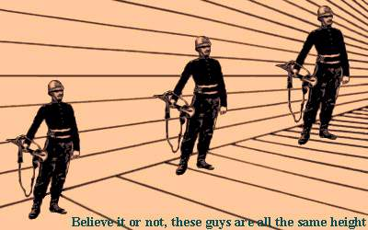
Optical Illusions

Slide 47
The Representativeness Heuristic
Below is a description of Steve, a person chosen at random from the U.S. population.
What occupation is Steve in--- farmer, doctor, salesman, or librarian? What is the probability he is a librarian?
“Steve is very shy and withdrawn, invariably helpful, but with little interest in people, or in the world of reality. A meek and tidy soul, he has a need for structure, and a passion for detail.”

Slide 48
Employment
Librarians: 160,000.
Salesmen (wholesale and manufacturing): 2 million.
Farmers: 1.2 million.
Doctors: 660,000.
“Steve is very shy and withdrawn, invariably helpful, but with little interest in people, or in the world of reality. A meek and tidy soul, he has a need for structure, and a passion for detail.”
Stereotyping is a danger because of the representativeness heuristic.

Slide 49
But Are People Fooled?
When you ask a question, people don’t always answer that question. They think you are asking something else.
“What occupation is Steve in--- farmer, doctor, salesman, or librarian? What is the probability he is a librarian?”
versus
“What occupation does it sound like Steve is in? Does the description fit that job well?”
If you meet somebody like Steve at a party, do you immediately think he must be a librarian?

Slide 50
The Intentions Heuristic
Is an action good, or bad? One way to judge it is to look at the person’s intention. Is he intending something good, or something bad? Is he altruistic, or selfish?
A different way of evaluation an action is whether it has good or bad effects.
Is it the thought that counts? (cash gifts show altruism)
Is it the thought that counts, but you have to show you really like the person by thinking hard about what they would like? (non-cash gifts)
Is a good gift one that shows clearly that the giver went to a lot of trouble and expense, even if it’s worthless to the recipient?
These things work out differently at the family level and at the political level.

Slide 51
How Scared Should You Be if Your Cancer Test Says “Cancer”?
Suppose that a cancer test is 90% accurate, in the sense that if someone has cancer he will test positive (meaning the chemical does change color) with 90% probability, but in the population only 2% of people have cancer. If someone does not have cancer, the test is 80% accurate and the chemical will not change color. Use Bayes’s Rule:

Slide 52
How Scared Should You Be if Your Cancer Test Says “Cancer”?
A BETTER APPROACH: Frequency Boxes
Suppose that a cancer test is 90% accurate, in the sense that if someone has cancer he will test positive (meaning the chemical does change color) with 90% probability, but in the population only 2% of people have cancer. If someone does not have cancer, the test is 80% accurate and the chemical will not change color.
On the board, draw boxes representing numbers of people. There are 1000 in all. 980 are fine, but 20 have cancer. Of the 980, 80% test negative, which is 784, and the other 196 test positive. Of the 20 who have cancer, 90% test positive, which is 18. Two test negative. So compare the 18 box with the 196 box.

Slide 53
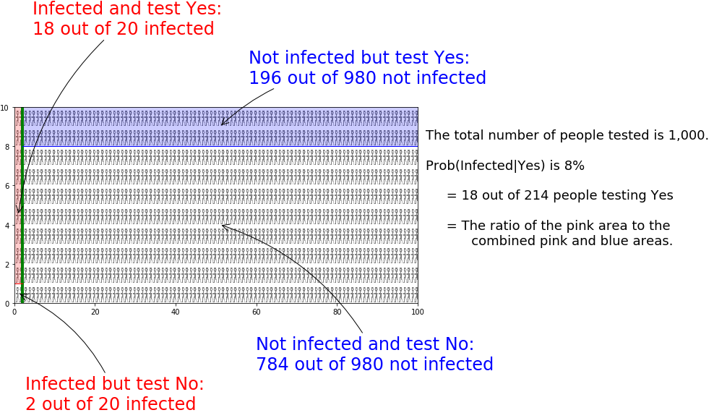
A Frequency Box
Link:"Bayes Theorem with Lego“.
The Python code for this figure is at https://github.com/erasmuse/Bayes-Rule

Slide 54
Throwing a Ball
When a man throws a ball high in the air and catches it again,
he behaves as if he had solved a set of differential equations in predicting the trajectory of the ball...
At some subconscious level, something functionally equivalent to the mathematical calculation is going on.
Richard Dawkins, The Selfish Gene

Slide 55
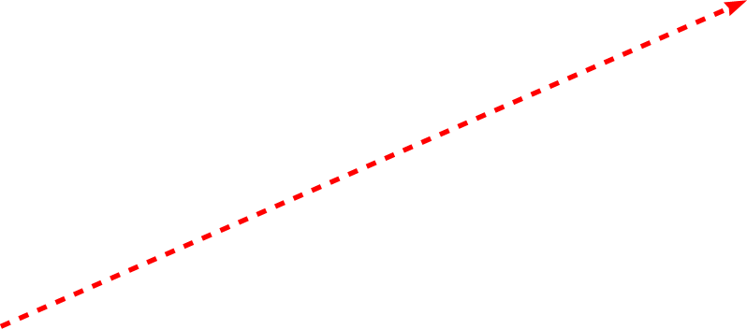
Gaze heuristic

Slide 56
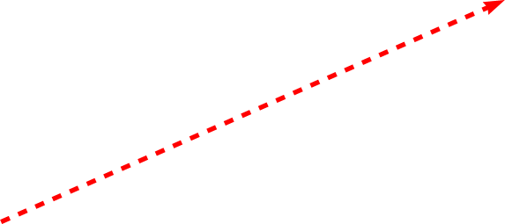
Gaze heuristic

Slide 57
Gaze heuristic

Slide 58
Gaze heuristic

Slide 59
Gaze heuristic
“The gaze heuristic is a heuristic employed by people when trying to catch a ball. Experimental studies have shown that people do not act as though they were solving a system of differential equations that describe the forces acting on the ball while it is in the air and then run to the place at which the ball is predicted to hit the ground. Instead they fixate the ball with their eyes and move so as to keep the angle of the gaze either constant or within a specific range. Moving in such a fashion assures that the ball will hit the catcher.”(Wikipedia)

Slide 60
“Ban the Box” regulation
Employers do not like to hire people with criminal records.
Is that rational, or irrational?
Should we forbid employers from asking about criminal records?

Slide 61
Nudging: Nationwide Mutual
Around 74% of Nationwide employees were enrolling each yea in 401-k programs.
In 2007, the company changed its policy. Enrollment was still voluntary, but each employee was automatically enrolled, and had to pro-actively ask to be removed.
Moreover, each year the employee contribution would rise unless the employee objected.
Just 6% of employees still opted out of the program, but the enrollment rate had increased to 94%.

Slide 62
More Slides
The number of slides is now about right for three classes.
Often I teach this material in two classes, skipping some of them. I have more slides below that are interesting.

Slide 63
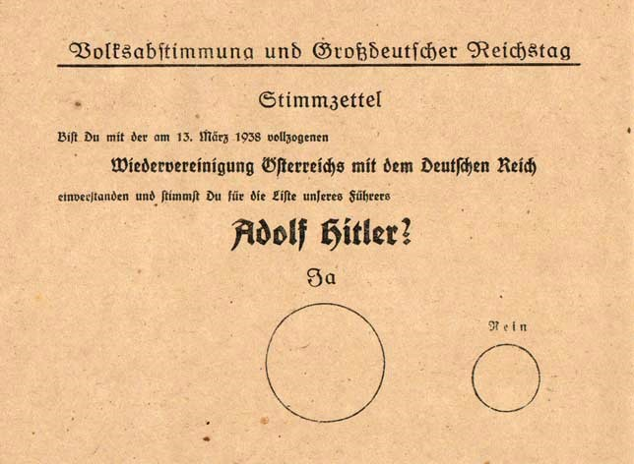
A Nudge Tactic

Slide 64
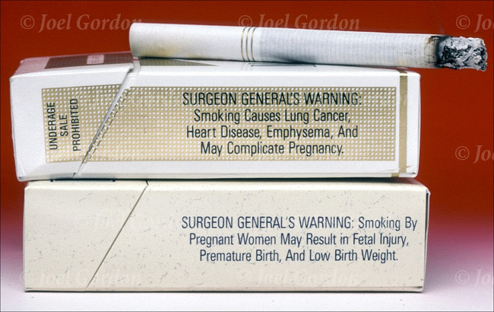
Cigarette Warning Labels

Slide 65
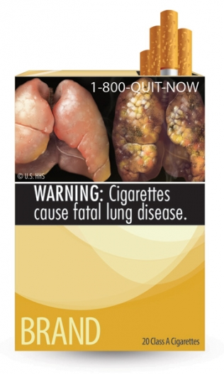
Cigarette Warning Label Requirement Struck Down
It was struck down as violating the 1st Amendment, being compelled speech that goes beyond just listing facts. (DC case)
Other of the proposed labels are too gruesome for me to show here.
The 6th Circuit appeals court ruled them constitutional
The government decided to give up on the labels.

Slide 66
Random Sequences
http:/rasmusen.org/g406/random-sequence.xls
Do men like to gamble more than women do?
Are gamblers overconfident, or just risk-loving?

Slide 67
“Casino Rewards Total Loyalty,”
COO Loveman , from Indianapolis, was up for tenure at Harvard Bus. School at age 43. He had managed only one secretary and one research assistant.
Customers carried a loyalty card that they connect to slot machines with a curly black cord. “The points can bring them a stream of "comps" - small complimentary gifts, such as meals and free hotel rooms - or they can save up for the big ones.
Plug in your card and Harrah's knows who you are, your average bet, how much you spent gambling and when you spent it. It knows how many slot machines or gaming tables you used, which of Harrah's two dozen casinos you visited, how often you visited them and how far you travelled to get there.
A modern slot machine is not much different from an ATM, so it could be used as a banking terminal. And rather than taking money out and then feeding it back in, the cash could simply be transferred from the gambler's account to Harrah's.”

Slide 68
Transaction Costs
Douglass North, Nobel laureate, told his students that
whatever the question is in the economics about some puzzling
phenomenon that doesn’t quite fit:
“The answer is always transaction costs.”
(Duke Prof. Michael Munger told me that.)
Coase Theorem. Extreme Waste in the economy. AirBnB. Uber. Craig’s List. Coffee Ceremony. Ebay. Used bookstores on Amazon.

Slide 69
Four Kinds of Transaction Costs
1. Finding the other person and figuring out what you both want.
2. Splitting the surplus.
3. Physically trading the goods.
4. Being able to get the other person to trade rather than steal.
1, 2, and 4 can all be considered info costs. 4 is Property rights/contracts, one might say. 2 is interesting. Nobody has the property right over the gains from trade.

Slide 70
“FDA Review of New Sunscreen Ingredients Languishes, Frustrating Advocates,”
For new sunscreens: Melanoma research charities, dermatologists , sunscreen manufacturers.
Against: ??? Just the FDA?
Eight ingredient applications are pending, some dating to 2003. Many were approved years ago in Europe, Asia, South America. “These sunscreens are being used by tens of millions of people every weekend in Europe, and we’re not seeing anything bad happening,” Lots of melanoma treatments have been approved, though.
The FDA defense: “the agency must undertake a lengthy rule-writing process... found some applications lacking in safety data ... differing standards mean that an ingredient considered safe in Canada .... might not automatically get a thumbs up from U.S. regulators.”
Congress is starting to write new legislation.
The FDA in 2011 announced lengthy new rules for terms like “ “broad spectrum protection”, “water resistant”, “SPF 50+”. They banned the terms “sun block,” “sweatproof” and “waterproof,” because the agency said such claims overstate the effectiveness of the sunscreens.

Slide 71
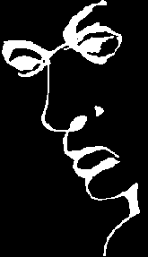
Optical Illusions
Turn your head sideways
To see the writing.

