Slide 1
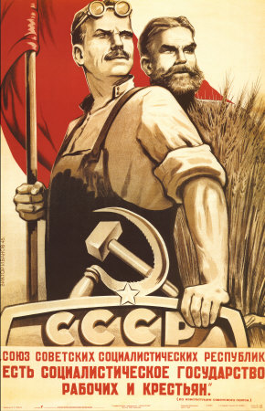
11: Regulating Labor

Slide 2
IDEA OF THE DAY
Labor unions are a special kind of cartel.

Slide 3
Restrictions on Labor Supply
1. The minimum wage
2. Licensing
3. Unions

Slide 4
The Demand for Labor

Slide 5
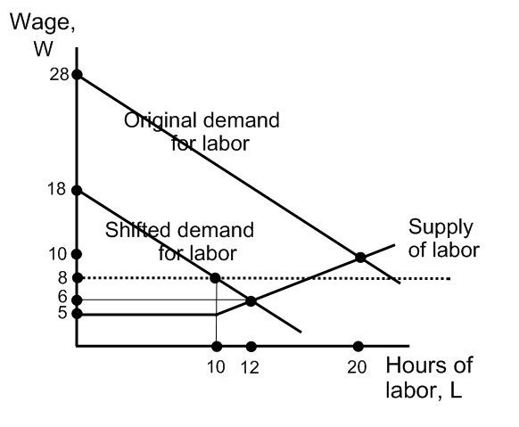
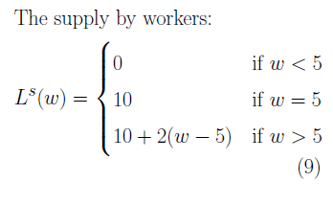
Effect of a Recession and Minimum Wage

Slide 6
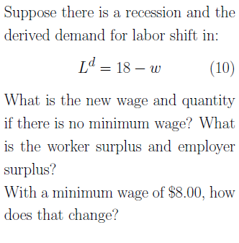
The Minimum Wage and Recession
Worker surplus (w=6) = 10(6-5)+.5(6-5)(2) = 11
Employer surplus(w=6) = .5(18-6)(12) = 72
Worker surplus(w=8) = 10(8-5) = 30
Employer surplus(w=8) = .5(18-8)(10) = 50

Slide 7
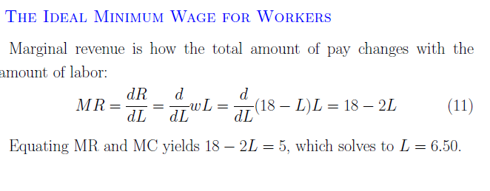
The Workers’ Ideal if Q_{d} = 18-L
Worker surplus = 6.5(11.50-5) = 42.25, more than the 11 from w = 8.
Employer surplus = .5 (6.5)(18-11.50) = 21.125.
But this will create unemployment too. Some workers get paid more, but some don’t get a job at all.
Or, maybe L does not change, but each worker works more hours than is efficient. Or the company only hires smarter workers.

Slide 8
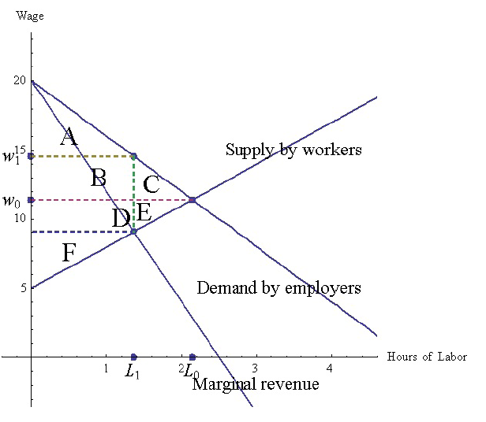
Market Power in Labor

Slide 9
The Minimum Wage
1938: Fair Labor Standards Act (FLSA) established a federal
minimum wage. Now $7.25/hour. Is there market failure to justify this
States and cities have their own minimum wage laws. In Seattle, the 2019 minimum wage is $16.00/hour.
https://www.jacksonlewis.com/publication/2019-minimum-wage-rate-increases-list-grows

Slide 10
Who Benefits from the Minimum Wage?
Labor unions support higher minimum wages, even though their mem-
bers already earn well above the minimum wage. Why? hIt is sometimes said that this is because their wages are tied to the minimium wage in contracts, but those seem to be only low-wage contracts. http://www.unionfacts.com/article/wp-content/uploads/2013/02/Union_Minimum_Wage_report.pdf
There is a public-interest argument: helping the poor.
But many minimum-wage workers are young or new to the workforce.
A subminimum wage is a lower minimum wage for young people.
Ireland: minimum wage is $11.94.
Workers under 18 can be paid just 70% of that and the minimum wages
in the rst and second year of employment after age 18 are at 80% and
90% to give employers incentive to hire workers new to the labor force.

Slide 11
In the long run, consumers bear more of the burden
The minimum wage raises prices, but not by as great a percentage as the wage. Why?
In the short-run, firms have upward-sloping goods-supply curves, and producer surplus there and in the employment market. Firm PS falls. Prices rise--- so CS falls too.
In the long run, producer surplus pays for fixed costs, so price rise more in the long run--- producers are hurt less and consumers more.
Consumers are rationally ignorant and so will not notice this consequence of the minimum wage.

Slide 12
“Minimum Wage for Interns? It Misses the Point”
“Charlie Rose, the TV interview-show host, last month settled a class-action lawsuit against his production company for failing to pay college interns a minimum wage. The settlement will pay 189 former interns $1,100 apiece (calculated at $110 a week for a 10-week semester). Based on New York's $7.25 per hour minimum wage, that reflects a 15-hour workweek.
Two similar suits pending against Hearst and Fox Entertainment argue that such chores don't fulfill the educational purpose of an internship.”
Conde-Nast ends program:

Slide 13
Minimum Wage for Interns? II
“Was it worth the cost of my son's college tuition, which gave him entry to the magazine internship, to have his decision-making abilities honed by making splitsecond choices about whether to take the A train or the No. 3 train? Not really. But he learned some invaluable career lessons, such as that his timetable didn't count—the magazine's deadline did. And by making his deliveries ahead of schedule, he was invited into the actual photo shoots, where his exposure to the creative process was priceless.
Internships are about self-discipline, showing up on time, dressing and comporting oneself properly—conforming to the norms of the organization, not merely to the fashion of the classroom. They are about learning how to listen and observe, to be responsive and responsible.”

Slide 14
Other Labor Regulations
1938: Fair Labor Standards Act (FLSA.
The FSLA also bans child labor and says pay must rise 50% for any hours beyond 40 hours/week. What market failure would justify these things?
Should it be illegal to have children work on farms? Consider Chick-Fil-A: A boy can’t help his father at work, unless the father owns the business, in which case he can, whether it’s a farm or some other business.

Slide 15
Labor Law and Unions
During the New Deal, the National Labor Relations Board (NLRB) was created in the Wagner Act to regulate unionized firms and unions. For example, the employer cannot:
Threaten to fire employees who join a union.
Threaten to close the plant if the employees form a union. Reject union offers without reading them (they must“bargain in good faith”)
The union cannot:
Strike on issues unrelated to employment
Threaten or assault non-striking workers.

Slide 16
Single Unions
A big principle of U.S. labor law is EXCLUSIVE REPRESENTION: if one union gets a majority of workers to sign up, it has the exclusive right to bargain on behalf of all the employees.
The default federal rule is that all employees must then join the union and pay union dues.
But states are now allowed to pass “right to work” laws, under which workers are not forced to join the union. (Taft-Hartley Act, more conservative, in 1947)
Indiana passed Right to Work in 2012. Michigan followed. Then Wisconsin.

Slide 17
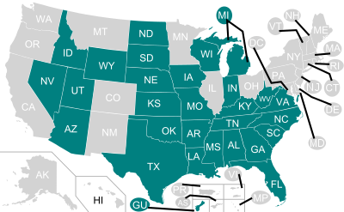
“Right to Work” States in Green

Slide 18
“Why Should Stage Hands At Carnegie Hall Make $400,000?” I
Carnegie Hall’s IRS form 990: (or, for 2015)
The executive and artistic director: $1,113,571
Top stagehand: $464,632
Carpenter: $441,223.
Chief financial officer: $429,259.
(Three other IATSE members Electricians $425,872 and $395,207, carpenter Ken $371,813)
“The strike was over a 24-room educational wing: Management had not wanted the stagehands to work there. In the deal reached today, students will be able to move their own music stands, chairs and instruments but not drums or marimbas, and one new full-time employee will be hired.”

Slide 19
“Why Should Stage Hands At Carnegie Hall Make $400,000?” II
Professor: “These labor disputes aren’t settled by who’s right and who’s wrong. It’s a bargaining situation and the employer, Carnegie Hall, wants the cooperation of the stagehands in exchange for their work.”
Professor: “Unions get a bad rap when they get good deals like this,” he says. “If you went to buy a car at a dealership and you did a really good job negotiating and walked away with a $100,000 car for $30,000, would you get blamed because you’re a good negotiator?”
Journalist: "As Cornell professor Ileen DeVault points out, most of us don’t begrudge the huge salaries of unionized NFL and Major League Baseball players At the risk of inviting angry comments from Forbes readers, I’d say that Local One’s members have achieved the American dream, working their way through the echelons of the middle class to a level on par with Carnegie Hall’s wealthy donors. Is that such a terrible thing?"

Slide 20
Which Jobs Are Unionized?
About 12% of wage and salary workers are unionized, down from 20% in 1983. 7.6 million were in the public sector (work for government) and 7.2 million in the private. 37% of public-sector workers are unionized, and 7% of private-sector.
The job category with the lowest rate is Sales (3%).
Why do we see this pattern?
http://www.bls.gov/news.release/union2.nr0.htm

Slide 21
Governor Walker and Public Employee Unions in Wisconsin
http://www.truth-out.org/news/item/39761-on-labor-and-beyond-trump-is-following-scott-walker-s-playbook
“In 1959, Wisconsin became the first state to authorize public employees to bargain.
Shortly after his inauguration, Walker was caught on tape telling a right-wing billionaire funder that he intended to "divide and conquer" the unions.
Act 10 stipulated that the unions could bargain only for wages up to the rate of inflation, and that they couldn't bargain on working conditions.
"The tactic was to attack everyone at once, like a political carpet bombing, so that people were put on the defense on every public issue at the same time,“
According to Rothschild, the massive protests that mobilized against Walker early on failed primarily because labor leadership decided to pour money and resources into the Democratic Party channels rather than allowing the movement to be truly grassroots.”

Slide 22
Governor Walker and Public Employee Unions in Wisconsin
http://www.truth-out.org/news/item/39761-on-labor-and-beyond-trump-is-following-scott-walker-s-playbook
“Act 10 also said that unions had to "recertify" every year, with a majority of members voting in favor of keeping the union
Act 10 prohibits public employers from deducting for wages an employee contribution toward the union's political action fund, and forbids the employer from deducting a fair share fee from non-members, as existed prior to Act 10.”

Slide 23
Licensing
Occupations: http://www.in.gov/pla/boards.htm
People: https://mylicense.in.gov/eVerification/
(Chiropractors, search “probation”)
Litigation: http://www.in.gov/apps/pla/litigation/advancedsearch.aspx
Indiana Criminal and Civil Records: http://mycase.in.gov/default.aspx

Slide 24
Useful Licensing?
Fake Dentists: (click to get the story)

Slide 25
Licensing: Marriage Counsellors
IC 25-23.6-3-1 Unlawful practices
Sec. 1. (a) An individual may not:
(1) profess to be a licensed marriage and family therapist;
(2) use the title:
(A) "licensed marriage and family therapist";
(B) "marriage and family therapist"; or
(C) "family therapist";
(3) use any other words, letters, abbreviations, or insignia indicating or
implying that the individual is a licensed marriage and family therapist;
or
(4) practice marriage and family therapy for compensation;
unless the individual is licensed under IC 25-22.5, IC 25-23.6-8-1, or IC
25-33.

Slide 26
“A license to be a florist? How occupational rules can be a burden on workers”
“IT’S NOT every day that references to Adam Smith and Milton Friedman show up in the footnotes of a Democratic White House report. But a new white paper from President Obama’s economic team on the jobkilling, anticonsumer effect of unduly burdensome state occupational licensing is that rarest of government intellectual products: one that actually transcends ideological categories
Military families move frequently from state to state, only to find that a nonmilitary spouse can no longer work without spending months qualifying for a new license.
Licensing also inhibits many exoffenders from rejoining the workforce because they lack the requisite clean police record.”

Slide 27
“A License To Be a Florist?”
25% of all U.S. workers need a license to do their jobs, according to a White House report, compared to 5% in the 1950s. 2/3 of this is from an increase in state licensing laws, not due to a bigger population.
Doctors. Market failure?
Louisiana: Florists. Market failure?
Greece: where almost the only way to get a pharmacist license is to buy one from a retiring pharmacist
Why does the President oppose these laws, where the state legislatures do not?

Slide 28
Why have ANY fringe benefits?
Why would employers offer health insurance, free gym, pension plans, cafeteria, housing allowances, etc… ?

Slide 29
Fringe benefits: 20% EMPLOYER COSTS FOR EMPLOYEE COMPENSATION
Private industry employer costs for noncash benefits were 30% of compensation (30% of pay + benefits) in 2015. This does not include mandates such as “family leave,” handicapped worker access, etc.
Legally required benefits (Social Security, Medicare,
unemployment insurance, workman’s compensation): 8.2 percent.
Insurance (life, health, and disability): 8.1 percent.
Paid leave (vacation, holiday, sick leave, and personal leave): 6.8 percent.
Supplemental pay (overtime and premium, shift differentials, and nonproduction bonuses): 2.9 percent.
Retirement and Savings: 3.5 percent. (It’s 8.5% for govt.—why?)
Paid leave and supplemental pay shouldn’t really count, since they are cash. Subtracting them, we get 20 percent.

Slide 30
Employer Mandates
An employer mandate is a regulation requiring the employer to provide something desirable to the worker.
The government doesn't pay for the mandates.
Wages fall.

Slide 31
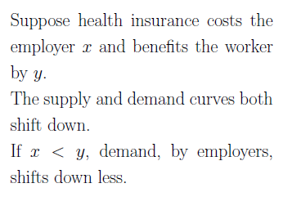
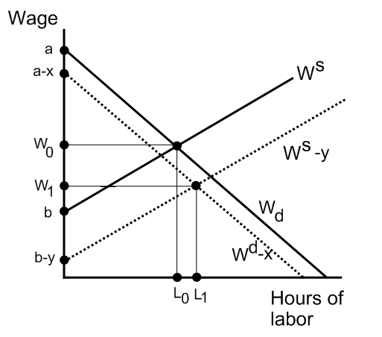
Health Insurance as an Efficient Fringe Benefit
by workers
Employers: If the wage dropped by x, they would be as happy as originally. The wage drops more than x, and L increases too.
Workers: If the wage fell by less than y, they would be as happy as originally. It drops less, and L increases too.
by employers

Slide 32
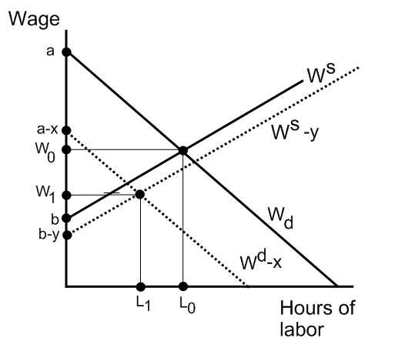
An Inefficient Fringe Benefit: Free Haircuts
Employers: If the wage dropped by x, they would be as happy as originally. It drops less, and L falls too.
Workers: If the wage fell by less than y, they would be as happy as originally. It drops more, and L falls too.
by workers
by employers

Slide 33
Mandates Reduce Wages even for a Monopoly Buyer
Suppose the workers will work for as little as $4/hour if there is air conditioning and $6/hour otherwise.
(1) If air conditioning costs $1/hour, the employer will provide it and pay them $4/hour.
(2) Suppose instead that workers value coolness at just $.50/hour, and it costs the employer $1.00/hour. The employer won’t provide it.
Now let’s mandate air conditioning. What will happen? The employer will reduce pay to $3.50/hour. Workers are no better off.

Slide 34
The ACA (Obamacare)
1. Pre-existing conditions cannot cause denial of insurance coverage.
2. Subsidies for the medium-poor--- nobody has to pay more than a certain fraction of income for health insurance. (The already-existing Medicaid program was free government health insurance for the poorest people.) Also: huge expansion in Medicaid eligibility (biggest part of law?)
3. Employer mandate--- any business employing over 50 people full-time must provide insurance.
4. New minimum standards for coverage, beyond the state requirements.
5. Cadillac Tax: 40% excise tax on insurance spending of more than $10,200 per employee or $27,500 per family. (Eventually, with inflation, this is like repeal of tax deductibility.)

Slide 35
What can the employer do?
1. Shift to high-skill workers (if the mandate is a fixed cost per worker) or capital.
2. Shift to producing abroad.
3. Break up into one-man or family operations.
4. Break one 40-hour job into two 20-hour jobs.
5. Fire the employee and rehire him as a contract temp.

Slide 36
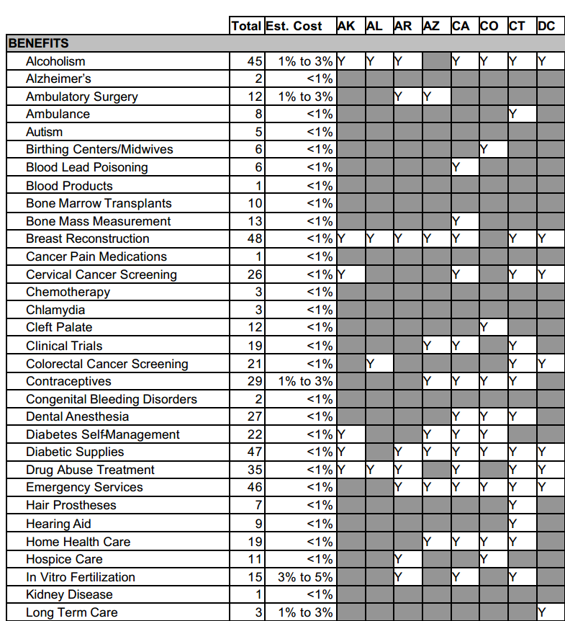
State Mandates
http://www.ncsl.org/research/health/state-ins-mandates-and-aca-essential-benefits.aspx

Slide 37
Cost of Health Ins. Mandates
Texas: Cost = 3.8% of premiums for 20 mandated benefits i
http://www.ncsl.org/portals/1/documents/health/MandatesCauchi09.pdf
Massachusetts: Cost = 12% of premiums for 26 mandates
--MA Division of Health Care Finance & Policy July 2008
maternity 3.73%
mental health 2.21%
home health 1.93%
preventive care for children 1.12%
infertility .89%
This report has a table listing the state requirements.

Slide 38
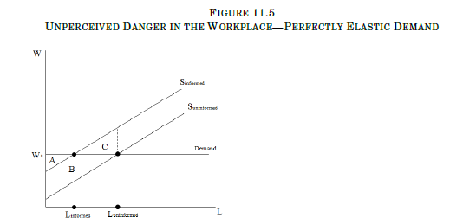
Worker Safety Laws
This is like an overvalued product, except it is the seller (the worker) who
is misinformed.

Slide 39
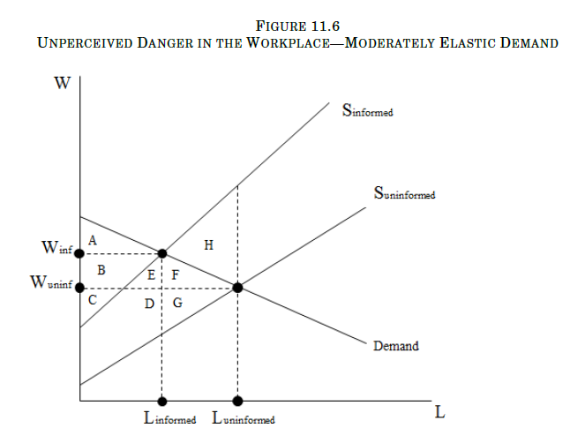
Worker Safety Laws--Downward-Sloping Demand

