Slide 1
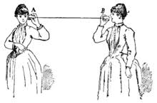
12: Telecommunications

Slide 2
The Final Examination
Monday, Dec. 16 5-7pm, in the regular classroom.
You do not need to bring paper or exam booklets. Calculators are allowed.
Cumulative---covers entire semester. It will not cover the end-of-chapter assigned readings.
Know the numbers you needed to know for the midterm (discount rates, etc.)
Multiple choice and short answer, like the midterm.
There is an old exam posted at http://rasmusen.org/g406/various/Final-answers.2018fall.doc
Office Hours: Friday 11-12. Sunday 8-9pm. Monday 11-11:45am, 1-3pm.

Slide 3
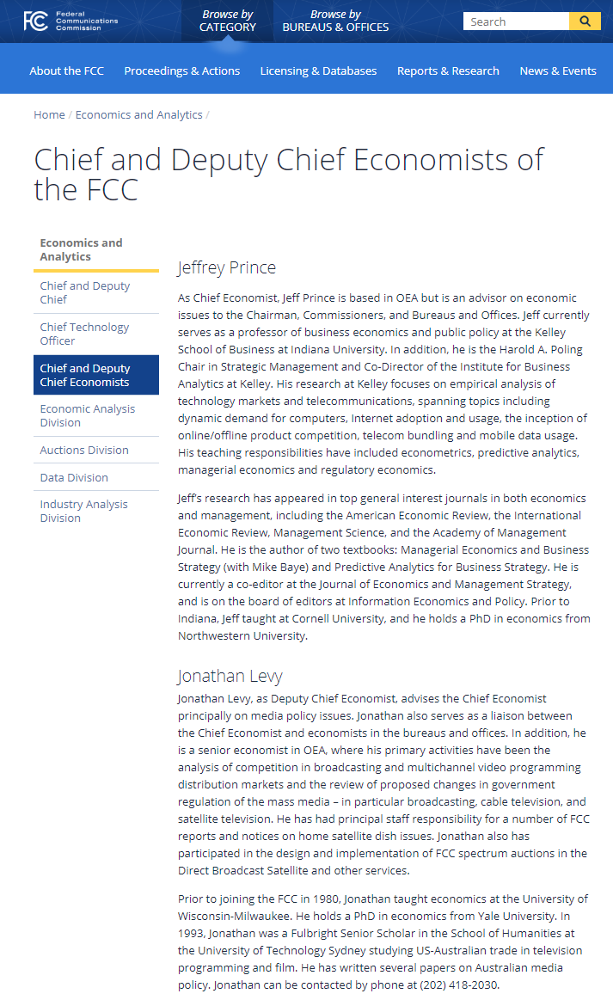
https://www.fcc.gov/economics-analytics/chief-and-deputy-chief-economists-fcc

Slide 4
Topic I: Net Neutrality
We don’t have to worry about all the bad things a company could do. We only have to worry about bad things that would be profitable.

Slide 5
What Is Telecom?
Telecommunications comprises a set of products
which involve using electric signals to transmit information.
Sometimes the signals are sent through wires (Cable TV) and sometimes through the air (radio).
In the case of the Internet, there are Internet Service Providers (AT&T) and there are Content Companies (Facebook).

Slide 6
Net Neutrality definition 1
Under net neutrality, an internet service provider (ISP) can’t charge different prices for different kinds of internet traffic, or assign different speeds.
Your home internet company would not be allowed to charge you more per amount downloaded of movies than per amount downloaded of text. Nor would it be allowed to give text transmissions priority over movie transmissions— it would have to treat all kinds of content equally.
Nor could it give medical connections (long-range surgery) priority over videogames.
Who would favor this kind of net neutrality? Think about toll road commuter lanes, but here, the fast lanes cost more.

Slide 7
Net Neutrality definition 2
Net neutrality is when the internet service provider (ISP) cannot charge different content providers different prices.
Comcast could not charge Netflix more than Amazon Prime for transmitting movies.

Slide 8
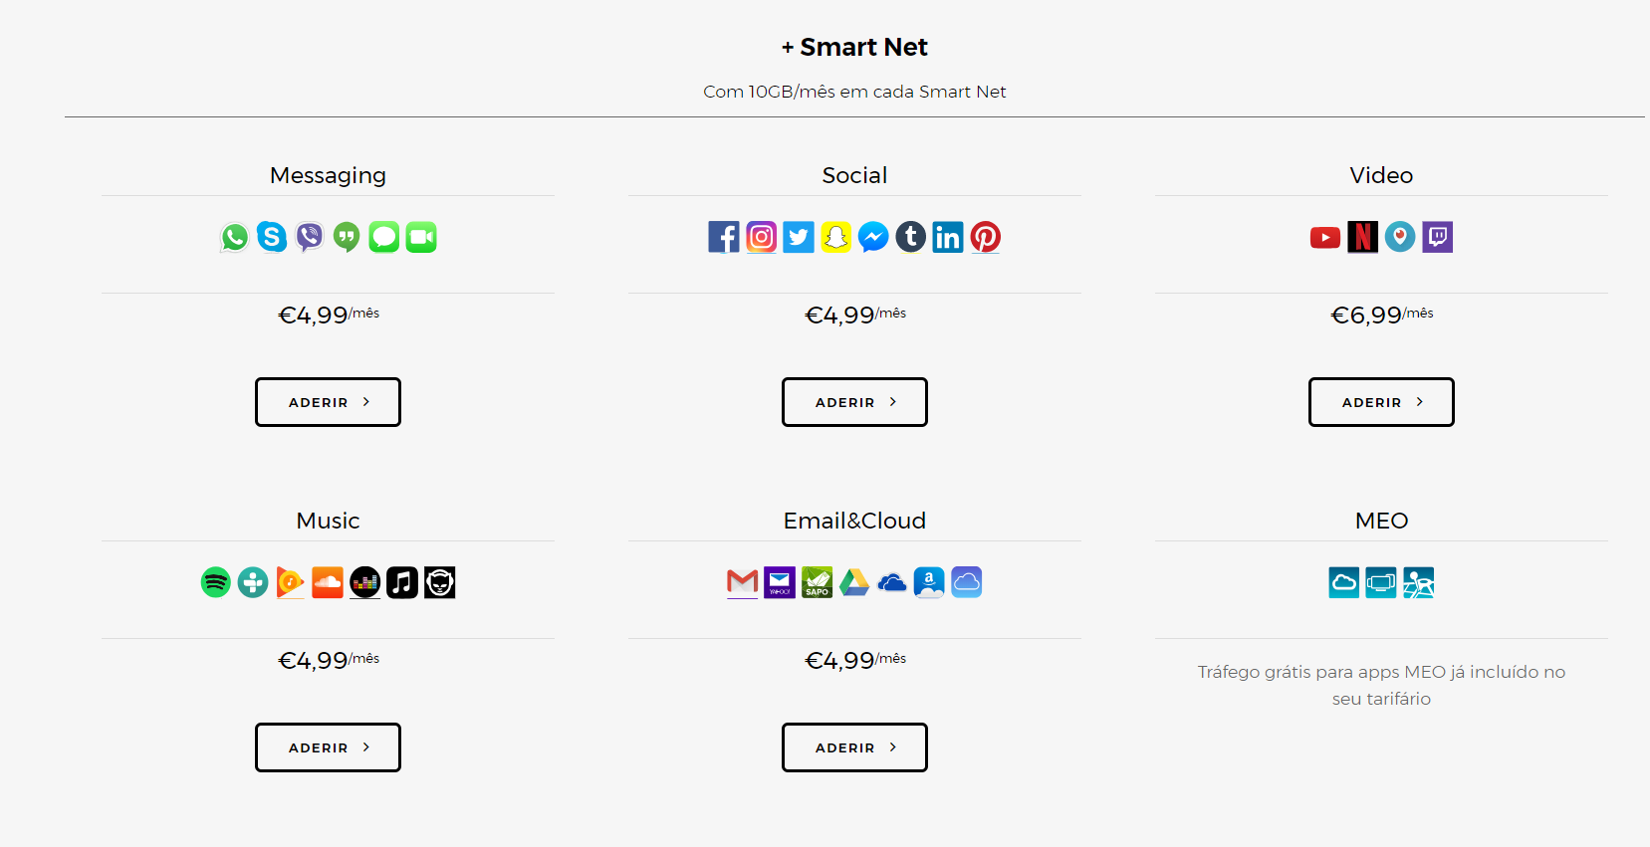
Price discrimination in Portugal
https://www.meo.pt/internet/internet-movel/telemovel/pacotes-com-telemovel

Slide 9
Net Neutrality Example 1
Suppose Comcast is a monopoly service provider and also sells
as content Comcast Movies. Netflix sells Netflix Movies.
90% of consumers want movies.
Without Net Neutrality, Comcast can charge Netflix for getting access to consumers.
Under Net Neutrality, Comcast cannot charge Netflix.
Either way, Comcast will charge a monopoly price to
consumers for the internet service. Consumers won’t care.

Slide 10
Net Neutrality Example 1
Suppose Comcast is a monopoly service provider and also sells as content Comcast Movies. Netflix sells Netflix Movies.
90% of consumers want movies.
In the absence of Net Neutrality, Comcast can charge Netflix for getting access to consumers.
Under Net Neutrality, Comcast cannot charge Netflix.
Either way, Comcast will charge a monopoly price to
consumers for the internet service. Consumers won’t care.

Slide 11
Net Neutrality Example 2
Suppose the value of internet is $40 per month for each consumer, and the value of Netflix is $15. Comcast charges $40.
Comcast could either charge the consumer $15 extra to get access to Netflix, or Netflix $15 to get access to the consumer— there is no real difference. In the second case, Netflix charges the consumer $15.
Under Net neutrality, Comcast can’t charge Netflix, but Netflix charges $15.
Consumers don’t care either way.
Netflix gets richer under net neutrality.

Slide 12
The Political Lineup
Comcast– hardware-Republicans-- Pennsylvania
versus
Facebook—software—Democrats--California

Slide 13
Applications:
Comcast could refuse to serve Democrats. But it won’t.
Comcast could charge immense fees to small web companies and kill them. But why would it do that?
Comcast could produce its own movies and refuse to show anybody else’s. But that would severely hurt its profits.
4. Comcast could provide poor service to its customers. But then it couldn’t charge them as much for internet service, because they wouldn’t be willing to pay as much.

Slide 14
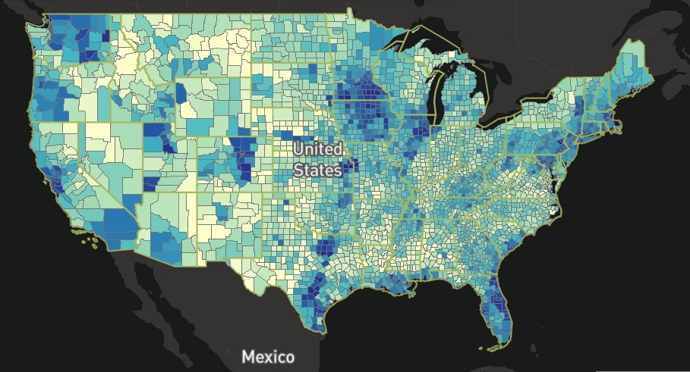
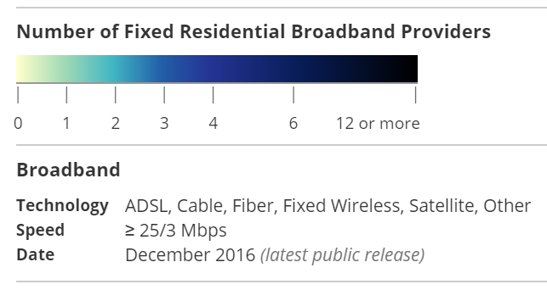
MAP (2018)
https://broadbandmap.fcc.gov/#/

Slide 15
A Common Carrier
"A common carrier is one who publicly undertakes to carry goods or persons for payment on the route he covers.
"A common carrier is subject to three common law duties: he must, if he has space,
accept any goods of the type he carries or any person;
he must charges only a reasonable rate;
and he is strictly liable for all loss or damage to goods in the course of transit.“
Bus route, Airline, Pipeline, Ferry, Toll road, Toll bridge, telephone company.

Slide 16
Twitter and Rep. Blackburn
“Twitter shuts down Blackburn campaign announcement video”
Should net neutrality apply to content providers?
Is Facebook a common carrier?
In early 2017, it was proposed to put content providers under the same privacy rules (can’t sell customer data) as service providers. In the end, both were allowed to sell data.

Slide 17
2015 Regs No Blocking Rule
‘prohibits broadband providers from charging edge providers a fee to avoid having the edge providers’ content, service, or application blocked from reaching the broadband provider’s end-user customer.'‘
(FCC 2015, section 113; section 120 does the same for reduced speed)

Slide 18
2015 Regs: No Paid Prioritization
‘‘A person engaged in the provision of broadband Internet access service, insofar as such person is so engaged, shall not engage in paid prioritization.’’ (section 18)
Paid prioritization is defined as
``‘the management of a broadband provider’s network to directly or indirectly favor some traffic over other traffic, including through use of techniques such as traffic shaping, prioritization, resource reservation, or other forms of preferential traffic management, either (a) in exchange for consideration (monetary or otherwise) from a third party, or (b) to benefit an affiliated entity.’’ (FCC 2015, section 18)

Slide 19
2017 Repeal
In 2017, Republican President Trump came to office. He appointed a new Federal Communications Commission Chairman, and the party balance on the Commission changed to be 3 Republicans to 2 Democrats.
In December 2017, after notice and comment, the 2015 regulations were repealed, so net neutrality disappeared.

Slide 20
EU Regulations
“The final guidelines in Europe comes quite close to the US 2015 Federal Communications Commission (FCC) Open Internet rules.” https://edri.org/net-neutrality-vs-5g-what-to-expect-from-the-upcoming-eu-review/
Wikipedia: “Some loopholes include the ability to offer priority to "specialised services", provided they still treat the "open" internet equally. Such services included remote surgery, driverless cars and anti-terrorism efforts. The law does say that these services cannot be offered if they restrict bandwidth for normal users. Another exemption is giving websites a "Zero-rating", not counting a website against a user's data limits, giving an advantage to those sites when being viewed via a metered connection.”

Slide 21
Competitive Markets
If the service provider market is competitive, then any blocking or paid prioritization we see is surplus-maximizing.
Suppose there are 100 service providers. What happens if one of them tries to charge content companies a higher price for high speed videogame service?
The content companies will refuse unless they think the provider will give them more customers. The provider can do that only if it reduces its price to consumers. It will retain customers only if there are consumers who like the combo of higher price for videogame service and lower price for everything else.

Slide 22
Double Marginalization: Situation
So the only interesting case is where the market is too small to accommodate more than one or two or three service providers.
Suppose we have just one service provider, and one content provider in a town. Both are monopolies.
These two monopolies depend on each other. One is upstream, one is downstream.
Their products are COMPLEMENTS--- when the price of
content falls, the demand for service rises.

Slide 23
Double Marginalization: Pricing
Service and Content are COMPLEMENTS--- when the price of
content falls, the demand for service rises.
This means there is a pecuniary externality between the two firms. When the content company raises its price, part of the lost sales are profit losses OUTSIDE, to the SERVICE company.
Thus, if the two companies were MERGED, they would REDUCE the price of both content and service. They would want to increase sales, to help both divisions of the new company.
This is a standard reason for merger, one that helps consumers.

Slide 24
Double Marginalization: Implication
The previous slide that if the two companies were MERGED, they would REDUCE the price of both content and service. They would want to increase sales, to help both divisions of the new company.
Here, we can apply the Coase Theorem. Suppose the companies can’t merge, but they are allowed to make a deal. They can overcome the externality. They would agree to have the service company charge P = MC, the content company charge
P > MC, and the content company pay the service company half the profits for its cooperation.
But net neutrality forbids this kind of deal. It ends up with higher prices for consumers and lower profits for firms.

Slide 25
Natural Monopoly: Situation
Think about those markets without much competition, served by just one or two service providers.
What kind of market would they be?
What can the government do to encourage entry? ---subsidies. We need to make these markets more profitable, and then there’d be entry.

Slide 26
Natural Monopoly: 0 to 1 firm
What can the government do to encourage entry?
The government could deregulate from net neutrality, and allow service providers to extract profits from the content companies.
If a market is too small to have ANY service providers--- which is worse even than monopoly--- it might attract one if the provider could extract profits from Facebook.

Slide 27
Natural Monopoly: 1 to 2 Firms
The government could deregulate from net neutrality, and allow service providers to extract profits from the content companies.
Suppose currently there is just one service provider. If it becomes possible to extract profits from Facebook, maybe a second provider would enter, even if it knew that would drive down prices.

Slide 28
Three Features
Three ideas important for thinking about Telecom are:
1. Economies of scale,
2. Network externalities,
3. Radio spectrum property rights.

Slide 29
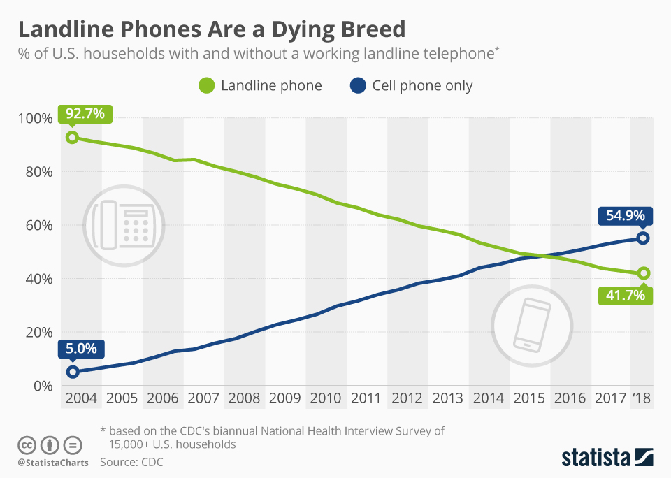
Topic II: Interconnection
https://www.google.com/url?sa=i&source=images&cd=&ved=2ahUKEwi55avSua7mAhUBsJ4KHZ88CboQjRx6BAgBEAQ&url=https%3A%2F%2Fwww.statista.com%2Fchart%2F2072%2Flandline-phones-in-the-united-states%2F&psig=AOvVaw1HuQEFss1nu9ZODS4O0GYh&ust=1576183042651123
https://www.textrequest.com/blog/how-many-people-still-use-landline-phone/

Slide 30
Telephones
After the sale of the government-owned British Telecom and Cable and Wireless in the early-1980s United Kingdom of Margaret Thatcher, 90 percent of countries have either partial or full competition in the mobile sector, and 93 percent in Internet service.
In many countries the provision of fixed services is still a monopoly.

Slide 31
Why Privatize?
1. The generally superior performance of private companies.
2. The political philosophy of the government in power at the time. This was behind some of the early privatizations, such as in the United Kingdom and Chile,
3. Financial crises. This was behind privatizations in several developing countries in the late 1980s: Argentina, Mexico and Malaysia,
4. The need to raise capital to expand infrastructure: Singapore,
5. Improving technology and management expertise: various African countries,
6. Opening the market to competition to give more incentive to reduce costs: Brazil.

Slide 32
Verizon to ATT Call
What if you are a Verizon customer, and you
call an ATT customer? Should ATT have to accept
the call?

Slide 33
Unbundling
Unbundling is the mandatory offering by network
operators of specific elements of their network
to other operators, on terms approved by a
regulator.
Under full unbundling, the incumbent must
offer a separate fully unconditioned local loop
service.

Slide 34
Regulation
The Telecommunications Act of 1996 requires all telecommunications carriers to interconnect to exchange traffic.
Only incumbents were required to unbundle and
share network components
The European Union requires National Regulatory
Authorities to regulate operators with significant market power.

Slide 35
Types of Fixed Costs
Short run costs: Costs of providing a given service, assuming that the current stock of capital is fixed. The long run cost of a service includes the cost of the capital plant required to supply that service.
Sunk cost: Costs that are irreversibly spent, independent of the future quantity of service.
Fixed costs do not vary as the volume of the service changes.
Service-specific costs: Costs the firm must incur to provide a specific service.
Shared fixed costs: Costs to provide a group of services that
do not vary with the level of any individual service in the group.
Common costs: Fixed costs shared by all services produced by the firm. The cost of the company president’s desk is an example.

Slide 36
Variable Costs
Incremental cost is the additional cost of producing a given increment
of output. How much does the firm’s total costs change if the volume
of a particular service increases (or decreases) by a given amount?
Marginal cost is the incremental cost of producing one additional unit
of output. Marginal cost is a limiting case of incremental cost, where
the increment is a single extra unit of service.
Long-run incremental cost (LRIC) is the cost of producing a given increment of output including the cost of capital.

Slide 37
TELRIC
Total element long-run incremental cost (TELRIC).
TELRIC is a special case of incremental cost, where the relevant increment is the total volume of the service in question, and the time perspective is the long-run.
TELRIC is the additional cost incurred by a firm when adding a new service to its existing lineup of services. TELRIC measures the fall in costs associated with just that service.
Stand-alone cost (SAC) is the cost that a standalone firm (producing no other services) would incur to produce the service.
SAC is greater than TELRIC because SAC includes shared fixed costs and common fixed costs.

Slide 38
The Verizon Case of 2002 - I
The Telecommunications Act of 1996 required incumbent local phone companies to sell interconnection to other companies at a price based on cost but unrelated to the price state regulators calculated using rate-of-return regulation.
The FCC uses TELRIC.
The incumbents thought TELRIC generated too
low an interconnection price because it is based on the replacement cost of the wiring in the local loops, not the amount the wiring actually cost.

Slide 39
The Verizon Case - II
Replacement cost was below wiring cost because new
technology meant that the cost of putting in
new wiring was falling over time.
The incumbents said that for the FCC to use
TELRIC meant the government was illegally forcing
them to sell their product at below cost.
The Supreme Court said TELRIC was okay: Verizon
Communications v. FCC, 535 U.S. 467 (2002).

Slide 40
What the Supreme Court Said
“The Act requires the FCC to decide how to value ‘the cost . . . of providing the “network element [which] may include a reasonable
profit,’’ although the FCC is (as already seen) forbidden to allow any “reference to a rate-of-return or other rate-based proceeding.”
Within the discretion left to it after eliminating any dependence on a
“rate-of-return or other rate-based proceeding,” the Commission chose
a way of treating “cost” as “forward-looking economic cost,”
something distinct from the kind of historically based cost generally relied upon in valuing a rate base after Hope Natural Gas.”
(Verizon Supreme Court opinion)

Slide 41
The Supreme Court on TELRIC
“In Rule 505, the FCC defined the “forward-looking economic cost of an element [as] the sum of (1) the total element long-run incremental cost of the element [TELRIC]; [and] (2) a reasonable allocation of forward-looking common costs,” common costs being “costs incurred in providing a group of elements that “cannot be attributed directly to individual elements.”
Most important of all, the FCC decided that the TELRIC “should be measured based on the use of the most efficient telecommunications technology currently available and the lowest cost network configuration, given the existing location of the incumbent’s wire centers.” ” (Verizon)

Slide 42
TELRIC’s Three Components
“ “The TELRIC of an element has three components, the operating expenses, the depreciation cost, and the appropriate risk-adjusted cost of capital.” ...
Assume that it would cost $1 a year to operate a most-efficient loop element;
that it would take $10 for interest payments on the capital a carrier would have to invest to build the lowest cost loop centered upon an incumbent carrier’s existing wire centers (say $100, at 10 percent per annum);
and that $9 would be reasonable for depreciation on that loop (an 11-year useful life);
then the annual TELRIC for the loop element would be $20.” (Verizon)

Slide 43
The Plain Meaning of “Cost”
“The incumbent carriers’ first attack charges the FCC with ignoring the plain meaning of the word “cost” as it occurs in the provision of §252(d)(1)... They contend that “cost” in the statute refers to “historical” cost, which they define as “what was in fact paid” for a capital asset, as distinct from “value,” or “the price that would be paid on the open market.”
The argument boils down to the proposition that “the cost of providing the network element” can only mean, in plain language and in this particular technical context, the past cost to an incumbent of furnishing the specific network element actually, physically, to be provided.” (Verizon)

Slide 44
The Plain Meaning of “Cost”: Unclear, the Court Says
“The incumbents have picked an uphill battle. At the most
basic level of common usage, “cost” has no such clear implication.
A merchant who is asked about “the cost of providing the goods” he sells
may reasonably quote their current wholesale market price,
not the cost of the particular items he happens to have on his shelves, which may have been bought at higher or lower prices.”
(Verizon)

Slide 45
The Technical Meaning of “Cost”
“When the reference shifts from common speech into the technical realm, the incumbents still have to attack uphill.
“Cost” as used in calculating the rate base under the traditional cost-of-service method did not stand for all past capital expenditures, but at most for those that were prudent, while prudent investment itself could be denied recovery when unexpected events rendered investment useless.
And even when investment was wholly includable in the rate base, ratemakers often rejected the utilities’ “embedded costs,” their own bookvalue estimates, which typically were geared to maximize the rate base with high statements of past expenditures and working capital, combined with unduly low rates of depreciation.” (Verizon)

Slide 46
TELRIC as Bad Policy
“The incumbents’ (and Justice Breyer’s) basic critique of TELRIC is that by setting rates for leased network elements on the assumption of perfect competition, TELRIC perversely creates incentives against competition in fact.
The incumbents say that in purporting to set incumbents’ wholesale prices at the level that would exist in a perfectly competitive market (in order to make retail prices similarly competitive), TELRIC sets rates so low that entrants will always lease and never build network elements.” (Verizon)

Slide 47
Verizon, a cite to an econ text
“TELRIC rates in practice will differ from the products of a perfectly competitive market owing to built-in lags in price adjustments. In a perfectly competitive market, retail prices drop instantly to the marginal cost of the most efficient company. See Mankiw 283–288, 312– 313.” (Verizon)

Slide 48
Topic III: Spectrum Allocation
The big idea:
To maximize surplus and give the government revenue, auction off scarce resources rather than giving them away, and structure the auction so the privately held information of one bidder can be deduced from his bids by the other bidders. This reduces the winner’s curse problem.

Slide 49
The Spectrum
Super low SLF 1,000-10,000km Wall electricity, submarine communication
Ultra low ULF 100–1,000km Mines
Very low VLF 10 –100km Avalanche beacons,
Low LF 1–10km AM longwave
Medium MF 100–1,000m AM medium-wave
High HF 10–100m Shortwave, citizens’ band, ham radio
Very high VHF 1–10m FM, TV, ham radio
Ultra high UHF 100–1,000mm TV, microwave ovens, mobile phones,
wireless LAN, Bluetooth, GPS
Super high SHF 10–100mm Wireless LAN, radar
Extremely EHF 1–10mm Radio astronomy, high microwave radio

Slide 50
Allocating the Spectrum
Telecom works by translating sounds and sights into radio waves or electrical impulses that can then be retranslated into the same sights and sounds.
Broadcasting uses radio waves. The receiving equipment— the TV, radio, or wireless telephone— can extract just the right wavelength out of a tangle of simultaneous signals, but if two transmissions are made at exactly the same wavelength, they will interrupt and confuse each other.
For this reason, it is important to assign property rights to each wavelength so that conflicting use does not reduce the value for everybody.

Slide 51
Unlicensed Spectrum Bands in the United Kingdom
40 MHz Telemetry, Telecom and and Model Control
49 MHz General Purpose Low Power Devices
173 MHz Alarms, Telemetry, Telecom and and Medical
405 MHz Ultra Low Power Medical Implants Devices
458 MHz Alarms, Telemetry, Telecomm and and Medical
864 MHz Cordless Audio Applications
2.4 GHz General Purpose Short Range, including Bluetooth
5.8 GHz Road Traffic and Transport Telematics
10.5 GHz Movement Detection
24 GHz Movement Detection
63 GHz Road Traffic and Transport Telematics
76 GHz Vehicle Radar Systems

Slide 52
The FCC
Starting in 1912 the Commerce Department
regulated radio, but in 1927 this was replaced by the Federal Communications Commission (the FCC), which later came to regulate television too.
The FCC is an independent commission, run by five commissioners appointed by the President for five-year terms with only three commissioners allowed to be of any one political party.

Slide 53
Old Spectrum Allocation
Radio and TV spectrum licenses were given out for free, but only if the FCC approved your application. These licenses were then tradeable. They were very valuable. A New York or Los Angeles license would be worth over $500 million.
“Public radio stations” could not sell their licenses. Also, they could not have ads, but since 1984 they can have “underwriters”. 6% govt., 10% Corp.Pub.Broadcasting (federal govt), competitive govt. grants 2%, 14% from universities.

Slide 54
Our Richest President till Trump?
“KTBC, an Austin radio-TV operation was bought in 1943 with a $17,500 certified check from Lady Bird Johnson. A syndicate of Texas businessmen had been trying to buy KTBC long before the Johnsons entered the scene, but the FCC refused to approve the sale. Austin Businessman E. G. Kingsbery met with Lyndon Johnson, then a 34-year-old Congressman.
“Now, E.G., I’m not a lawyer or a newspaperman. I have no means of making a living. At one time I had a second-class teaching license, but it has long since expired. I understand you’ve bought the radio station. I’d like to go in with you or have the station myself.”
By 1952, when Lyndon Johnson was a U.S. Senator, television arrived, and the FCC gave KTBC the only very high frequency (VHF) channel in Austin.”

Slide 55
The Waco TV Station
In 1954, when Lyndon was Senate minority leader, the Johnsons bought KANG, a foundering UHF TV station in Waco. The FCC had just given a VHF license to a proposed Waco TV outlet, KWTX. CBS, which had been negotiating with KWTX, quickly decided to award its contract to KANG instead. Shortly thereafter, so did ABC.
With FCC approval, the Johnsons increased the transmitting power of their Austin station and made a costly swath across KWTX’s viewing and advertising market. KWTX pushed an unsuccessful federal antitrust action against the Johnsons, gave up, and agreed to sell them 29% of its stock in a trade for KANG.

Slide 56
Radio Campesina, KUFW
Cited 5 times in 20 years for running ads.
The Inspector General for Corp. Pub. Broadcasting found it in violation of grant terms in 2012 and they agreed to repay $400,000--- but got it back as a new grant.
In 2016 the FCC fined KUFW $12,500 and FCC staff approved the application to swap to become for-profit.
KUFW continues to broadcast ads and get CPB funding.
It’s owned by the Chavez Foundation, which owns nine other stations, all for-profit.
http://www.insideradio.com/free/ad-running-noncomm-still-defiant-despite-fine/article_145ce7be-411e-11e7-9e02-eb2ef3101a9f.html

Slide 57
Spectrum Auctions I
In 2000-2001 a sequence of auctions took place,
beginning with the UK, where operators bid very
large amounts— $35 billion for five 3G licences.
Sequentially or simultaneously.
The licences can be assigned by open bidding,
with bids visible to other parties, or sealed bidding,
under which each party marks a single private
offer.
The auction can have a minimum acceptable
bid or reserve price.

Slide 58
Spectrum Auctions Example I
A spectrum regulator proposes to assign a single
license for the provision of a national second
generation mobile telephone service.
The successful applicant must commit itself to
providing coverage to 50% of the land area and
80% the population.
Sealed bids must be submitted by a specified
date, by firms which have pre-qualified (i.e. have
shown their competence to become a licensee).
The winner is the firm which bids the most.

Slide 59
Spectrum Auctions Example II
Two or more licenses to provide national 3G mobile services are auctioned.
Pre-qualified applicants bid in an open bidding auction. They have the opportunity to submit new bids for the licenses at pre-specified intervals.
The auction ends when the winning bids are the same as in the previous round. To ensure completion, firms must bid at a specified frequencies.
In one auction, participants were using the amounts they bid to signal to competitors— to “Warn them off” bidding for certain lots. So a rule was made requiring bids to be in round numbers, which could not send signals so easily.

Slide 60
Spectrum Auctions Example III
A country’s territory is divided into, for instance, twenty areas, and three (identical or similar) licenses are auctioned in each area (sixty in all).
At each round, a firm can bid for one license in each region. This procedure makes it possible for firms to put together a national service by bidding in all areas simultaneously.
At the opposite extreme a firm can bid to provide a local service in one area only.

Slide 61
Spectrum Auctions Example IV
An ascending clock auction is a procedure for selling multiple identical licenses. The auctioneer to announce prices to bidders that increase over time (ascend with the clock) and bidders choose whether to keep going or drop out.
The auction is over when the number of bids equals the number of licenses.
The winning bidders all pay the same required bid amount.
Clock auctions can also be combined with a subsequent phases to deal with bids for packages of complementary licenses.

Slide 62
Auction Lessons
Open bidding is better than a single sealed bid;
2. Allowing bidders to bid for packages (e.g. a group of local licenses capable of providing wider area services) is desirable in principle but can be too difficult in practice;
3. Collusion in a major problem, which can be countered by concealing bidders’ identities (i.e. publishing the bid, but not who made them), amongst other ways.

